Slide 1
The Flipped Classroom
American Society of Hematology
December 6, 2015
Gow Arepally, MD
Division of Hematology
Associate Professor, Medicine

Slide 2
Outline
Definitions
  Flipped Classrooms
  Principles
Duke University Medical School
Case study: Duke Renal Physiology Curriculum Redesign

Slide 3
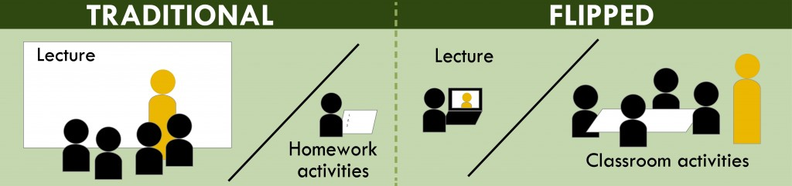
What is a Flipped Classroom?
Image: http://www.washington.edu/teaching/teaching-resources/engaging-students-in-learning/flipping-the-classroom/

Slide 4
Flipped Classroom
Outgrowth of student-centered learning environments
  Active learning strategies: student presentations, small group problem solving, self/peer evaluation, group discussions
Inverted instructional approach using technology to move lectures out of classrooms
  Online video lectures prior to in-class sessions
  Allows self-paced online learning
  Interactive classroom time; differentiated learning

Slide 5
Why Flip?
Aligns with adult learning styles (andragogy;M.Knowles)
  Adults need to be involved in the planning and evaluation of their instruction.
  Experience (including mistakes) provides the basis for the learning activities.
  Adults are most interested in learning subjects that have immediate relevance and impact to their job or personal life.
  Adult learning is problem-centered rather than content-oriented

Slide 6
Implementing A Flipped Classroom
Using a backward instructional design to plan learning activities
Creating opportunities for prelearning (short recordings)
Developing diagnostic assessments to identify learning gaps
Using technology to address learning gaps and develop competency

Slide 7
Medical School: Student Centered Learning
& Use of Flipped Classrooms

Slide 8

Background
Duke unique medical school curriculum
  First year: basic sciences
  Second year: clinical sciences
  Third year: research
  Fourth year: clerkships
Implementation of flipped classrooms ~ 5 years ago
  Team based learning methodology
  Pass/fail curriculum
Colleen O’Connor Grochowski, PhD
Associate Dean for Curricular Affairs

Slide 9
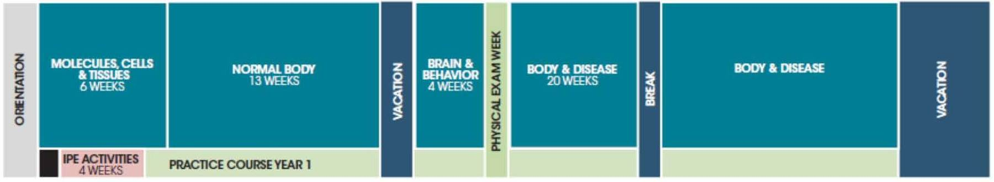
Duke: First Year Curriculum
Block | Duration (weeks) | Format
Molecules, Cells and Tissues | 6.5 | lectures/TBL x3/labs
Normal Body | 12.5 | Lectures/TBL x 4/Labs
Brain & Behavior | 4 | Full TBL
Body & Disease | 20 | Full Flipped Classroom (occasional lectures)

Slide 10
Team Based Learning
Prior to class:
  Assigned learning materials: readings, pre-recorded lectures and interviews with scientists and clinicians.
  Students assigned to teams for the year by medical school administration equalizing by gender/racial/academic abilities
Classroom activities (2-3 hours):
  iRA: individual readiness assessment
    5 minute quiz
    Closed book; counts towards grade
  tRA or gRA: same quiz team/group readiness assessment (closed book)
    Same quiz
    Closed book; counts towards grade
  Group application
    New minted knowledge applied
    Groups have to convince each other of correct answer

Slide 11
Duke’s Use of Flipped Classrooms
Utilize on-line 1 hour pre-recorded lectures or streaming lectures
Loaded onto internal curriculum management system (Blue Docs)
Discussed in small groups
Quizzes every two weeks
Content experts: “guide on the side”

Slide 12

Mastery of Brain & Behavior course content compared to other courses
Notes:
Mastery Data

Slide 13
Survey: Overall the flipped classroom worked for me
44%
22%
15%
11%
8%
Notes:
Overall the 100 % flipped curriculum worked for me dta – nice pie chart

Slide 14
Survey: Which type of curriculum would you prefer for most 1st & 2nd year courses?
65%
16%
19%
Notes:
Which would you prefer
Mixed!!!!!

Slide 15
Lessons Learned from 5 Yrs
Online materials, quizzes, team based activities must be correlated/match content
Questions need to be appropriate level for students
Time for off-site learning must be counted
Creating teams that are equal with respect to academic capabilities

Slide 16
What Lies Ahead @ DukeMed?
Increased reliance:
  on technology (apps) to individualize training
  on simulation technology
Incorporating social media

Slide 17

Duke Nephrology: Curricular Redesign

Slide 18
Individualized Renal Physiology Curriculum
Reasons for rethinking Nephrology curriculum:
  NRMP data 2009-2014: 44% decline in applicant pool to nephrology
  Non-renal fellows: renal disease “too complicated”
  Medical school renal physiology considered too “difficult”

Slide 19
Q-method Statement Sets
5 domains identified:
  Comprehension of renal physiology
  Relevance or renal physiology
  Learning preferences
  Course characteristics
  Interest in nephrology
Roberts et. al., Adv Physiol Educ. 2015 Sep;39(3):149-57
Notes:
60-79% are multimodal
Sources of material:
Renal physiology course evaluations 2011/12 and 2012/13
Peer reviewed journals about student/resident interest in nephrology
Educational literature on learning styles: VARK paradigm
V: visual and symbolic learners /A: aural learners/ R: Read & write/K: kinesthetic learners

Slide 20
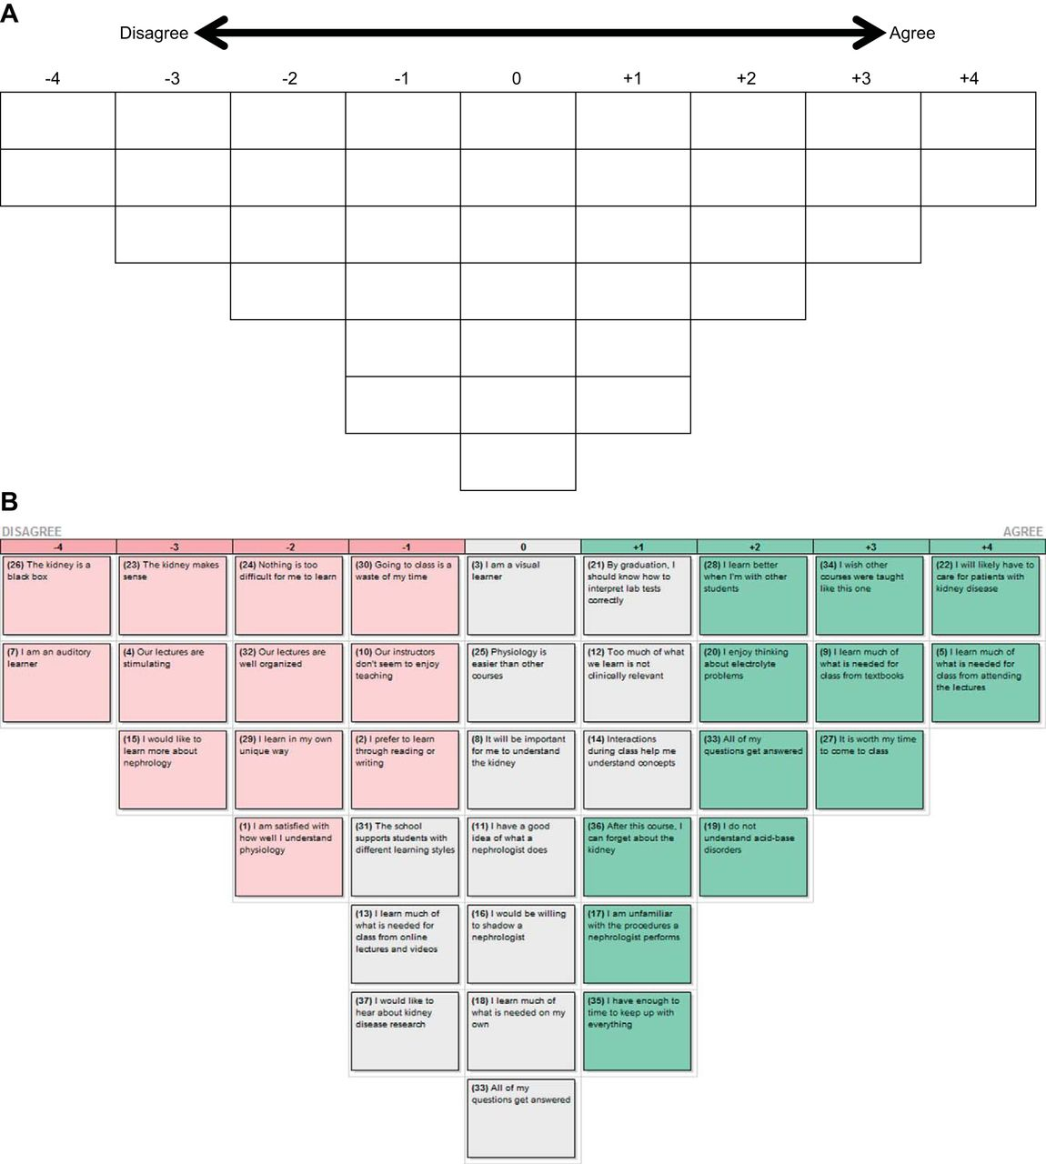
37 Q-Sort Questions Posed
Kidney is a ‘black box’
I am a visual learner
I would like to hear about kidney research
I will likely care for renal patients
Roberts et. al., Adv Physiol Educ. 2015 Sep;39(3):149-57

Slide 21
Results
Total of 113 students entering course given survey by e-mail
  60 unique surveys collected (53% response rate)
  Mean rank score for each statement collected (-4 to +4)
Highest rank scores (agree):
  “by graduation, I should know how to interpret labs correctly”: +2.55
  “Important for me to understand kidney”: +2.28
Lowest rank scores (disagree):
  “I can forget about kidney after this course”: -2.78
  “Instructors don’t enjoy teaching”: -2.30
Roberts et. al., Adv Physiol Educ. 2015 Sep;39(3):149-57

Slide 22
Factor Analysis
Performed to see which viewpoints correlated together
Three dominant themes revealed:
  Social-auditory learners: value attending class; satisfied with current lecture organization; improved learning through peer interactions
  Readers: value learning from textbook/notes; do not prefer to attend lectures; interactions during class not so helpful
  Visual learners: primarily prefers to learn from online videos, like learning in unique ways; however, often not feeling “prepared”for class

Slide 23
Individualized Renal Physiology Curriculum
Lectures developed by individual lecturers
Mini chapters written by individual lecturers
Online video tutorials (“pen casts”)
  https://vimeo.com/channels/814792/98583516
Interactive in-class experiences
  In-class assignments
  Case discussions
  Simulation of content

Slide 24
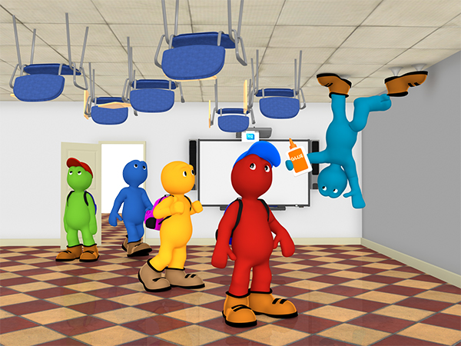
To Flip or Not to Flip?
Image source: http://www.teq.com/blog/2014/11/flipped-classroom-youve-started-flipping-now/#.VmCrOrgrJaQ

Slide 25
Flipping: Advantages
Aligns with adult learning theory/student-centered learning
Aligns with real world learning environments
Self-paced learning
Highly interactive/promotes peer to peer interactions/dialogue

Slide 26
Flipping: Disadvantages
Increased administrative coordination
Requires curricular development teams to interface students and instructors
Utilized technology
  Time intensive
  Need for creativity/not rehash
  Facile with technology
  Technology support
Assess learning gaps
Gauge student compliance

Slide 27
Acknowledgements
Carol Grochowski, PhD, Associate Dean for Curricular Affairs
Matt Velkey, PhD

Slide 28

THANK YOU…..

Slide 29
Implementation Strategies
Provide opportunities for exposure prior to class
Provide incentives to prepare for class
  Drawback: not all students watch videos
Provide a mechanism to assess student understanding
  Drawback: students just click next and/or post questions to show compliance
Provide clear connections between in-class and out of class activities
Provide clearly defined and structured guidance
Provide enough time for students to carry out assignments
Provide facilitation for building a learning community

Slide 30
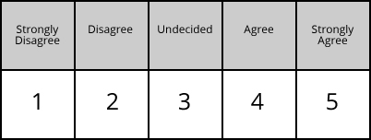
Methods: Assessment of Learners
Targeted assessment of learners
Likert scales:
  Defined by the researcher
  Responses influenced by survey structure, question & response characteristics
  Systematic error
Q-methodology :
  Borne out of social science research
  Measures subjectivity
  Subjects provide meaning to statements through a sorting procedure

