Slide 1
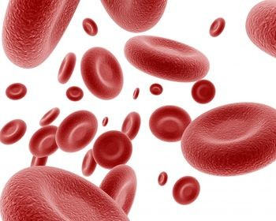
Red Cell Questions for the 2nd year Hematopathology Course
Marc Zumberg MD
Red Blood Cell Questions
ASH Course Director’s breakfast
December 2012

Slide 2
Initial Thoughts
Be able to link test ?s to goals and objectives
Be able to link test ?s to the course material
Write explanations for the correct answer and the incorrect answers
  Helps you to review each of the choices
  Provide further education to the students after the examination
Perform metrics on your test ?s

Slide 3
There is an art to test writing
NMBE tutorial on test writing
  www.nbme.org/IWTutorial
Constructing Written Test Questions For the Basic and Clinical Sciences National Board of Medical Examiners 2002
Primary purpose of test writing is to communicate what you think is important
  Motivate students to study
  Identify areas of deficiency in need of remediation
  Final grades/promotion decisions
  Identify where the curriculum is weak

Slide 4
What should be tested
Content should match course objectives
Important topics should be weighed more heavily
Testing time devoted to a topic should reflect relative importance and lecture time
The sample of items should be representative of instructional goals

Slide 5
Technical Item Flaws
Testwiseness
  Flaws that make it easier for some students to answer the ? correctly based solely on test-taking skills
Irrelevant difficulty
  ? Is difficult for reasons unrelated to the focus of assessment

Slide 6
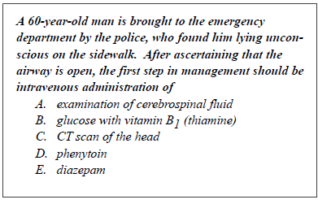
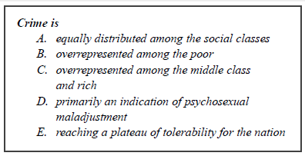
Testwiseness
Avoid absolutes such as never and always when more vague choices are included

Slide 7
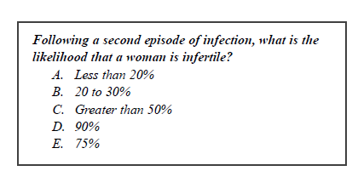
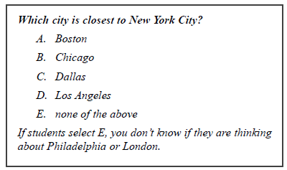
Irrelevant Difficulty

Slide 8
General Guidelines
Make sure the item can be answered without looking at the options OR that the options are 100% T or F
Include as much as possible in the stem and keep options short
Avoid ‘tricky or complex” items
Write items that are grammatically consistent and compatible with stem
  Choices in logical or alphabetical order
  Plausible distracters and about the same length
Avoid absolutes as well as vague terms (usually, frequently)
Avoid negatively phrased items (except or not in the lead-in)

Slide 9
Basic Science Content
Use experimental and clinical vignettes
Focus items on key essential concept and principles
Test material that is relevant to the clinical clerkship
Avoid items that only require recall of isolated facts
Avoid esoteric or interesting topics that are not essential

Slide 10
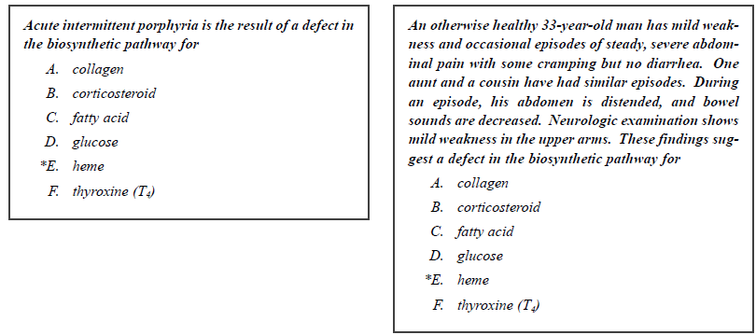
Basic Science Content (ex.)

Slide 11
Guidelines for Clinical Science Item Content
Test application of knowledge using clinical vignettes to pose medical decisions in pt. care settings
  Mechanism of disease
  Diagnosis
  Management
Focus on common or potentially catastrophic problems (avoid zebras)
Pose clinical-decision making tasks
Avoid situations so difficult they would only be handled by a subspecialist

Slide 12
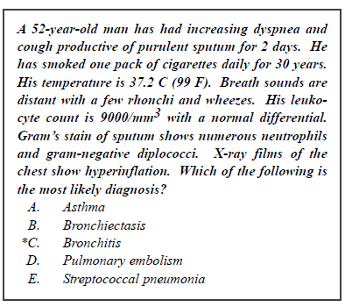
Diagnosis ex.
….is the most appropriate next step in diagnosis
….most likely to confirm the dx.

Slide 13
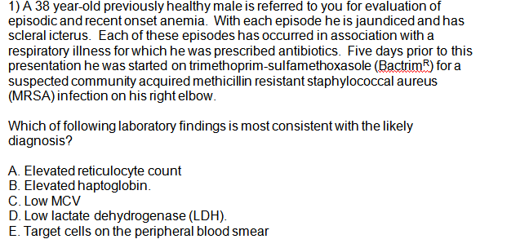
Goal: Understand the common laboratory and blood smear findings in hemolytic anemia
Goal 2: Understand the clinical presentation of G-6PD deficiency

Slide 14
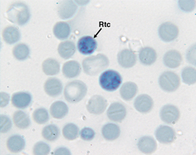
LABORATORY EVALUATION:
Suspected Hemolytic Anemia
Know this slide
Initial suspicion
CBC with MCV
Reticulocyte count (retic. count)
Review peripheral blood smear
  Nucleated red cells, reticulocytosis
Secondary tests
Bilirubin-total and indirect
Lactate Dehydrogenase (LDH)
Haptoglobin
Urinalysis for hemoglobin (hemoglobinuria)
Stain for reticulocytes

Slide 15

G-6PD: Oxidant stressors lead to intermittent hemolysis
Drugs
  Sulfa compounds, antimalarials, nitrofurantoin
  Many others
Infections
Favism
  Restricted to Mediterranean
  variant
  All patients with favism are G6PD deficient, but many G-6PD deficient patients do not have favism

Slide 16
A 68 year-old male was recently diagnosed with Stage 0 chronic lymphocytic leukemia (CLL). His initial WBC was 23,000/mm³ with 78% lymphocytes. His hemoglobin, hematocrit, and platelet count were normal. He was not prescribed any therapy and takes no medications.
The patient presents five months after diagnosis complaining of extreme fatigue, intermittent chest pain and dyspnea on exertion. He denies fevers, chills, sweats or weight loss. On physical exam he is noted to have jaundice, scleral icterus, and splenomegaly. No lymphadenopathy is appreciated. The following laboratory data are obtained:
Laboratory studies: Pt result Reference interval
Hemoglobin 9.1 g/dL 12-16 g/dL
Hematocrit 27% 36-48%
MCV 108 fL 80-100 fL
WBC count 28,000/uL 4,500-10,500/uL
Platelet count 162,000/uL 150,000-450,000/uL
Reticulocyte count (uncorrected) 8.0% 0.5-1.8%
Total bilirubin 2.3 mg/L =<1.2 mg/dL
Direct bilirubin 0.8 mg/dL =<0.3 mg/dL
Lactate dehydrogenase (LD) 733 U/L =<200 U/L
Coombs test
With anti-IgG reagent Strongly positive Negative
With anti-C3d reagent Weakly positive Negative
Which of the following peripheral smear images is expected ?
Goal: Understand the common laboratory and blood smear findings in hemolytic anemia
Goal 2: Interpret the results of the Coombs test in the evaluation of autoimmune hemolytic anemia

Slide 17
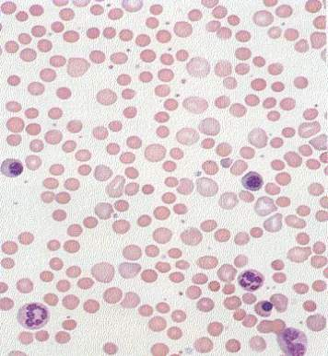
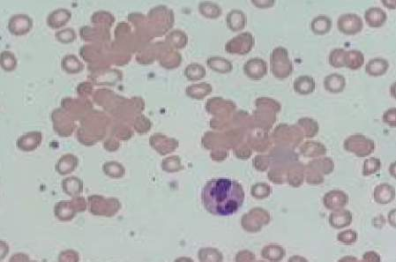
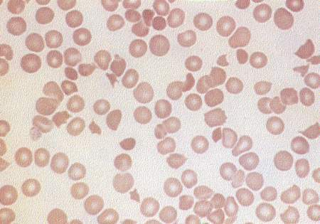
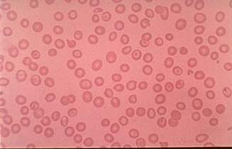
A.
C.
D.
B.

Slide 18
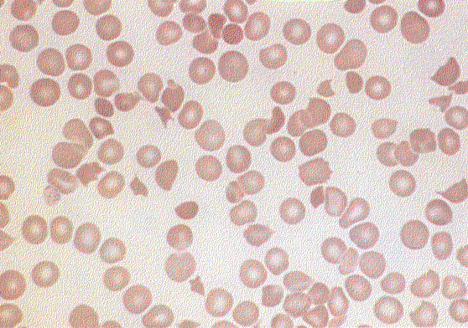
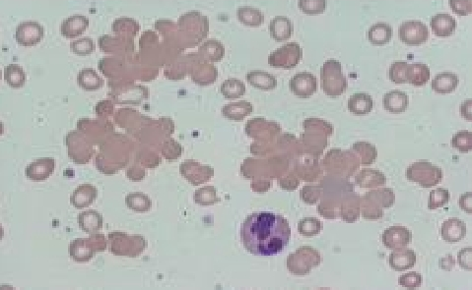
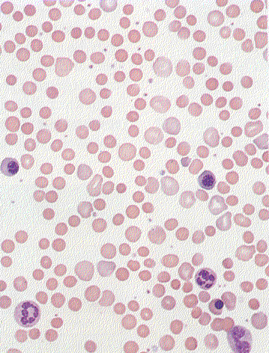
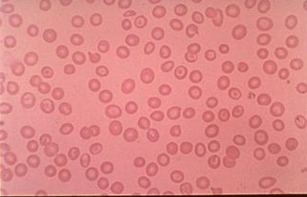
Classic Blood Smear Findings (Know these smears and associated diseases)
RBC agglutination
Schistocytes
Target cells
Spherocytes

Slide 19
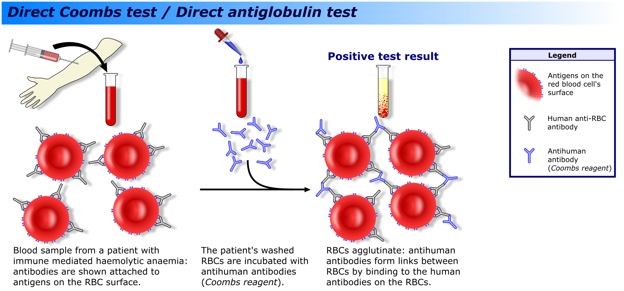
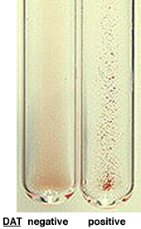
Coombs test
Understand this test
IgG, C3 or both
Often the first test sent in the evaluation of hemolytic anemia unless the etiology is already known

Slide 20
Coombs Test Results Examples
Warm Autoimmune hemolytic anemia
  IgG 3+ (strong)
  C3 negative or weak (1+)
Cold agglutinin disease
  IgG negative
  C3 3+

Slide 21
A 21 year-old male with hereditary spherocytosis is seen in the emergency room for increased lethargy, fatigue, and low grade fevers which have developed in the last week. He does not recall any sick contacts, but works fulltime in a daycare facility. He has no pets and has had no recent travel. He is compliant with his only medication, folic acid 2.5 mg daily. His baseline hemoglobin is 10-11 g/dL (reference interval 11.5-16 g/dL). On exam he is afebrile and has pale sclera. There is no lymphadenopathy or splenomegaly. Laboratory data are shown below:
Laboratory studies: Pt result Reference interval
Hemoglobin 4.2 g/dL 12-16 g/dL
Hematocrit 13% 36-48%
MCV 95 fL 80-100 fL
WBC count 4,900/uL 4,500-10,500/uL
Platelet count 164,000/uL 150,000-450,000/uL
Reticulocyte count 0.1% 0.5-1.8%
What is the most likely cause of his worsening anemia?
A) Warm autoimmune hemolytic anemia
B) Folic acid deficiency
C) Vitamin B12 deficiency
D) G6PD deficiency
E) Parvovirus B19 infection
Goal: Understand the complications of hereditary spherocytosis
Goal 2: Recognize the aplastic crisis as a complication of hemolytic anemias

Slide 22
CLINICAL PRESENTATION:
Commonly (not always) associated with hemolytic anemia
Know this slide
Jaundice
Scleral icterus
Gallstones
  bilirubinate
Splenomegaly
  LUQ pain, early satiety
  Depends on etiology
Leg ulcers
Acute crisis
  ex. Aplastic crisis, megaloblastic crisis

Slide 23
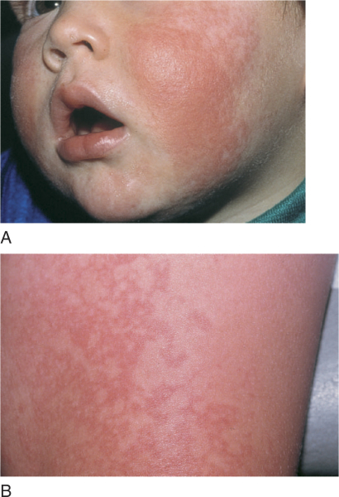
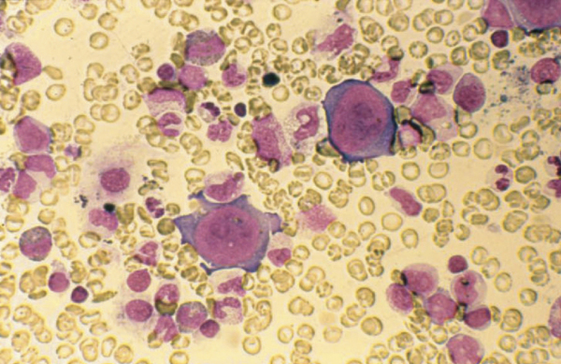
Parvovirus: Fifth’s disease and Aplastic Crisis in a patient with a chronic hemolytic anemia
Giant pronormoblast

Slide 24
You are asked to provide hematology consultation to evaluate anemia in a 34 year old hospitalized female. She was admitted with fevers, chills, and sweats. She admits to using intravenous heroin and is subsequently diagnosed with endocarditis of the tricuspid valve. Multiple sets of blood cultures are growing methicillin sensitive staphylococcal aureus (MSSA) at the time of your consultation. Her examination shows track marks on her arms and splinter hemorrhages at the nail beds. Her C-reactive protein and westergren sedimentation (WESR) rate are markedly elevated. She denies blood in her urine, stool or heavy menstrual periods.
Laboratory studies: Pt result Reference interval
Hemoglobin 10.2 g/dL 12-16 g/dL
Hematocrit 32% 36-48%
MCV 84 fL 80-100 fL
WBC count 9,900/uL 4,500-10,500/uL
Platelet count 194,000/uL 150,000-450,000/uL
Which of the following additional laboratory results would be consistent with the most likely etiology of her anemia?
A.) Elevated percent (%) iron saturation
B.) Elevated total iron binding capacity
C.) Elevated reticulocyte count
D.) Elevated hepcidin
E.) Decreased ferritin
Goal: Understand the laboratory studies used to diagnosis iron deficiency, anemia of chronic disease/inflammation, and iron overload

Slide 25
Anemia of Chronic Disease/ Inflammation: Causes
Know this slide
Infection
  Subacute bacterial endocarditis
Inflammatory disorders
  -ex. SLE, rheumatoid arthritis, Crohn’s disease
Malignancy
Not seen in chronic noninflammatory medical illness such as hypertension, high cholesterol, well controlled diabetes

Slide 26
Pathogenesis
Cytokine mediated (e.g. IL-6, IL-1, TNF-α)
Key is IL-6 mediated increase in hepcidin levels
  Hepcidin is the key negative regulator of iron absorption and macrophage iron release
Site of hepcidin production
-
-
**

Slide 27
Iron studies summary – Laboratory Evaluations—Know this slide
Tests | Iron Deficiency | Anemia of Chronic Disease | Iron Overload
Serum iron | ↓ | ↓ | ↑
Total iron binding capacity (TIBC) | ↑ | ↓-Nl | ↓-NI
Percent saturation (serum iron/TIBC X 100) | ↓ | ↓-NI | ↑
Serum ferritin | ↓ | NI-↑ | ↑
**

Slide 28
A 32 year-old African American women is sent to you for evaluation of anemia. She has been complaining of excessive fatigue and dyspnea on exertion for the past month. She has had 5 prior uncomplicated pregnancies. Her menstrual cycle is unchanged and described as heavy and lasting at least 6 days. She has no other medical problems. Her mother was anemic when she was younger, but this has resolved. She has no obvious toxin, travel, or pet exposures.
Prior CBC values were located for the patient and had always previously been normal.
The following laboratory data are obtained:
Laboratory studies: Pt result Reference interval
Hemoglobin 11.1 g/dL 12-16 g/dL
Hematocrit 33% 36-48%
MCV 73 fL 80-100 fL
WBC count 9,900/uL 4,500-10,500/uL
Platelet count 401,000/uL 150,000-450,000/uL
Reticulocyte count: 1.7% 0.5-1.8%
Which of the following is the most likely diagnosis?
A.)Alpha-thalassemia
B.)Iron deficiency anemia
C.)B-12 deficiency
D.)Anemia of chronic disease (ACD)
E.)Beta-thalassemia
Goal: Identify the common causes and underlying defects leading to iron deficiency, anemia of chronic disease/inflammation and iron overload
Goal 2: Understand the laboratory studies used to diagnosis iron deficiency, anemia of chronic disease/inflammation, and iron overload

Slide 29
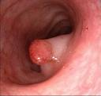

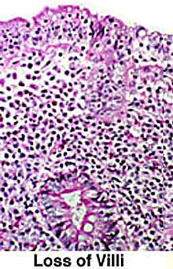
Common Causes of Iron Deficiency
Know this slide
Blood loss
  Menstrual
  GI>>>GU>>Pulmonary
Increased demand
  Pregnancy
  Rapid growth
Malabsorption
  Achlorhydria
  Gastric bypass
  Celiac sprue
Poor Dietary Intake

Slide 30
Laboratory studies (know this slide)
Test (normal values) | Iron-Deficiency Anemia
Peripheral blood smear | Hypochromic, microcytic cells; marked anisocytosis
Reticulocyte count | Low
MCV (80-100 cu microns) | <80 (microcytic)
Serum iron (40-135 ug/dL) | <25
Serum TIBC* (225-430 ug/dL) | Increased (>350)
Iron saturation (iron/TIBC X 100) (20-50%) | <15%, often less than 10%
Serum ferritin (10-185ng/mL) | <15
Bone marrow iron stain | Absent
*Total iron binding capacity: a reflection of serum transferrin

Slide 31
You are asked to evaluate a 78 year-old African American female who presents with poor balance, gait instability, and declining memory. The only past medical history is resection of part of her ileum for prior perorated diverticulitis.
She has no personal or family history of autoimmune or hematologic disorders. Her only medication is a multivitamin with iron.
On examination you note pallor, glossitis, and loss of distal vibratory sensation.
Laboratory studies: Pt result Reference interval
Hemoglobin 9.1 g/dL 12-16 g/dL
Hematocrit 28% 36-48%
MCV 114 fL 80-100 fL
WBC count 3,900/uL 4,500-10,500/uL
Platelet count 136,000/uL 150,000-450,000/uL
Which of the following would be supportive of the most likely diagnosis?
A.)Low folate
B.)Hyposegmented neutrophils
C.)Anti-parietal cell antibodies
D.)Elevated methylmalonic acid
E.)Low homocysteine
Goal: Define the characteristics, clinical features, and laboratory findings of the megaloblastic anemias including:
  B₁₂ –function, absorption, diagnosis and deficiency
    Pathophysiology and laboratory evaluation of pernicious anemia

Slide 32
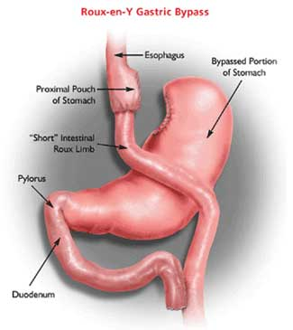

Megaloblastic anemias
Know this slide
B-12 deficiency
May take years to develop
Often due to poor absorption
Folate
Onset can occur within months
Often due to poor nutritional intake or increased demand

Slide 33
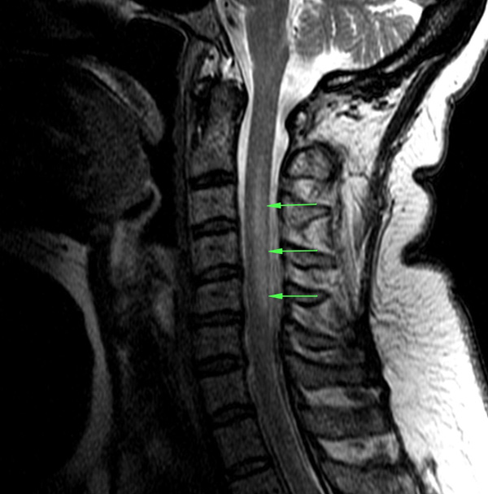
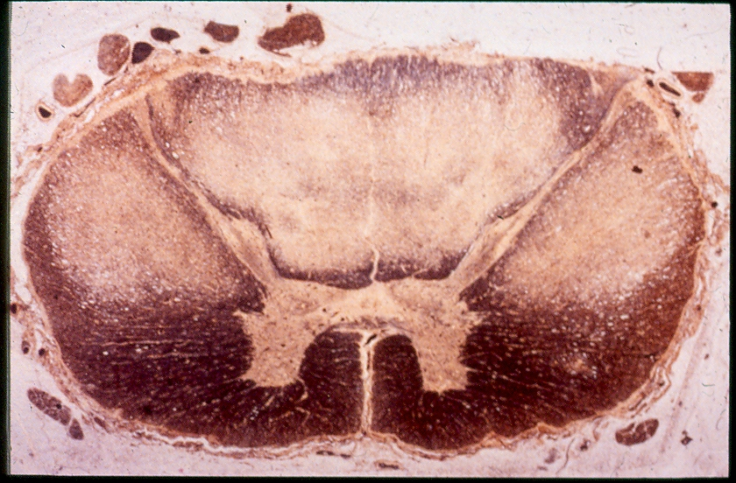
Subacute Combined Degeneration
Note neurologic findings are found in B-12, but not folate deficiency

Slide 34
Megaloblastic Anemia:
Laboratory Studies
Know this slide
Macrocytic anemia
  MCV typically between 110-130 fL
Pancytopenia in some cases
Peripheral blood smear
  Anisocytosis and poikilocytosis of the red blood cells
  Macro-ovalocytes
  Hypersegmented polymorphonuclear neutrophils
    >5 lobes

Slide 35
Vitamin B₁₂ Deficiency
Most common cause is an abnormality of the gastrointestinal tract
  - Intrinsic factor deficiency
    gastrectomy or disease (H. pylori)
    autoimmune (pernicious anemia)
    elderly
  - Pancreatic insufficiency
  - Blind loop with bacterial overgrowth
  - Ileal absorption defect
    food-bound vitamin B₁₂ in elderly
    resection or disease (Crohn’s)

Slide 36
  Laboratory Evaluation of Vitamin B₁₂ _{Know this slide}
  Value less than 200 pg/mL almost always indicates clinical
  deficiency
  Patients with serum vitamin B₁₂ levels between
    200-300 pg/mL may have a subclinical deficiency
  Serum levels of homocysteine and methylmalonic acid are elevated
    Useful in the diagnosis of subclinical B-12 deficiency in the elderly
  Identification of antibodies to intrinsic factor or parietal
  cells in pernicious anemia

Slide 37
A 43-year-old Caucasian woman presents to your office for evaluation of insomnia.
She has taken iron pills on and off over the past 10 years for persistent anemia.
Laboratory studies: Pt result Reference interval
Hemoglobin 11.4 g/dL 12-16 g/dL
Hematocrit 33% 36-48%
WBC count 5,200/uL 4,500-10,500/uL
Platelet count 420,000/uL 150,000-450,000/uL
RBC count 5.6 x 10⁶/uL 4.5-5.5 x 10⁶/uL
MCV 64 fL 80-100 fL
Reticulocyte count (uncorrected) 2.9 % 0.5-1.8
Reticulocyte count (corrected) 2.1 % - - -
Serum iron 84 ug/dL 40-135 ug/dL
Total iron binding capacity 260 ug/dL 225-430 ug/dL
Iron saturation of transferrin 32% 20-50%
Ferritin 310 ug/L 10-185 ug/L
Total bilirubin 1.0 mg/L =<1.2 mg/dL
After reviewing the above results a hemoglobin electrophoresis was ordered revealing:
Hemoglobin A: 94% and hemoglobin A2: 5.8% (normal <3.5%).
What is the most likely diagnosis?
A. Anemia of chronic disease.
B. Iron deficiency.
C. Sideroblastic anemia.
D. Beta-thalassemia minor.
E. Alpha thalassemia.
Goal: To understand the diversity of genetic abnormalities and cellular consequences of the thalassemias
Goal:. To understand the diagnostic criteria and clinical consequences of α and β thalassemia

Slide 38
    β thalassemias - are due to over 150 different mutations there result either in the absence of the β globin chain or reduction in the amount of the β globin chain. Approximately 3% of the world’s population (over 150 million people) carry β thalassemia genes.
Molecular abnormalities causing β thalassemia include insertions, deletions; nonsense, frame shift, splicing and polyadenylation mutations (see Figure).
Heterozygous β thalassemia (β+-thalassemia resulting in mild anemia; usually no significant clinical consequences) [thalassemia minor].
Homozygous β thalassemia [results in absent (β⁰) or severely reduced (β+) hemoglobin A] The classic disease has also been called Cooley’s anemia. (Thalassemia major).

Slide 39
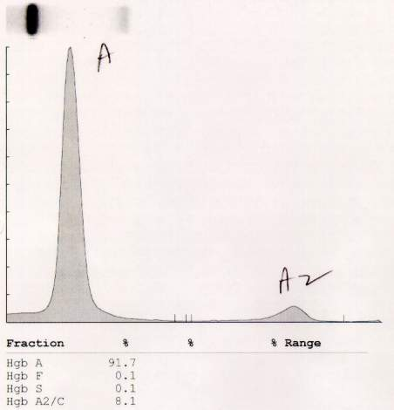

β Thalassemia Minor
Hb A 91.7%
Hb F 0.1%
Hb S 0.1%
Hb A₂ 8.1% (nl < 3.5%)

Slide 40
β Thalassemia Minor (Trait)
  Mild to minimal anemia
  Microcytosis (MCV range: 60-70 fL)
  Normal to high RBC count
  Target cells, basophilic stippling
  Must differentiate from iron deficiency

Slide 41
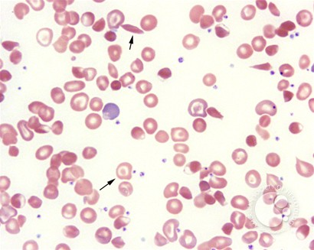
A 22 year-old man is being evaluated for chronic anemia.
The peripheral blood smear is shown.
Hemoglobin electrophoresis shows:
22% hemoglobin A
68% hemoglobin S
10% hemoglobin A2 (normal: <3.5%).
What is the most likely diagnosis?
A. Sickle cell trait.
B. Sickle/alpha thalassemia.
C. Sickle/beta⁺ thalassemia.
D. Sickle/beta⁰ thalassemia.
E. Hemoglobin H disease
Goal: To appreciate the spectrum of hemoglobin structural abnormalities causing clinical consequence
Goal: To understand the diagnostic criteria and clinical consequences of α and β thalassemia

Slide 42
Types of Sickle Cell Disease
Sickle cell anemia (Hb SS) is the most common
There are other genotypes
  Hb S-β Thalassemia
  Hb SC
  Hb SD

Slide 43
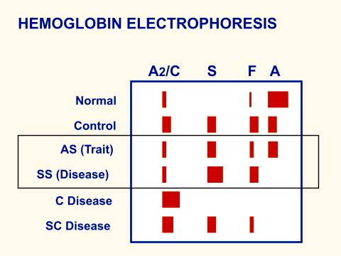
Laboratory Diagnosis

Slide 45
Conclusion
Case based questions
  Clinically relevant
  Covered in course goals and objectives and curriculum
  Accurately formatted
  Appropriate distracters
  Review questions with students after
    Explanation for correct and incorrect answers

Slide 46
An 18 year old woman is referred to you from the University Student Health Center.
She has hemoglobin SC disease and had a splenectomy at age 8 due to splenic sequestration. You instruct her to fill a prescription for an antibiotic (ampicillin) to have on hand in case she has a temperature of =>102⁰ F or shaking chills (and she must then proceed to the Emergency Department). In selecting the antibiotic, infection from which micro-organism are you attempting to prevent?
A. Salmonella enteritidis.
B. Staphylococcus aureus.
C. Clostridium perfringens.
D. Streptococcus pneumonia.
E. Plasmodium falciparum.
Goal: To understand the clinical consequences of sickle cell disease (including double heterozygotes) and sickle cell trait

Slide 47
NOTES
Chronic hemolytic anemia (Hb usually 6-8 g/dL): the anemia tolerated because of decreased O₂ affinity of Hgb; anemia is actually protective because of reduced blood viscosity. The anemia first manifests by 6-9 months and is normocytic to slightly macrocytic (because of reticulocytosis and a tendency toward folate deficiency). Jaundice, pallor, and gallstones are common.
Increased risk of infections: The function of the spleen is impaired because of repeated infarcts, and the Hb SS patient is particularly prone to infection due to encapsulated organisms. A leading cause of death in young patients used to be pneumococcal infections during the first 3 years of life (reduced incidence with prophylactic penicillin and vaccination). The spleen is commonly infarcted by age 5.

