Slide 1
Physicians & Social Media:
There’s an App for That
Merry-Jennifer Markham, MD, FACP
University of Florida College of Medicine
@DrMarkham

Slide 2
Merry-Jennifer Markham, MD, FACP
56th ASH Annual Meeting
Disclosure Statement
Nothing to disclose
Discussion of off-label drug use: not applicable

Slide 3
Learning Objectives
After reviewing this material, the participant should be able to:
Understand how social media is being used in healthcare and medicine
Identify potential uses of social media in medical education

Slide 4

What is Social Media?
Web-based tools and applications that allow for the creation and sharing of user-generated content and for social networking

Slide 5
5 Characteristics of Social Media
User-generated content
Real-time dissemination of information
Interactive
Community-driven
Thrives on relationships

Slide 6
The
(Very Abridged) Social Media Landscape
Networking
Facebook
Google+, LinkedIn
Blogs
WordPress
Blogger, TypePad
Microblogs
Twitter
Pinterest
Flickr
Yelp
Wikipedia
Social Bookmarking
YouTube
Photo Sharing
Video Sharing
Reviews & Ratings
Wiki
Instagram
Reddit
Vine
TripAdvisor
Tumblr

Slide 7

Facebook
Founded in Feb 2004
Originally for networking among college students
  Harvard first, then other Boston colleges, then Ivy League schools and Stanford
Over 1.3 billion monthly active users
Users create a profile and can share information with their “friends.”
Groups and pages
Notes:
Largest social networking site.

Slide 8

Google+
Social networking site established in 2011
540 million registered users
Users can
  Share information with “circles” - organized groups of people for sharing with
    Friends, Family, Colleagues, etc.
  See updates those in their circles
  Participate in “hangouts”
    Group video chats
Notes:
5th largest social networking site

Slide 9

Twitter
Founded in March 2006
Social networking and micro-blogging
Users send and read “tweets”
  Text-based posts of 140 characters only
In 2014
  284 million monthly users; 100 million daily users
  500 million tweets per day
Notes:
8th largest social networking site

Slide 10

LinkedIn+
Professional networking site, since 2003
313 million active users
Users create a profile and connect (“link in”) with people they have a connection with
Job searches, business opportunities, networking
Groups & discussion boards
  Examples: Student Doctor Network, Registered Nurse Group

Slide 11

Doximity
Since 2011, online professional network for US physicians
Founded by a co-founder of Epocrates
295,000 physician members (40% of physicians in US)
Serves as an online address book, professional profile page, CME tool, news portal, and virtual doctors’ lounge

Slide 12
Why Should We Use Social Media?
Our patients are online.
Our patients use social media.
Our learners are online.
Our learners use social media.

Slide 13
87% of US Adults are Online
72% of internet users look online for health information
  Most likely to do this:
    Women
    Younger people (18-50 > 50-64 > 65+)
    White adults
    Household earnings more than $75,000
    College or advance degrees
77% start with a search engine (“Dr. Google”)
http://www.pewinternet.org/fact-sheets/health-fact-sheet/, accessed 12/01/2014
Notes:
US adults using the internet: 97% of those with a college degree vs 76% of those with a high school diploma

Slide 14
Social Media as Health Info Source
PwC Consumer survey of 1,060 US adults
Consumers use social media to:
  Access health related consumer reviews: 42%
  Support a health cause: 30%
  Post about their experience: 25%
  Join a health forum or community: 20%
PwC Health Research Institute. Social media likes healthcare, April 2012.

Slide 15
Social Media as Health Info Source
Consumers surveyed reported that information found via social media would
Affect their decision to seek a second opinion – 45%
Affect how they cope with a chronic condition or approach to diet/exercise – 40%
PwC Health Research Institute. Social media likes healthcare, April 2012.

Slide 16



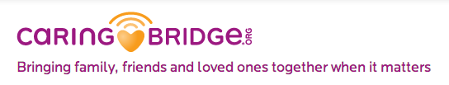




Patients are Finding Support Through Social Media

Slide 17
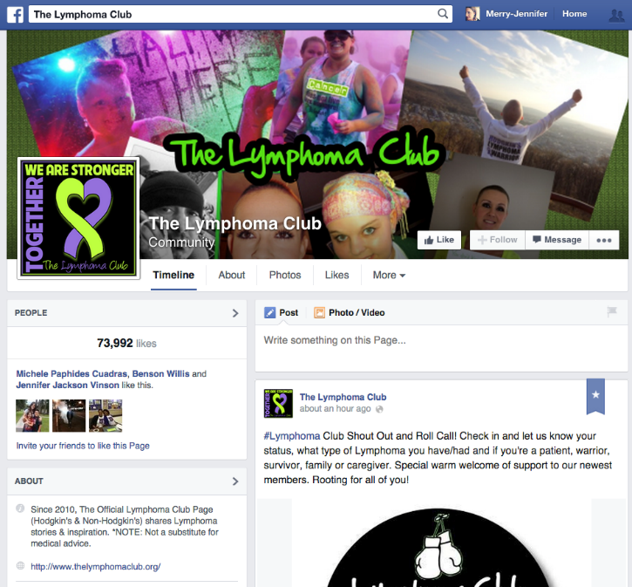

Slide 18
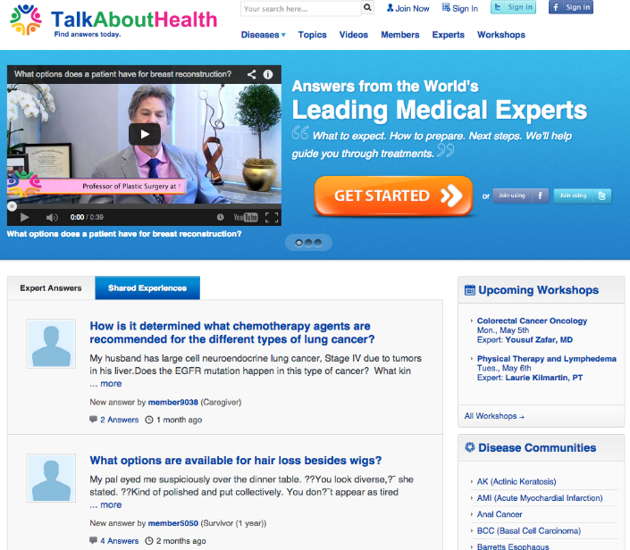
Patients Use Social Media to Seek Health Information

Slide 19
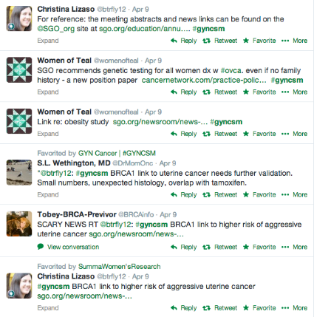
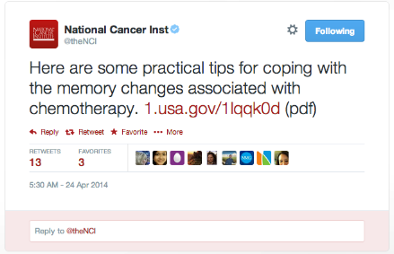
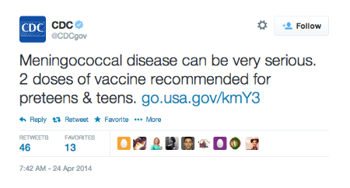
Public Health Education & Advocacy

Slide 20
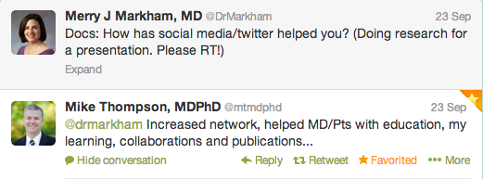
8 Reasons to Participate in Social Media
Keep informed – rapidly
Engagement with community, local & distant
Be part of the conversation
Crowdsourcing of ideas
Patient and public health education
Build relationships, networking
Collaboration
Research

Slide 21
Risks & Pitfalls of Social Media Use
Personal privacy concerns
Potential damage to professionalism
Patient friends/follows
HIPAA violations
Decreased productivity
Quality of information shared may be lacking

Slide 22
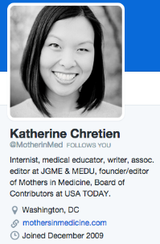
Physicians Misbehaving on Twitter
Analysis of 260 self-identified physician users in 2010
  5156 tweets were analyzed
144 tweets (3%) categorized as unprofessional
  Potential patient privacy violations
  Profanity
  Discriminatory statements
  Sexually explicit
Chretien et al. JAMA 2011;305(6):566-568.
Notes:
Content analysis of public profile pages of self-identified physicians with 500 or more followers during one month in 2010.

Slide 23
In #MedEd, Social Media Can Be Used…
To curate and share information
To elicit learner reflections
To facilitate learner-teacher interaction and learner engagement
To continue educational process outside the classroom
To inspire

Slide 24
Barriers to Use in Medical Education
Unfamiliarity
Lack of time
Lack of knowledge/skills
Lack of trust
Lack of access

Slide 25
Examples of Social Media Use
In Medical Education

Slide 26
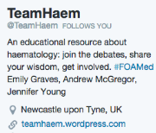
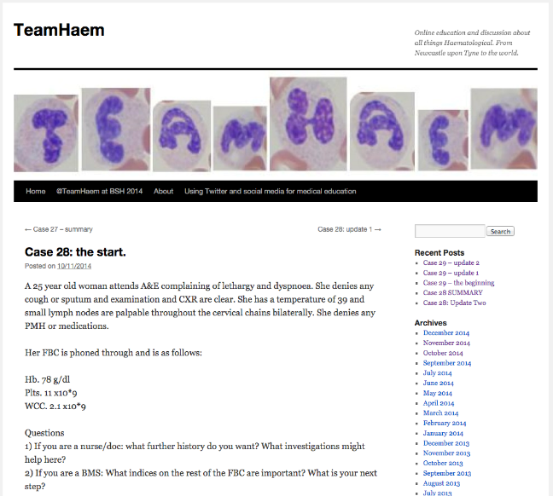
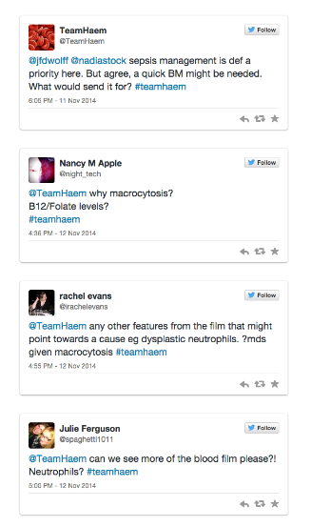

Slide 27
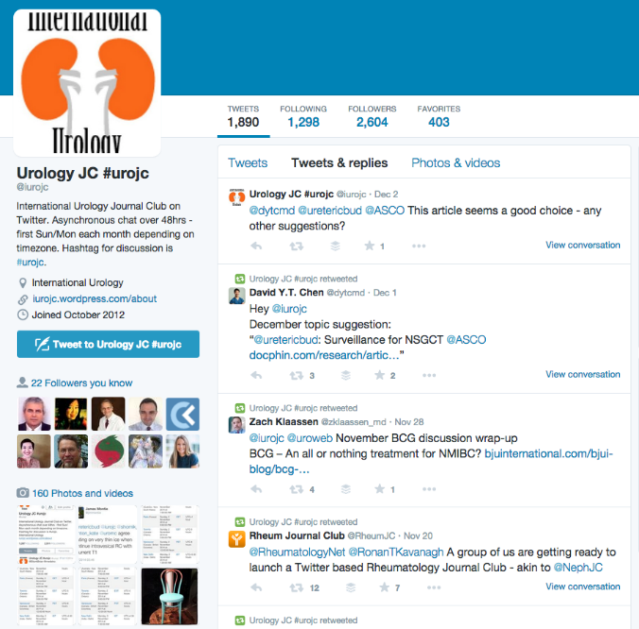

Slide 28
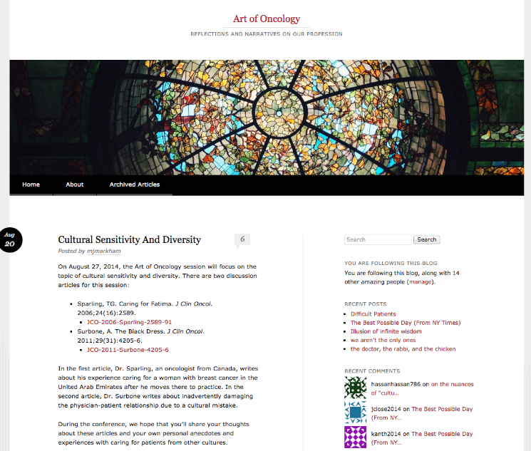

Slide 29
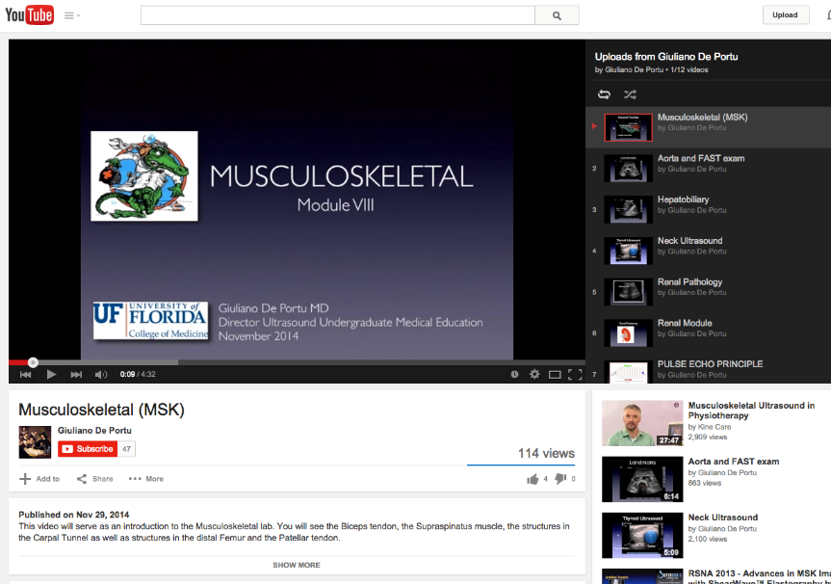

Slide 30
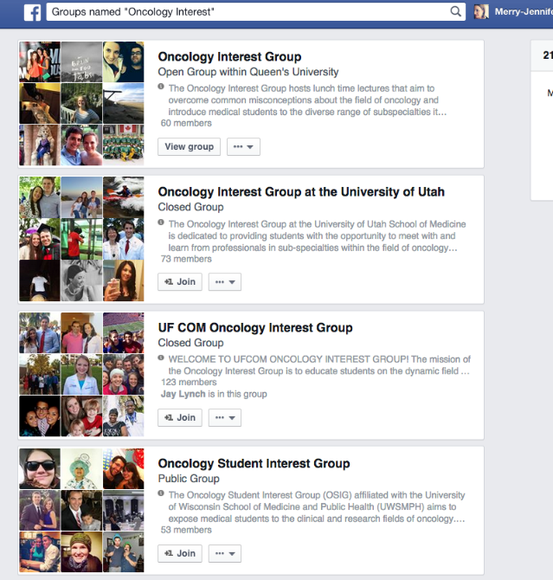

Slide 31
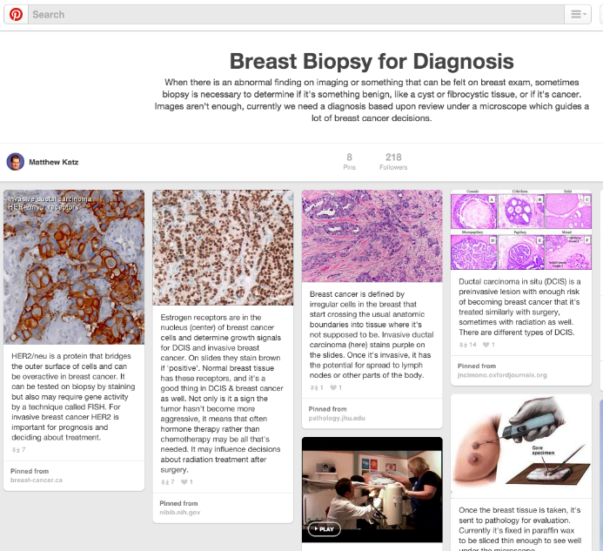

Slide 32
Who Are You Online?
Physicians who use social media may experience an online identity crisis
  Professional versus personal identity
Recognize that social media occurs in a PUBLIC space.
“Should I post this on social media?” should prompt this question: “Is it appropriate for a physician in a public space?”
DeCamp M, et al. “Social Media and Physician’s Online Identity Crisis,” JAMA 2013;310:581-82.

Slide 33
To Get Started in Social Media
Decide on your goal(s):
  Share content
  Monitor news or stay up to date
  Build relationships/network
  Be entertained
Sample the menu of offerings
Be professional
Be honest
Have fun

Slide 34
Thank you!
Contact Information:
Merry-Jennifer Markham, MD, FACP
Twitter: @DrMarkham
Email: merry.markham@medicine.ufl.edu

