Slide 1
Gary Schiller, MD
56th ASH Annual Meeting Disclosure Statement
Nothing to disclose
Discussion of off-label drug use: not applicable

Slide 2
How to Teach
Recommendations for Reaching an Audience and Communicating

Slide 3
The Objectives of Teaching in a Medical Environment
To communicate an idea
Introduction of a new concept
Pathophysiology, Diagnostic, Pharmacology
To develop a skill
Introduction of a procedural, technical skill
Radiological, Surgical, Diagnostic

Slide 4
Establishing Objectives
Determining, a priori, the objectives of the presentation
Developing a general set of objectives
Developing a specific set of objectives
Considering methods to test the success of the teaching method

Slide 5
Technical Methods of Teaching
Didactic lectures
Small-group presentations
Programmed approaches
Interactive web-based approaches
Written material
Articles, Reviews, Chapters, Books

Slide 6
Mastery of the Topic
Preparation requires
Appropriate reference materials
A large bibliography
An outline
A set of objectives
A set of tools to determine the outcome of the educational intervention

Slide 7
The Nature of Communication
Direct
Lectures, Small-group presentations, Tutorials
Indirect
Manuscripts, Abstracts, Posters, Web-based systems

Slide 8
The Nature of Direct Communication
Projection
Reflection
Confrontation
Empathy
Distance

Slide 9
The Nature of Indirect Communication
Formal stylistic rules of presentation
Manuscripts: Introduction, Methods, Results, Discussion, Conclusion
Reviews: History, Pathophysiology, Histology, Natural History, Treatment, Future Directions
Books: follow the same patterns as Reviews
Programmed approaches

Slide 10
Specific Tips for Direct Communication
Know your audience
Understand the topic thoroughly
Know where you are going
Repetition
Identify the purpose to your conclusion

Slide 11
Further Tips for Lectures, Oral Presentations
Do not rely on technology
Know the topic well enough to speak without props
Never read from slides
Never read a prepared text, unless you have a teleprompter
Minimize text

Slide 12
Further Tips for Lectures, Oral Presentations
Never initiate a lecture with an apology
The purpose of jokes
Try not to hide behind a podium
Engage the audience
Finish early, with time for questions

Slide 13
Specific Tips for Written Communication
Establish the distinctiveness of your presentation
Make the most general statements in the introduction
Make the most arcane statements in the results
Clarify your results in the discussion

Slide 14
Further Tips for Poster Presentations
Minimize the amount of text
Establish the distinctiveness of your presentation in bullet points
Clarify the obscure points of your methods
Highlight results
Avoid a written discussion, and minimize conclusions

Slide 15
Tips for Assessing Efficacy
Interactive sessions
Audience response
Written assessments

Slide 17
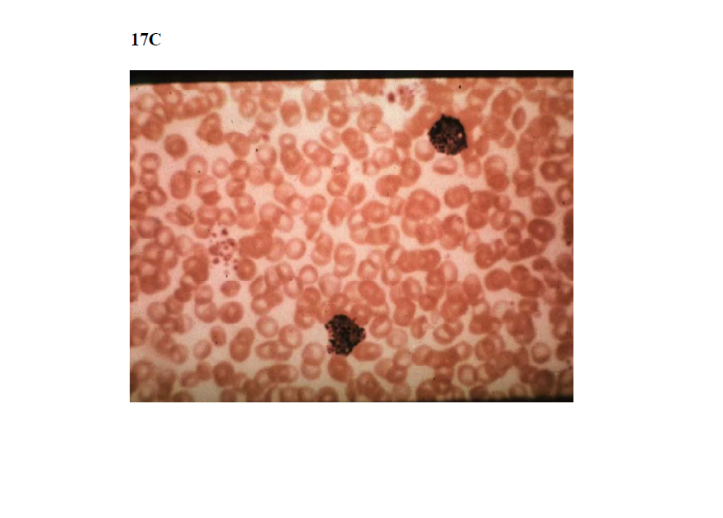

Slide 18
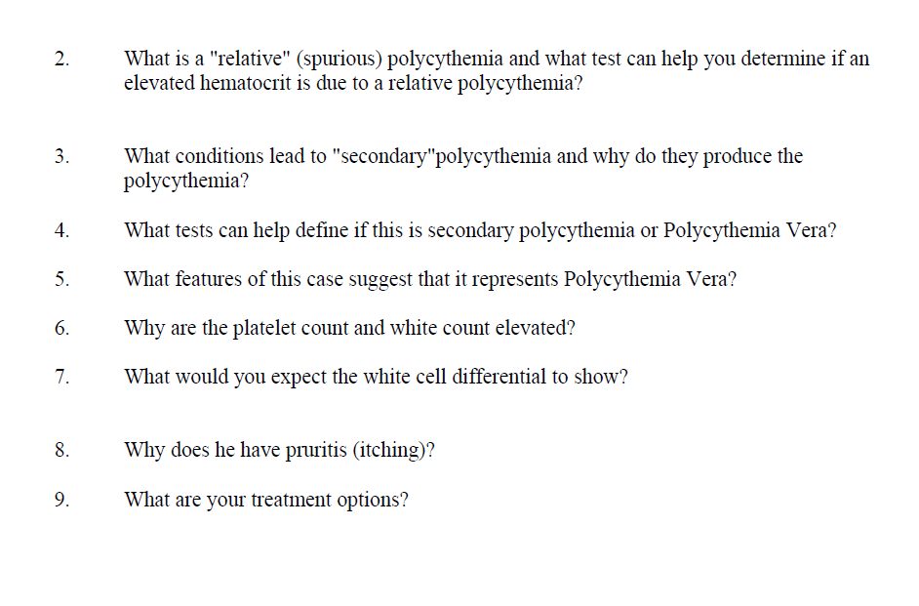

Slide 20
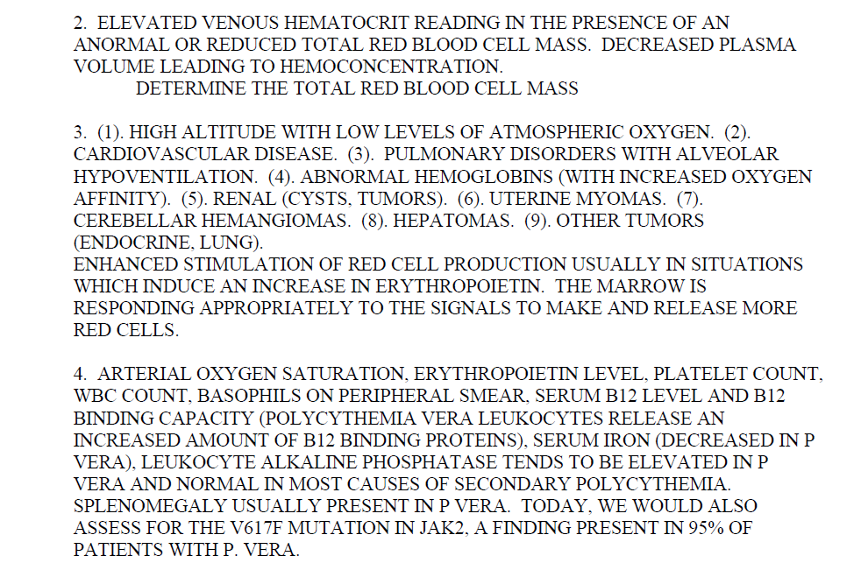

Slide 22
Table of Contents
Case Study #13
EXIT
History
A 50 year old white man come to your office complaining of headaches and generalized itching.
Exam
On examination you notice that he had a ruddy complexion, his heart and lung exam are normal, and his spleen is palpable 3 cm below the left costal margin.
Labs
CBC reveals:
Hemoglobin = 19 gm%
Hematocrit = 68%
RBC = 9 x 10⁶/mm³
WBC = 30,000/mm³
Platelet count = 700,000/mm³
Previous
Next
Case 13 of 17
Notes:
#13=#17

Slide 23
Table of Contents
Case Study #13
EXIT
Case Info
Question 1 of 9
What is the differential diagnosis of a high hematocrit level?
See Answer
Previous
Next
Case 13 of 17
Notes:
#13=#17

Slide 24
Table of Contents
Case Study #13
EXIT
Case Info
Question 1 of 9
What is the differential diagnosis of a high hematocrit level?
See Answer
Relative (spurious), secondary, primary (polycythemia vera)
Previous
Next
Case 13 of 17
Notes:
#13=#17

Slide 25
Table of Contents
Case Study #13
EXIT
Case Info
Question 2 of 9
What is a "relative" (spurious) polycythemia and what test can help you determine if an elevated hematocrit is due to a relative polycythemia?
See Answer
Previous
Next
Case 13 of 17
Notes:
#13=#17

Slide 26
Table of Contents
Case Study #13
EXIT
Case Info
Question 2 of 9
What is a "relative" (spurious) polycythemia and what test can help you determine if an elevated hematocrit is due to a relative polycythemia?
See Answer
Elevated venous hematocrit reading in the presence of an abnormal or reduced total red blood cell mass. Decreased plasma volume leading to hemoconcentration.
Determine the total red blood cell mass.
Previous
Next
Case 13 of 17
Notes:
#13=#17

Slide 27
Table of Contents
Case Study #13
EXIT
Case Info
Question 3 of 9
What conditions lead to "secondary" polycythemia and why do they produce the polycythemia?
See Answer
Previous
Next
Case 13 of 17
Notes:
#13=#17

Slide 28
Table of Contents
Case Study #13
EXIT
Case Info
Question 3 of 9
What conditions lead to "secondary" polycythemia and why do they produce the polycythemia?
History
A 50 year old white man come to your office complaining of headaches and generalized itching.
Exam
See Answer
On examination you notice that he had a ruddy complexion, his heart and lung exam are normal, and his spleen is palpable 3 cm below the left costal margin.
(1) High altitude with low levels of atmospheric oxygen.
Cardiovascular disease.
Pulmonary disorders with alveolar hypoventilation.
Abnormal hemoglobins (with increased oxygen affinity).
Renal (cysts, tumors).
Uterine myomas.
Cerebellar hemangiomas.
Hepatomas.
Other tumors (endocrine, lung).
Enhanced stimulation of red cell production usually in situations which induce an increase in erythropoietin. The marrow is responding appropriately to the signals to make and release more red cells.
Labs
CBC reveals:
Hemoglobin = 19 gm%
Hematocrit = 68%
RBC = 9 x 10⁶/mm³
WBC = 30,000/mm³
Platelet count = 700,000/mm³
Previous
Next
Case 13 of 17
Notes:
#13=#17

Slide 29
Table of Contents
Case Study #13
EXIT
Case Info
Question 4 of 9
What tests can help define if this is secondary polycythemia or Polycythemia Vera?
See Answer
Previous
Next
Case 13 of 17
Notes:
#13=#17

Slide 30
Table of Contents
Case Study #13
EXIT
Case Info
Question 4 of 9
What tests can help define if this is secondary polycythemia or Polycythemia Vera?
See Answer
Arterial oxygen saturation, erythropoietin level, platelet count, WBC count, basophils on peripheral smear, serum B12 level and B12 binding capacity (polycythemia vera leukocytes release an increased amount of B12 binding proteins), serum iron (decreased in P. Vera), leukocyte alkaline phosphatase tends to be elevated in P. Vera and normal in most causes of secondary polycythemia. Splenomegaly usually present in P. Vera. Today, we would also assess for the V617F mutation in JAK2, a finding present in 95% of patients with P. Vera.
Previous
Next
Case 13 of 17
Notes:
#13=#17

Slide 31
Table of Contents
Case Study #13
EXIT
Case Info
Question 5 of 9
What features of this case suggest that it represents Polycythemia Vera?
See Answer
Previous
Next
Case 13 of 17
Notes:
#13=#17

Slide 32
Table of Contents
Case Study #13
EXIT
Case Info
Question 5 of 9
What features of this case suggest that it represents Polycythemia Vera?
See Answer
High WBC, high platelet count, splenomegaly, and JAK2 mutation.
Previous
Next
Case 13 of 17
Notes:
#13=#17

Slide 33
Table of Contents
Case Study #13
EXIT
Case Info
Question 6 of 9
Why are the platelet count and white count elevated?
See Answer
Previous
Next
Case 13 of 17
Notes:
#13=#17

Slide 34
Table of Contents
Case Study #13
EXIT
Case Info
Question 6 of 9
Why are the platelet count and white count elevated?
See Answer
P. Vera is a panmyelosis with involvement of all cell lines.
Previous
Next
Case 13 of 17
Notes:
#13=#17

Slide 35
Table of Contents
Case Study #13
EXIT
Case Info
Question 7 of 9
What would you expect the white cell differential to show?
See Answer
Previous
Next
Case 13 of 17
Notes:
#13=#17

Slide 36
Table of Contents
Case Study #13
EXIT
Case Info
Question 7 of 9
What would you expect the white cell differential to show?
See Answer
Basophilia. May have some left shift of the myeloid series.
Previous
Next
Case 13 of 17
Notes:
#13=#17

Slide 37
Table of Contents
Case Study #13
EXIT
Case Info
Question 8 of 9
Why does he have pruritus (itching)?
See Answer
Previous
Next
Case 13 of 17
Notes:
#13=#17

Slide 38
Table of Contents
Case Study #13
EXIT
Case Info
Question 8 of 9
Why does he have pruritus (itching)?
See Answer
Etiology not completely understood but is a common symptom in P. Vera. May relate in part to the basophilia and histamine release.
Previous
Next
Case 13 of 17
Notes:
#13=#17

Slide 39
Table of Contents
Case Study #13
EXIT
Case Info
Question 9 of 9
What are your treatment options?
See Answer
Previous
Next
Case 13 of 17
Notes:
#13=#17

Slide 40
Table of Contents
Case Study #13
EXIT
Case Info
Question 9 of 9
What are your treatment options?
See Answer
Phlebotomy, hydroxyurea
Previous
Next
Case 13 of 17
Notes:
#13=#17

Slide 41
Table of Contents
Case Study #13
EXIT
Case Info
Question 9 of 9
What are your treatment options?
Alternate method
See Answer
Phlebotomy, hydroxyurea
Previous
Next
Case 13 of 17
Notes:
#13=#17

