Slide 1
Pathways Curriculum at Harvard Medical School
Hematology Course Directors’ Breakfast
December 6, 2015
Orlando, FL

Slide 2
Objectives
Provide rationale for broad curriculum reform at Harvard Medical School
Delineate anticipated changes for hematology teaching
Explore potential opportunities and obstacles

Slide 3
Disclosures
No conflicts of interest to report
I am not (yet) a course director
Tutorial leader for several years
Transitioning into a course co-director role
The hematology course has not (yet) been changed
New course will run early 2016

Slide 4
Acknowledgements
Slides created with input from HMS leaders
Dr. Richard Schwartzstein, leading curriculum reform
Dr. Barbara Cockrill, Director of Facutly Development
Dr. Edward Hundert, Dean for Medical Education
Guidance from Drs. Matt Heeney and Scott Lovitch

Slide 5
HMS Curricular Reform
Summary of major changes
Improve the way students think and problem-solve
Structural/sequence changes to reorganize exposures
New learning spaces that will facilitate attainment of goals
Improvements in assessment and feedback
Faculty development

Slide 6
Rationale for Curricular Reform
If it’s not broken, why fix it?
Our students are mostly happy and successful
USMLE passage rates
Residency match

Slide 7
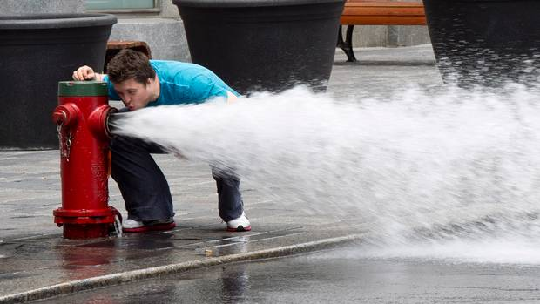
Rationale for Curricular Reform
Surface Learning
-- Knowledge abundant but disorganized
-- New info not linked to previous knowledge
-- Focus on memorization and recall
-- Learns concepts and facts without reflection

Slide 8
Kolb Cycle of Experiential Learning
Concrete Experience
Experimentation
Reflection
Reflection
Reflection
Abstract Conceptualization
David A. Kolb. Experiential Learning: Experience as the source of learning and development (1984)
Notes:
Moving on to another lead figure in adult learning theory, David Kolb defined this cycle of experiential learning.
So according to Kolb, the first step is concrete experience, when the learner, after hearing your instruction on this procedure, gets directly involved with the activity through concrete experience. After completing the activity, the learner delves into reflection, during which he thinks critically about the experience…what went well? At what point did I run into difficulty? The learner will then engage in abstract conceptualization, during which he tries to link your message from your teaching with what was just experienced. The learner may say “I remember my teacher telling me that I would likely need to be in solid bone, not cartilage, in order to successfully obtain bone marrow. I bet if my failed aspirate attempts were related to being in cartilage, not bone.” Or, a learner may say “Gee, I guess that is why my teacher suggested I reassure this mother, early in our conversation, that it is not her child’s fault that this tumor developed…I can see now that that really was on the mother’s mind and I probably did not address it soon enough.” With these realizations in mind, the learner engages in experimentation where he tried to improve his performance now that he has better understood your lessons.

Slide 9
Missed Steps
Optimal learning requires time for all four steps
Rushed learners often skip reflection and abstract conceptualization
Oscillation between experience and experimentation is far less effective
Concrete Experience
Experimentation
Reflection
Notes:
The challenge with this model is that optimal learning requires time be allowed for all four of these steps. So often our learners are as rushed as we are….and this often leads them to skip both reflection and abstract conceptualization. Without those, the learners is really just oscillating between concrete experience and experimentation…he is just bouncing around, trying and trying again, until something goes well. This kind of trial and error process is chaotic and may be upsetting for everyone involved which is why we as the teachers must make sure the learner takes the time to process through all steps of active learning.

Slide 10
Consequences (according to faculty)
Decreased retention
Basic science left behind, not integrated
Difficulty transferring knowledge to new contexts
Difficulty reasoning through an unknown problem
Students poorly prepared; wait to see what we say is important and then study that material
Lecture attendance is poor

Slide 11
Thinking!
upthebarconsulting.com

Slide 12
Task Force on Classroom Learning 2010
New curricular goals
Increased active learning
Higher expectations and accountability for preparation and learning
Shift bulk of “transfer of content” from faculty to self-study and small group study
Emphasize creation of frameworks, application of knowledge and problem solving/analysis in teacher-student interactions
FOCUS LESS ON WHAT AND MORE ON HOW / WHY

Slide 13
Move Learning from Surface to Deep
-- Relates new knowledge to previous knowledge
-- Content organized into coherent whole
-- Focus on problem-solving; apply, analyze
-- Link concepts/principles to everyday experience
Modified from Harasym et al. 2008

Slide 14
Changes is Structure and Sequence
Structural changes
14 months basic science (reduced)
Early clinical experiences integrated
Aim to prepare students for clerkship only
Include principles of biomedical, population, and social sciences
Core clerkships begins earlier
Advanced sciences post clerkship

Slide 15
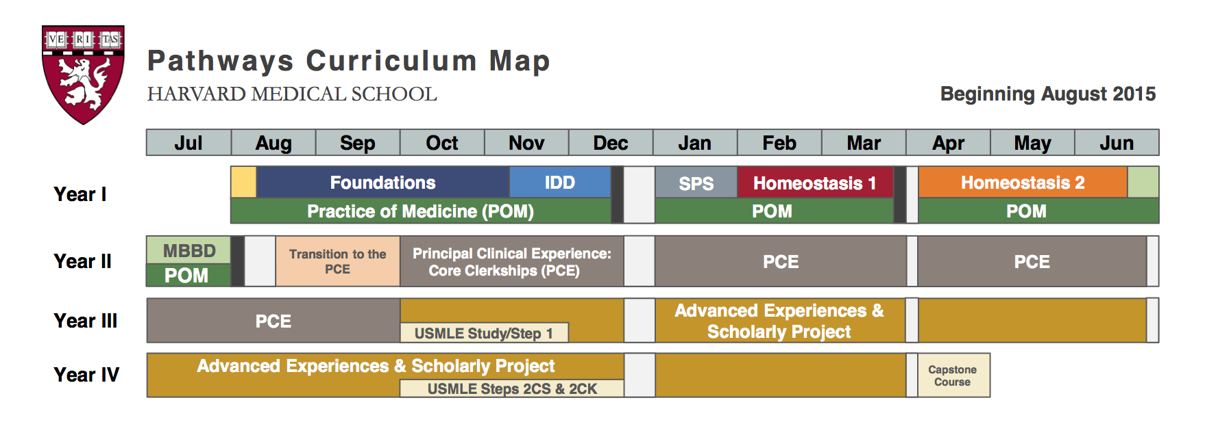
Changes in Teaching Pathways
Reduced (eliminated) lectures
Divide the class into 4 sections
Use CBCL
Core faculty
Notes:
Foundations=anatomy, cellbio, biochem, microbiology
IDD=Immunity in Defense o fDisease = immunology, rheum, path
SPS: social and population sciences

Slide 16
Integrated Organ System “Courses”
Support of Aerobic Metabolism – Homeostasis 1
Cardiovascular, Respiratory, Hematology
Anatomy/histology
Physiology
Pathophysiology/pathology
Pharmacology
Radiology
Nutrition

Slide 17
MONDAY 3/7 | TUESDAY 3/8 | WEDNESDAY 3/9 | THURSDAY 3/10 | FRIDAY 3/11
8:00-8:50 Small groups: review and discuss assignments from prior night | 8:00-8:50 Small groups: review and discuss assignments from prior night | POM | 8:00-8:50 Small groups: review and discuss assignments from prior night | 8:00-9:00 Quiz 3 Learning Studios
9:00-9:50 Intro to hemostasis Amphitheater Neufeld/Trenor | 9-9:50 Thrombophilia and Anticoagulants Amphitheater K. Bauer |  | 9:00-10:00 Topic TBD Amphitheater TBD | 9:05-9:50 Small groups: review and discuss assignments from prior night
10:00 -11:10 ITP, Plt function, vWD, DIC mini-cases Learning Studios Matt & Rachael | 10:00-11:10 Pulmonary embolism, DVT, Factor-V Leiden mini-cases Learning Studios Barbara |  | 10:10-11:20 ECG session supraventricular arrhythmias and hypertrophy Learning Studios Dara | 10:00-11:10 Pulmonary Hypertension Amphitheater Barbara
11:20-12:30 Hemophilia, Inhibitor mini-cases Learning Studios Matt & Rachael | 11:20-12:30 Anticoagulation in cardiac disease Learning Studios Dara & Mary |  | 11:30-12:30 Ventricular arrhythmias and Pharmacological treatment mini-cases Learning Studios Dara | 11:20-12:30 Pulmonary Hypertension RV function-heart failure mini-cases; Review HF concepts in general Learning Studios Barbara and Mary
Assignment: Valvular heart disease | Assignment: ECG and supraventricular and ventricular arrhythmias; pharmacological treatment of arrhythmias |  | 1:30-2:30 Patient clinic: hemophilia Amphitheater Matt | Assignment: Pulmonary infections; antibiotics; pericardial disease
 |  |  | Assignment: PE and pulmonary hypertension; endocarditis

Slide 18
Case-Based Collaborative Learning (CBCL)
CBL
PBL
TBL
Peer instruction

Slide 19
Anatomy of the CBCL
Work from Home (night before)
Morning Meeting
Small group learning
Reading/videos
Readiness Assessment (MCQ)
Thought questions
Case vignette
Students discuss responses to questions
No faculty presence
Lecture as large group
Small group
Case vignette based
Group hypotheses
Faculty facilitation
May involve splitting into even smaller groups that report back
Individual hypotheses

Slide 20
Opportunities
Students direct their own learning and remain active
Greater preparation
Increased integration leads to understanding of “the big picture”
Decreased dependence on lectures
Opportunities for faculty to gain new skills
Videos
Small group facilitation

Slide 21
New Challenges
Students are less experienced
In hematology course
In clerkships
Faculty development is never easy
Decreasing number of faculty
Time commitment
How much preparatory work is the right amount?

Slide 22
Outcomes
Personal/behavioral - curiosity, empathy, reflective, respectful, committed to scholarship and inquiry
Learning environment
Knowledge
Critical Thinking
Team function
Clinical integration into PCE

Slide 23
Outcomes – Mixed methods
Instruments to assess curiosity, empathy, burnout
NBME style exam
Critical thinking cases
Simulation
Surveys
OSCEs
Assessment by PCE directors

Slide 24
Questions and Discusison

