Slide 1
MILLENNIAL LEARNERS:
HOW TO TEACH AND ENGAGE GENERATION Y IN MEDICAL SCHOOL
Hematology Course Directors Workshop, Sunday December 7th, 2014
Alexandra P. Wolanskyj MD, FRCP, FACP
Associate Professor of Medicine, Mayo Clinic College of Medicine
Senior Associate Dean of Student Affairs, Mayo Medical School
Consultant Division of Hematology, Dept. of Medicine

Slide 2
Alexandra Wolanskyj, MD
56th ASH Annual Meeting
Disclosure Statement
Nothing to disclose
Discussion of off-label drug use: not applicable

Slide 3
OBJECTIVES OF TODAY’S SESSION
#1 Describe generational differences among educators-Baby Boomers/Gen Xers and Medical Students-Millennials
#2 Summarize the ideal learning environment for Millennials
#2 List 5 tips to Engage. Teach and Evaluate Millennials
#4 Design your own toolbox to Engage and Teach Millennials and have fun doing it

Slide 4
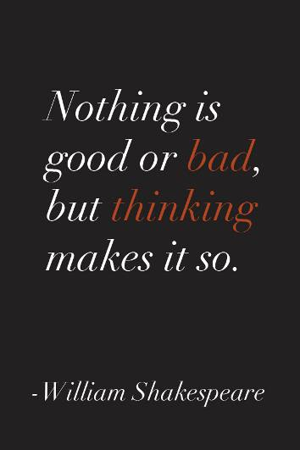

WILLIAM SHAKESPEARE…

Slide 5
MILLENNIAL LEARNERS:
HOW TO TEACH AND ENGAGE GENERATION Y IN MEDICAL SCHOOL
Training Directors Workshop, American Society of Hematology
Sunday December 7th, 2014
And Have Fun Doing it…

Slide 6
QS Which generation do you belong to?
  Silent Generation, born 1922-1943
  Baby Boomers, born 1944-1960
  Generation X’ers, born 1961-1980
  Millenials, Born 1981-2000

Slide 7
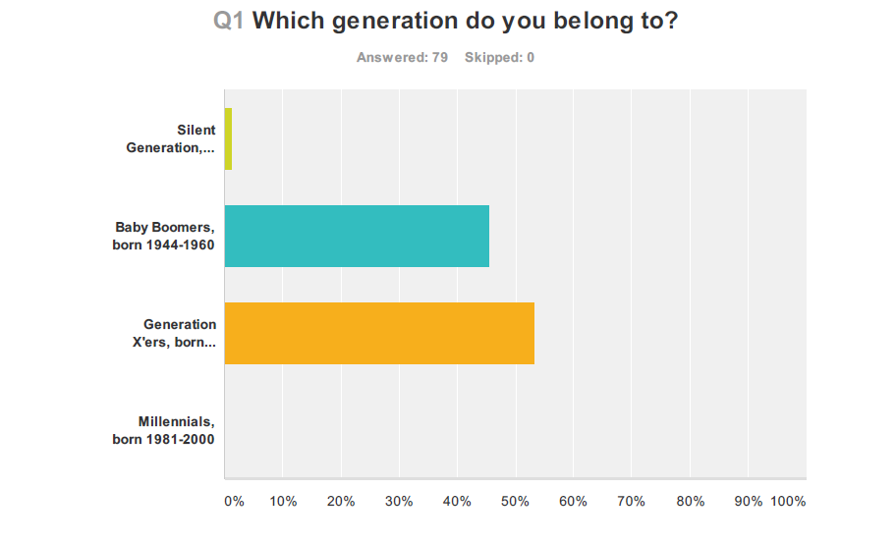
Wolanskyj et al…Generation differences among Heme Onc Program directors 2014

Slide 8
I. GENERATIONAL DIFFERENCES
CULTURAL

Slide 9
DEFINING GENERATIONS
Career
Goals &Stage
Chronologic
Age
Social Attitudes
Common Experience in History &
Life Events
Cultural Beliefs
~ 20 Years
Linear
Pitt-Catsouphes M et al. the 21st century multi generational workplace, 2007
Notes:
About 20 years
Changes are linear
Defined by

Slide 10
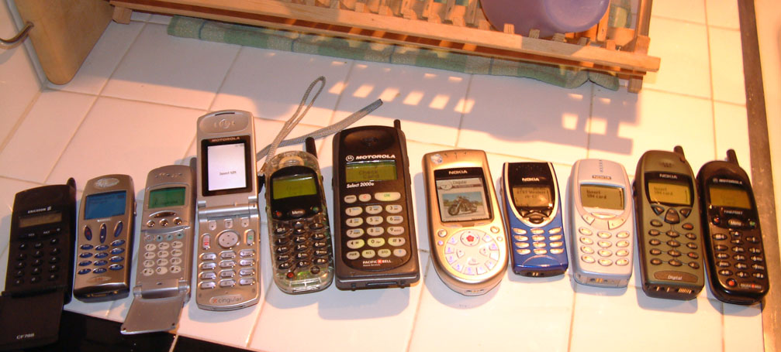
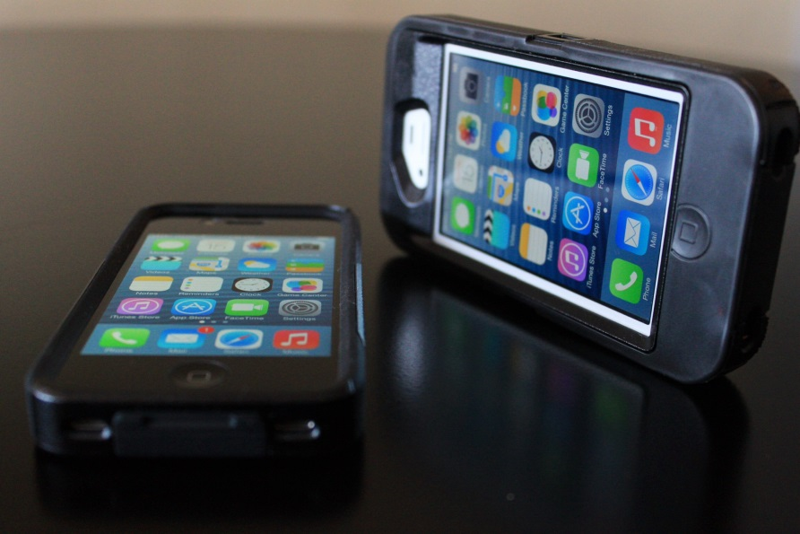
WHAT IMAGE IS CONSISTENT
WITH YOUR FIRST CELL PHONE….
1973
Flickr.com Creative commons licensing

Slide 11
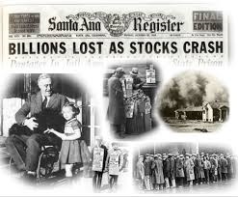
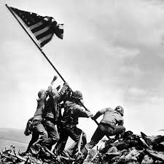
SILENT GENERATION-1922 TO 1943
~ 50 MILLION
SACRIFICE
FOLLOW RULES
WORK HARD
PRACTICAL
NEWSPAPER
RADIO
Adapted from Caudill and Schnitlzer: Millennials Special Handling required

Slide 12
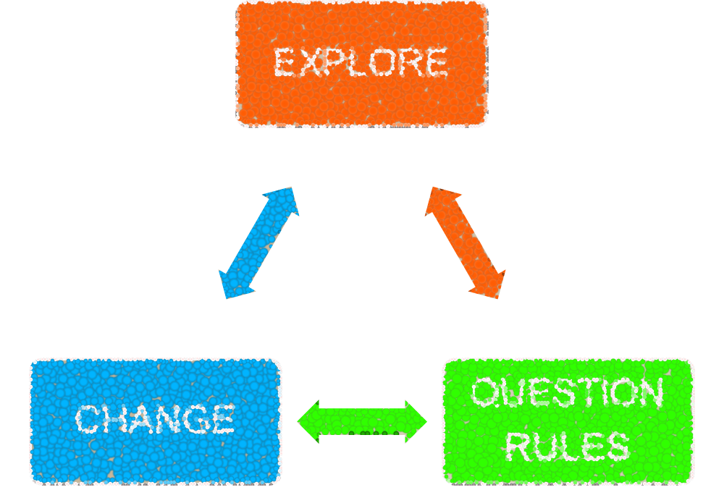
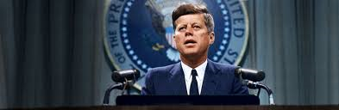
BABY BOOMERS: 1944 to 1960 ~80MILLION
OPTIMISTIC
TELEVISION
TELEPHONE
Adapted from Caudill and Schnitlzer: Millennials Special Handling required

Slide 13


GENERATION Xers: 1961 to 1980
~ 47 Million
SELF-DIRECTED
OUTCOMES
IMPATIENT
SKEPTICAL
COMPUTER
EMAIL
Adapted from Caudill and Schnitlzer: Millennials Special Handling required

Slide 14
MILLENNIALS: Born 1981 to 2000 ~ 81 million
CONFIDENT
DIVERSE
COLLECTIVELY MINDED
HOPEFUL
IPHONE
IPAD
INTERNET
Adapted from Caudill and Schnitlzer: Millennials Special Handling required

Slide 15
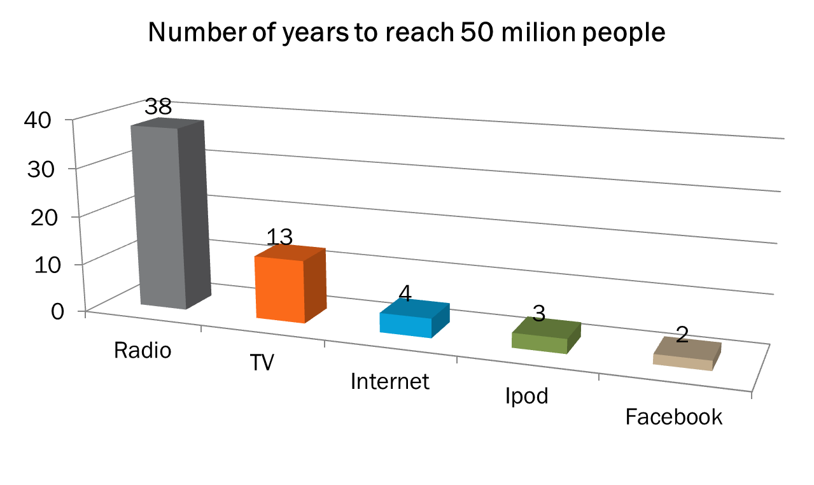
POWER OF EVOLVING TECHNOLOGIES
From the Millennium Report; UN CyberSchool bus

Slide 16
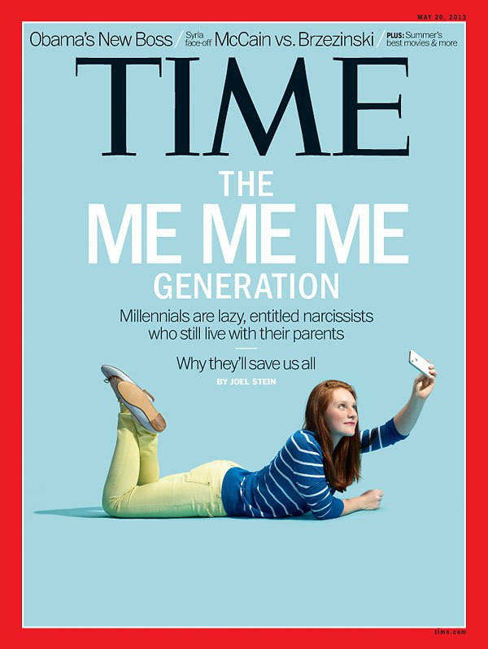
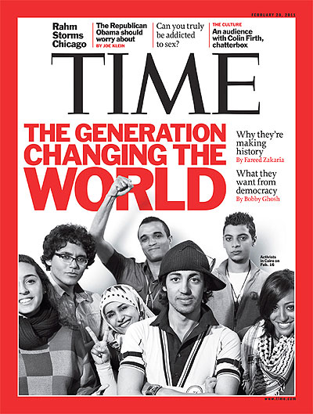
TECH SAVY

Slide 17
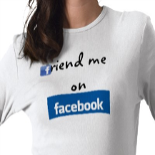


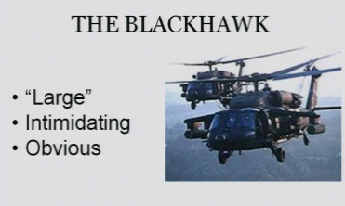

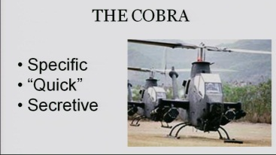

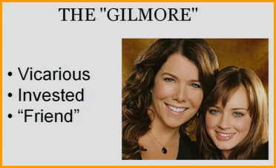
FACTORS WHICH CREATED MILLENIALS
TECHNOLOGICAL
Less Face to Face
False Familiarity
Tailored 24/7 to interests
SOCIETAL
BB on Board
Participant award
Developmental Theory
PARENTAL
Helicopter-Hover
Academic Integrity
Academic Progress
MILLENIALS
CONSUMER MENTALITY…IF YOU SAY IT I EXPECT IT!
“We Offer a World Class Education”…I will get it if I show up
Licensed from A perfect Storm Managing and Understanding Millenials-W.Scott Lewis
Notes:
Overprotective parents always there to soften the blow and run interference…their definition of stressors is different as they do not have developed coping skills (always shielded)
They have been approached since childhood As the consumer ex: tv ads for toys (have your parents by you this); thus they are the consumer of the product which is a world class education; change to the opportunity for a world class education, Must put the onus back on the student of this is your opportunity to make the most of…
Why? Technology with blogs, groups makes it ok to say out loud what your issues are and normalized the seeking of counseling. Inc support pos and neg. Also less copin skills to deal with stressors and gage what is a big vs little stressor ex failing a course may equal suicidal ideation and carry through (warning systems developed in IHE)

Slide 18
QS You are a freshman in college, and have just taken your first physics 101 exam. You received an F and you are premed. Your thoughts are:
  1. I better buckle down and work harder
  2. I better find a smart person to study with
  3. I wonder if I can even pass this. I should reconsider my major
  4. There is no way I deserve this F. I will never go to med School. I’m calling home to see what to do.

Slide 19
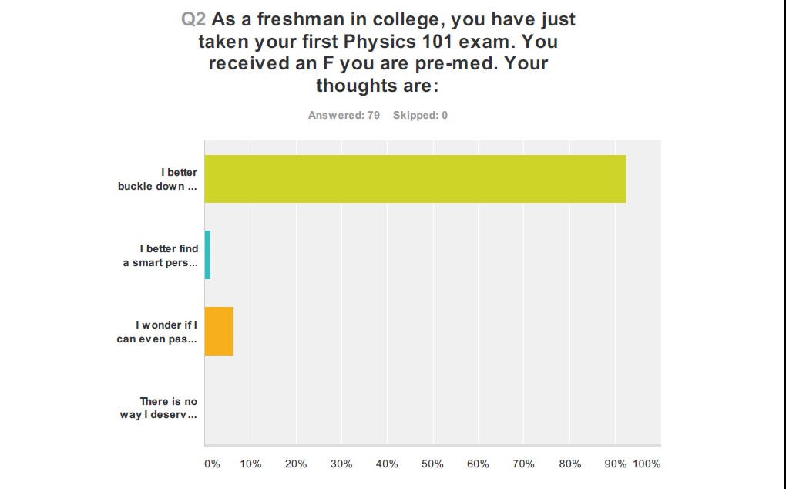
Wolanskyj et al…Generation differences among Heme Onc Program directors 2014

Slide 20
FACTORS TO CONSIDER IN INTERGENERATIONAL LEARNING
PERSONALITY
MOTIVATION
VALUES
DEMOGRAPHICS
LEARNING STYLES
FEEDBACK
OPINIONS & ATTITUDES
CAREER GOALS

Slide 21
I. GENERATIONAL DIFFERENCES
PERSONALITY /MOTIVATON

Slide 22
PERSONALITY DIFFERENCES
Today’s students score higher on
Assertiveness
Self-liking
Narcissistic traits
High expectations
Stress, anxiety and poor mental health
Today’s students score lower on
Self Reliance
J. M. Twenge, Generational changes and their impact in the classroom: teaching Generation Me. Medical Education 2009;43: 398-405

Slide 23
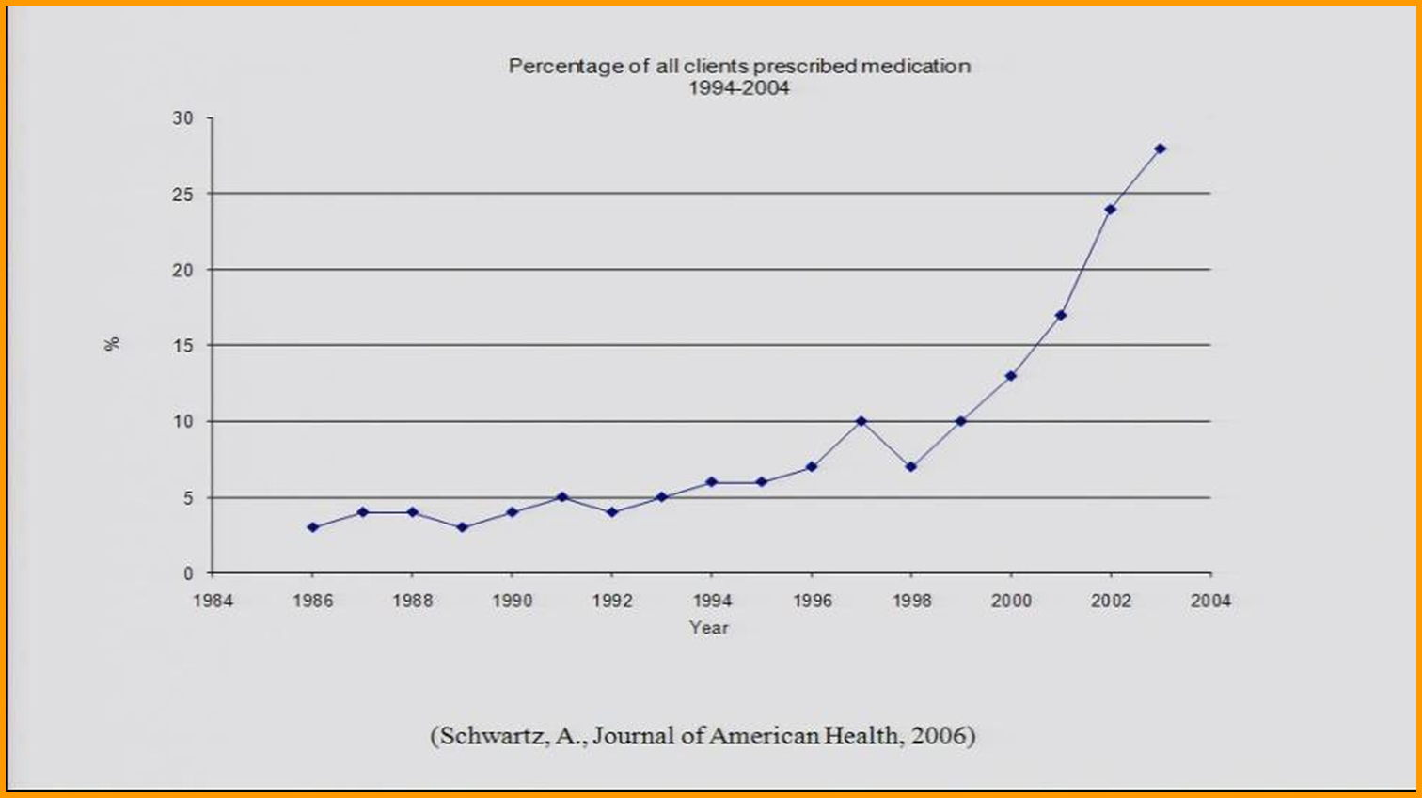
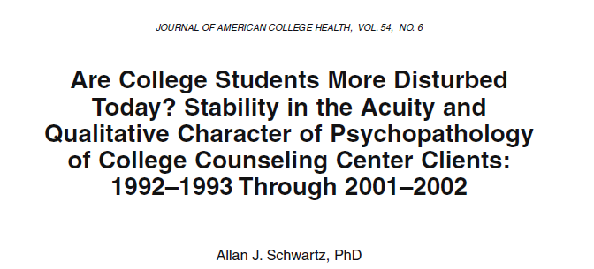
GREATER MENTAL HEALTH ISSUES AMONG MILLENIALS
MORE:
  Self-Injurious
  Need of Counseling
  Medicated
  Suicidal Attempt or Ideation
Notes:
Bad grade=suicidal ideation…self injurious behavior etc…they have not developed practice and coping skills…new generational filters
Al Gore inconvenient truth like meteoric rise in meds among college and IHE millennial students entering college
Why? Technology with blogs, groups makes it ok to say out loud what your issues are and normalized the seeking of counseling. Inc support pos and neg. Also less copin skills to deal with stressors and gage what is a big vs little stressor ex failing a course may equal suicidal ideation and carry through (warning systems developed in IHE)

Slide 24
MEDICAL STUDENTS’ PERSONALTY AND MOTIVATION ACHIEVEMENT

Slide 25

PERSONALITY DIFFERENCES MEDICAL STUDENTS
Warmth | Liveliness | Vigilance | Openness to Change
Reasoning | Rule Consciousness | Abstractedness | Self-Reliance
Emotional Stability | Social Boldness | Privateness | Perfectionism
Dominance | Sensitivity | Apprehension | Tension
Red = Millennials Higher
Blue = Generation Xers higher
Black = No difference
Borges, Manuel, Jones & Elam, Academic Medicine, 2006

Slide 26









MEDICAL STUDENT DIFFERENCES IN ACHIEVEMENT MOTIVATION
Need for Achievement
    The motive to succeed with a strong need for feedback and progress, and a need for a sense of accomplishment.
Need for Affiliation
    The motive to share defined by a need to interact with, share with and be liked by others, feel a sense of involvement and “belonging” with a social group
Need for Power
    The motive to succeed while influencing others, having ideas
prevail, and making an impact with a strong need to lead.
Millennials scored higher on Affiliation and Achievement
Generation Xers scored higher on the motive of Power

Slide 27
II. LEARNING ENVIRONMENT

Slide 28
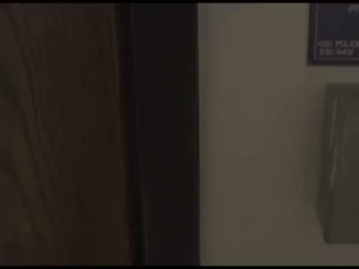
A VISION OF STUDENTS TODAY-Michael Wesch
This work is licensed under a Creative Commons
Attribution-Noncommercial-Share Alike 3.0 License. So you are welcome to download it, share it, even change it, just as long as you give me some credit and you don't sell it or use it to sell anything

Slide 29

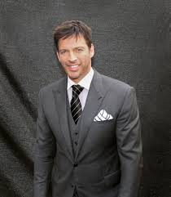

LEARNING CHARACTERISTICS
SILENT
Informational
BOOMER
Transformational Learning Style
GenXer
Self-Directed
Consider alternatives
Questions & explore
Self Paced
E-learning
Technology + Media Integration
Classroom learning + learning through participation
Traditional Classroom
Excellent Mentors and Teachers
Outcomes Based
Needs Proof
Millennial
●Incidental & Informal
●Short Attention Span
●Must Integrate technology and Media (webinar; Blog; Tweet etc.)
To which Generation do PPT Presentations cater?
United Nations Joint Staff Pension Fund, Talent management team Report, 2010

Slide 30
Optimizing the learning environments for Millennials
Recognize that students need to understand
the purpose and meaning of activities
Emphasize learning by doing
Break up lectures with pictures, graphics and
short video segments
Use audience response system, team learning
For students requesting special treatment:
all students should have same advantages
Do not compromise on content that must be learned

Slide 31
MEDICAL STUDENTS’ PERSPECTIVE ON THE LEARNING ENVIRONMENT

Slide 32
Millennial medical students prefer
  Hands-on learning experiences in a non-competitive environment
  Behaviorally-based & individualized feedback
  Use of technology to manage information.
They recognize difficulties in maintaining a healthy balance in their lives.
Students desire improved advising and mentoring, and assurance of education on the cutting edge.
Elam, Borges, & Manuel, 2011

Slide 33
QS The demands of my work interferes with my home and family.
  Always (Daily)
  Often (several times weekly)
  Sometimes ( I/week)
  Rarely

Slide 34
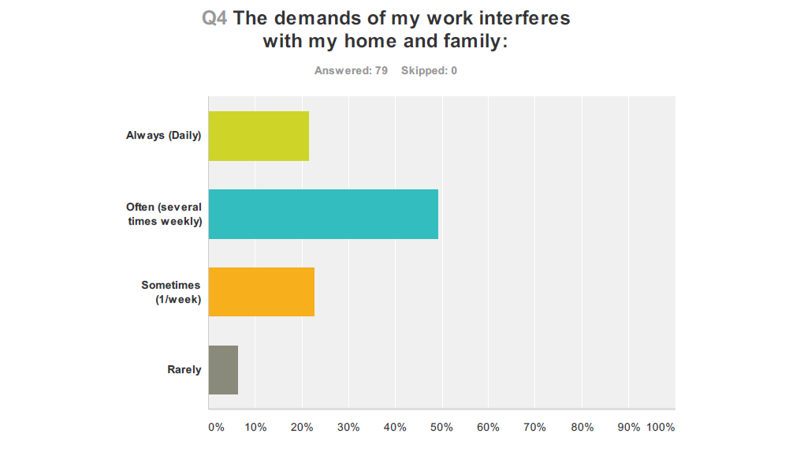
Wolanskyj et al…Generation differences among Heme Onc Program directors 2014

Slide 35
QS How many additional hours do you work (related to your medical Job) per week at home?
    >20
    10-19
    1-9
    I never work at home

Slide 36
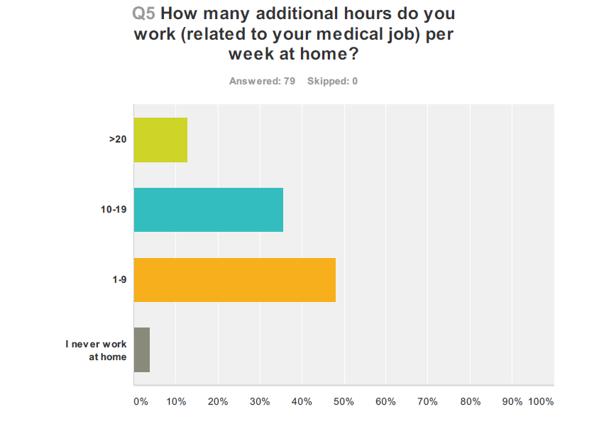
Wolanskyj et al…Generation differences among Heme Onc Program directors 2014

Slide 37
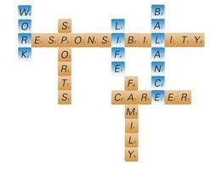

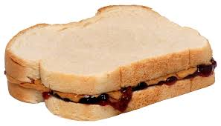
WORK LIFE BALANCE TO INTEGRATION IS THE NORM…TEACH IT…MODEL IT…
http://www.forbes.com/sites/danschawbel/2014/01/21/work-life-integration-the-new-norm/

Slide 38
MOST IMPORTANT REASON FOR ATTENDING LECTURE
MOST IMPORTANT REASON FOR REPLACING CLASS TIME WITH PERSONAL LEARNING TIME
Not motivated to watch the recorded lectures on my own
To show professionalism and respect for the instructor
To talk with classmates
So I feel like I am getting more out of my tuition
I learn better live
So I can use learning methods that work better for me
Because it allows me to watch the lectures at any time of day/structure my day to improve my productivity/sleep
To watch lectures at my own pace
So I can set my own learning priorities
CARELL 2008 Live vs Video Lectures

Slide 39

IN SUMMARY MILLENNIALS ARE………
ON THE ONE HAND…….
ON THE OTHER HAND…..
  Need Professional development
  Do not Prioritize Loyalty and Authority
  Have Significant Financial Obligations
  Lack Emotional intelligence
  Prefer non face to face Communication
  Expect immediate results
  Narcissistic
  Extraordinary Civic Advocacy
  Very Tech Savvy and Creative
  Expect Work-life Balance-Integration
  Dedicated to making a difference
  Confident-Team Player
  Altruistic
  Inspiring
  High Expectations of others and of life

Slide 40
III. STRATEGIES TO EFFECTIVELY ENGAGE MILLENNIALS IE COOL TOOLS

Slide 41


COOL TOOLS TO ENGAGE MILLENIALS INCLUDE THE FIVE “R’s
Relaxed
  Less formal environment-Coffee? Outside?
  Interact with advisors, teachers and others
Rapport
  Use to adult showing great interest in them (advisors/mentors)
  Connect with them on personal level-customize it
  Don’t have to be their best friend but on their side
Price C. “Why don’t my Students Think I’m Groovy?” The teaching Professor 2009 (23)
Notes:
Christy Price EdD, sychology professor Dalton State College notied gap between student’s expectation for success and the effort they put forth in the classroom-conducted a qualitative anlysis of narratives provided by millenials to understand what makes them tick
Relevance can Google anything they want for information thus do not value information for information sake.

Slide 42
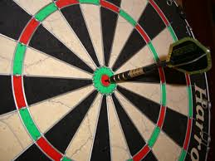


Relevance
  Professor role shift from dissemination/authority to helping students apply it to current culture-they relate to
  Tie in expectations to relevant goals
Rationale
  Prefer non-authoritarian manner
  More compliant of expectations if reasoning explained
Research Based Methods
  Variety of active learning methods (Simulation any sort)
  Short attention span if bored
  Use multimedia-peer collaboration
Price C. “Why don’t my Students Think I’m Groovy?” The Teaching Professor 2009 (23)
Notes:
Christy Price EdD, sychology professor Dalton State College notied gap between student’s expectation for success and the effort they put forth in the classroom-conducted a qualitative anlysis of narratives provided by millenials to understand what makes them tick
Relevance can Google anything they want for information thus do not value information for information sake.

Slide 43
PUTTING IT ALL TOGETHER:
TOP 12 TIPS TO FACILITATE MILLENNIAL LEARNING

Slide 44

TIP #1 Learn generational differences
1) Know your own Generation
2) How it affects your teaching
3) Discuss at faculty meetings
*4) Take “How millennial are you quiz” http://www.pewresearch.org/quiz/how-millennial-are-you/
Roberts DH et al, Medical Teacher 2012

Slide 45
TIP #2 Learn Cultural and social forces affecting learning tools for Millennial
1) Ask learners which technologies are used team work-based projects
*2) Ask learners how they studied for exams and resources used
Roberts DH et al, Medical Teacher 2012

Slide 46
TIP #3 Identify your Teaching or Life Philosophy
1) Introduce yourself to learners, and the background and path to your role
2) Details of why you enjoy your position Rewards you receive from your work
3) Give Examples of how to link/balance work with home life and interests* ie work life Integration vs Balance
Roberts DH et al, Medical Teacher 2012

Slide 47
TIP #4 Understand the Effect of Intergenerational tension on Learning
1) Avoid statements “the way I was taught”
2) Highlight areas of overlap and similarities
3) Avoid references to past/requirements not relevant
4) Avoid judgment and encourage discovery and curiosity ex. Web search vs library
Roberts DH et al, Medical Teacher 2012

Slide 48

TIP #5 Identify the Limits of Multitasking
1) Dispel the myth that Learning successful when multi tasking
*2) Successful learning –focus and attention http://www.nytimes.com/interactive/2010/06/07/technology/20100607-task-switching-demo.html/
3) Limit your use of text, email etc when teaching
Roberts DH et al, Medical Teacher 2012

Slide 49
TIP #6 Provide guidance and focus in Learning
1) Help prioritize goals
2) Focus on “why” “how” and “in what context”
3) Encourage application of knowledge not just information
4) Deliberately Teach Critical Thinking
Roberts DH et al, Medical Teacher 2012

Slide 50
TIP #7 Learn about eLearning Technologies
*1) Ask learners how to maximize your computer
2) Connect with IT at your institution re Educational technology tools
3) Identify new ways to disseminate content Ie. Social Media Tweet; blog; Webinar; etc
Roberts DH et al, Medical Teacher 2012

Slide 51
TIP #8 Recognize that millennial expect esthetically pleasing presentations
1) Tap into local experts or faculty development course ex embed graphics, video
*2) Free web based resources http://www.google.com/edu/teachers/ http://www.boxoftricks.net/internet-resouces-for-education/
3) Get feedback from colleagues and learners re Slides/curricular material
Roberts DH et al, Medical Teacher 2012

Slide 52
TIP #9 Identify ongoing opportunities for Help and Support
1) Post reading and resources on website promptly
*2) Establish “drop in hours” and frequent, direct personal feedback
3) Structured learning activities Specific achievable targets ie for ITE
4) BUT: Avoid answering emails at 2 am-will set a standard
Roberts DH et al, Medical Teacher 2012

Slide 53
TIP #10 Encourage modern forms of curiosity
1) Provide challenges where answers require more than web search (ex. patients outcomes )
3) Be open and allow creativity to accomplish task by learners (ex.QI projects; curriculum development ie Apps etc.)
Roberts DH et al, Medical Teacher 2012

Slide 54
TIP #11 Encourage Collaboration
Foster teamwork and team dynamics to complete task
2) Simulation for different role playing-involve other health care professionals Ex Simulation of procedures
Roberts DH et al, Medical Teacher 2012

Slide 55
TIP #12 Be Fair and Direct and Consistent
1) Clearly ID learning objectives
*2) Stay firm on rules once set (do not waffle)
3) Reassure frequently and validate process for Grades
Roberts DH et al, Medical Teacher 2012

Slide 56
IV.EVALUATION OF MILLENNIAL MEDICAL STUDENTS

Slide 57
QS My Thoughts Regarding Feedback Are As Follows
1. It is unnecessary i.e. No news is good news (Trad)
2. Planned feedback is best and should be infrequent i.e.. ~1/year and with documentation to justify it (Boomer)
3. Frequent, spontaneous, fast and with an in your face attitude i.e. “Hope I am not bothering you but how am I doing Now? (Gen Xer)
4. Continuous and Now i.e. 24/7 electronic whenever and wherever I want to get it at the push of a button (Millennial expectation)

Slide 58
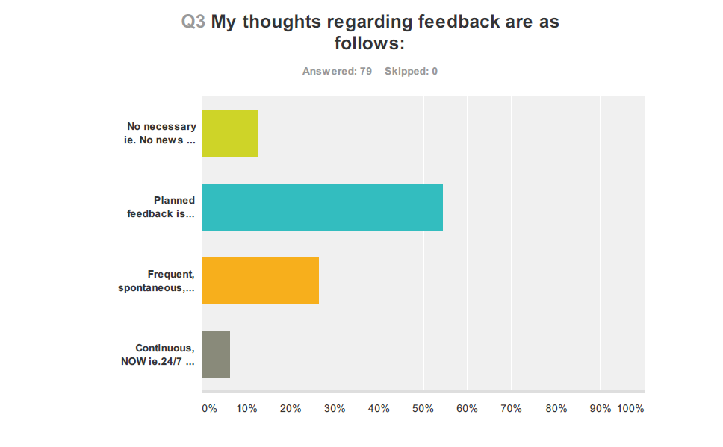
Wolanskyj et al…Generation differences among Heme Onc Program directors 2014

Slide 59
MILESTONES BASED ASSESSMENT
Expert
Proficient
Competent
Advanced Beginner
Novice
Dreyfus Model of Skill Acquisition through 5 Progressive Steps to achieve Proficiency
The ACGME & soon AAMC transition competencies assessment to a milestones based outcomes, defining a series of observable behaviors, following an expected developmental progression
Notes:
Adapted from the Dreyfus model of skill acquisition
Defines 5 steps of progression to achieve proficiency from novice to Aspirational
This framework allows for individualized learning plans, as some students may have naturally acquired more advanced skills levels which they can measurably demonstrate. This framework of evaluation metrics and observable behaviors will lend itself to a natural transition to lifelong learning self assessment measures.
• These milestones can serve multiple goals:
1. Promote competency based training
2. Track progression and inform decisions regarding promotions and readiness for graduation
3. Guide curricular development and guide assessment strategies
4. Provide benchmark for learner directed self-assessment
5. Assist remediation by facilitating the identification of specific deficits
7. Improve public accountability and safety for fellowship training by enumerating expectations of graduates.

Slide 60
MILESTONES LEARNER GOALS ARE SYNERGISTIC WITH MILLENIALS
MILLENNIAL CHARACTERISTIC
MILESTONE GOALS FOR LEARNERS
Need explicit expectations
Need Constant and specific feedback
Need 1:1 mentoring and Guidance
Need ARS, Frequent Quizzes
Hands on Demonstration of knowledge
Provide more explicit and transparent expectations of performance
Support better self-directed assessment and learning
Facilitate better feedback for professional development
NEJM, March 2012 Thomas J. Nasca, M.D., M.A.C.P.,
http://www.acgme.org/acgmeweb/Portals/0/PDFs/NAS/NEJMfinal.pdf

Slide 61
“A challenge remains for
educators to incorporate technologies students find useful while creating an interactive learning environment” Cardall et al., 2008

Slide 62

WHAT TOOLS WILL YOU GATHER FOR YOUR TOOLBOX TODAY?
Google images-open clip art

Slide 63
FINAL THOUGHTS
Millennials can inspire us to be our best
Set expectations but then we have to show up with our best
Mutual understanding can make teaching millennials extremely rewarding

Slide 64
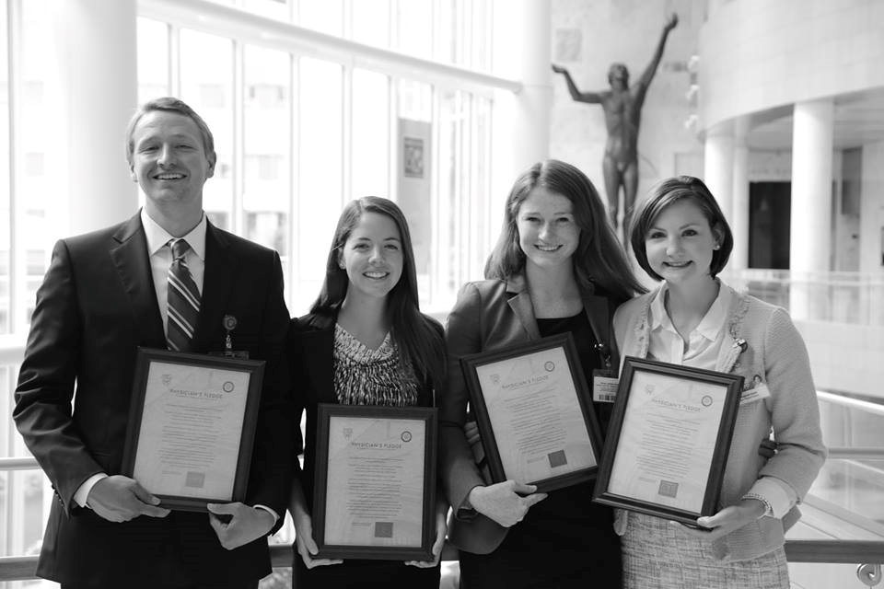
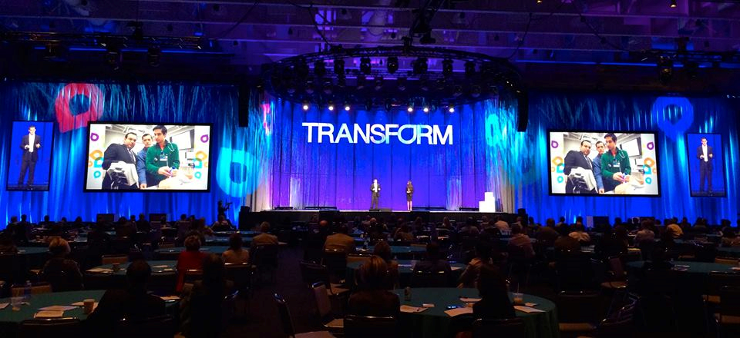
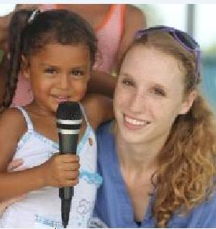
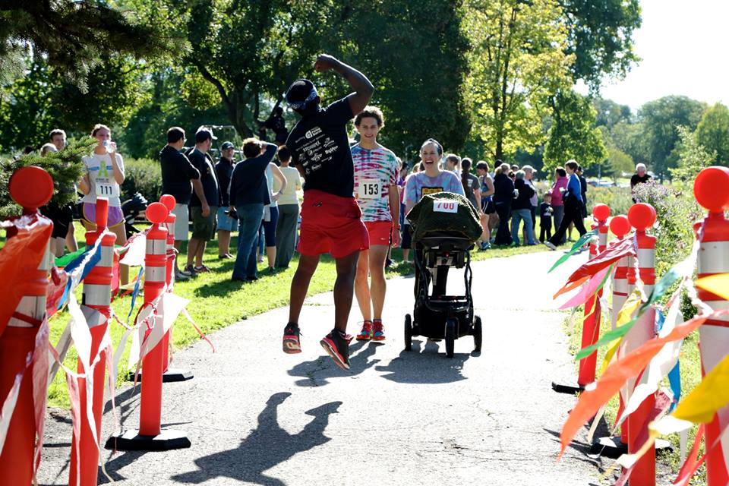
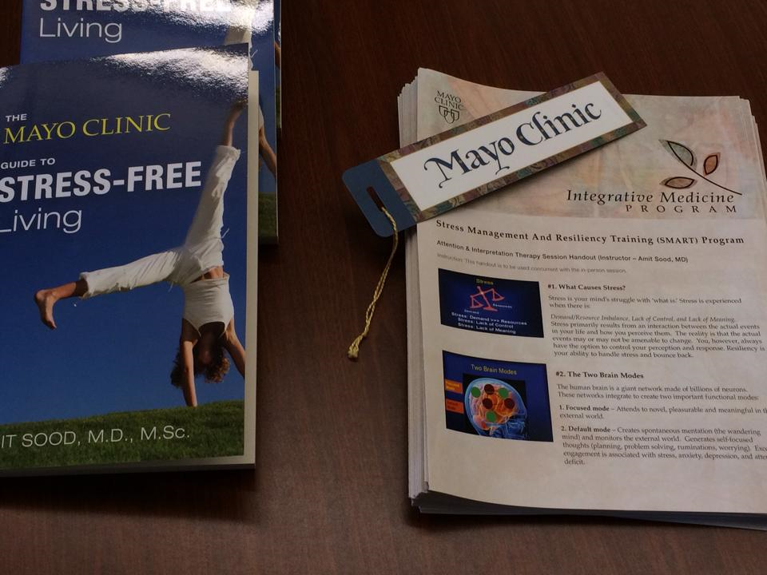
QUESTIONS/DISCUSSION

Slide 65
RESOURCES FOR ALL GENERATIONS….

Slide 66
RESOURCES
Websites:
Faculty Development , Teaching Millennial Students Institute at Western Michigan University
http://www.wmich.edu/facdev/Programs/TeachingMillennials.html
CD and Seminars
  Five strategies to Engage Today’s students
  https://www.magnapubs.com

Slide 67
RESOURCES
Video:
  http://vimeo.com/24148123 Millennial Generation and “The Lecture”
Blogs:
  https://edtechdigest.wordpress.engaging-millennials/ Cool Tools for Engaging the Millennial Learner
  Podcast:
  Radio Series on Millennials on NPR New Boom Generation

Slide 68


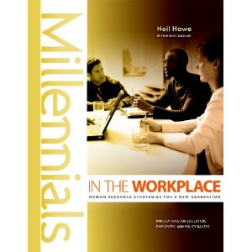
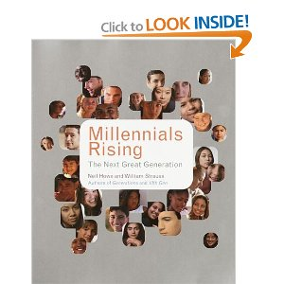

E-Books:
The Net Generation
http://www.educause.edu/research-and-publications/books/educating-net-generation
Books Kindle & Ibooks Version
Strauss & Howe 1991
Howe & Nadler 2010
Strauss & Howe 2005
Josse & Bass 2008

Slide 69
References
Lynne Lancaster & David Stillman, When Generations Collide: Who They Are. Why They Clash. How to Solve the Generational Puzzle at Work. Harper Business: New York, 2002.
Borges, N.J., Manuel, R.S., Elam, C., & Jones, B.J. (2010). Differences in Motives between Medical School Millennials and Generation Xers. Medical Education, 44, 579-576.
Borges, N.J., Manuel, R.S., Jones, B.J., & Elam, C. (2006). Comparing Millennial and Generation X medical students at one medical school. Academic Medicine, 81(6), 571-576.
Cardall, S., Krupat, E., & Ulrich, M. (2008). Live Lecture Versus Video- Recorded Lecture: Are Students Voting with Their Feet? Academic Medicine, 83, 1174-1178.
Elam, C.L., Borges, N.J., & Manuel, R.S. (2011). Millennial Students’ Perspectives on the Medical School Learning Environment: A Pilot Study from Two Institutions .Medical Science Educator, 21(2), 20-22.
Twenge, J.M. (2009). Generational changes and their impact in the classroom: teaching Generation Me. Medical Education; 43, 398-405.

