Slide 1
Prevention of venous thromboembolism in surgical patients, medical patients and long-distance travelers in Latin America
Educational Slide Kit
American Society of Hematology– ASH | 2022
Authors:
Mario Luis Tejerina Valle, MD, Caja Petrolera de Salud - Bolivia
Juan Carlos Serrano Casas, MD, Universidad Central de Venezuela- Specialized Hematologic Unit

Slide 2
Guidelines 2022 for the prevention of venous thromboembolism in surgical patients, medical patients and long-distance travelers in Latin America
Ignacio Neumann, Ariel Izcovich, Ricardo Aguilar, Guillermo León Basantes, Patricia Casais, Cecilia Colorio, Cecilia Guillermo, Pedro Garcia Lazaro, Jaime Pereira, Luis Meillon, Suely Meireles Rezende, Juan Carlos Serrano, Mario Luis Tejerina Valle, Felipe Vera, Lorena Karzulovic, Gabriel Rada, Holger Schunemann.
Neumann I, Izcovich A, Aguilar R, et al. ASH, ABHH, ACHO, Grupo CAHT, Grupo CLAHT, SAH, SBHH, SHU, SOCHIHEM, SOMETH, Sociedad Panameña de Hematología, SPH, and SVH 2022 guidelines for prevention of venous thromboembolism in surgical and medical patients and long-distance travelers in Latin America. Blood Adv. doi: 10.1182/bloodadvances.2021006482.

Slide 3

Latin American ADOLOPMENT project
The Latin American ADOLOPMENT project is a pilot collaborative effort of the following institutions
Sociedad Argentina de Hematología (SAH) Cecilia Colorio, MD
Sociedad Boliviana de Hematología y Hemoterapia (SBHH) Mario Luis Tejerina Valle, MD
Associação Brasileira de Hematologia, Hemoterapia e Terapia Celular (ABHH) Suely Meireles Rezende, MD PhD
Sociedad Chilena de Hematología Jaime Pereira, MD
Sociedad Peruana de Hematología (SPH) Pedro García Lázaro, MD
Sociedad de Hematología del Uruguay (SHU) Cecilia Guillermo, MD
Sociedad Venezolana de Hematología (SVH) Juan Carlos Serrano, MD
Grupo Cooperativo Latinoamericano de Hemostasis y Trombosis (CLAHT) Patricia Casais, MD
Asociación Mexicana de Hematología Luis Meillon MD
Asociación Colombiana de Hematología y Oncología Guillermo Basantes MD
American Society of Hematology
MacGRADE Center
GRADE-ADOLOPMENT is an explicit and systematic method for adopting, adapting or developing evidence-based recommendations from existing recommendation developed using the GRADE approach.
GRADE Evidence to Decision frameworks for adoption, adaptation, and de novo development of trustworthy recommendations: GRADE-ADOLOPMENT¨ (J Clin Epidemiol. 2017 Jan; 81:101-110).

Slide 4
ASH Clinical Practice Guidelines on VTE
Prevention of VTE in hospitalized surgical patients
Prevention of VTE in hospitalized patients
Treatment of acute VTE (DVT and PE)
Optimal management of anticoagulation therapy
Prevention and treatment of VTE in cancer patients
Heparin-Induced Thrombocytopenia (HIT)
Thrombophilia
Pediatric VTE
VTE in pregnancy
VTE diagnosis

Slide 5
How were the ASH guidelines developed?
PANEL COMPOSITION
Each panel was formed according to key criteria:
Balance in expertise (including disciplines beyond hematology and patients).
Attention to minimization and management of COI
CLINICAL QUESTIONS
10 to 20 clinically relevant questions generated in PICO format (population, intervention, comparison, and outcome).
EVIDENCE SYNTHESIS
Analysis of the evidence for each PICO question x systematic review of outcomes:
Desirable and undesirable outcomes
Resource use
Feasibility
Acceptability
Accessibility
Patient values and preferences
DRAFTING OF RECOMMENDATIONS Recommendations made by panel members based on evidence from all contributing factors.
EXAMPLE OF A PICO* QUESTION
Should we use thromboprophylaxis in patients undergoing major neurosurgical procedures?
*PICO Questions: Patients/Population, Intervention/Indicator, Compare/control, Outcome
ASH guidelines are reviewed annually by expert work groups convened by ASH. Resources, such as this slide set, derived from guidelines that require updating are removed from the ASH website.

Slide 6
How should patients and physicians use these guidelines?
 | STRONG Recommendation ("The panel recommends...") | CONDITIONAL Recommendation ("The panel suggests...")
For patients | Most individuals will want the intervention. | Most individuals will want the intervention, but many will not.
For physicians | Most individuals should receive the intervention. | Different options will be appropriate for different patients, depending on their values and preferences. Use shared decision making.

Slide 7
General Objectives
Establish models of thromboprophylaxis in surgical patients in terms of indication, type of prophylaxis, starting phase and duration of prophylaxis.
Evaluation of the use of antithrombotic prophylaxis in medical patients with indication, type of pharmacological agent, role of mechanical prophylaxis, duration of prophylaxis.
Thromboprophylaxis guidance in short and long-distance travelers.

Slide 8
What are the relevant aspects in this chapter?
IN SURGERY
Surgery causes 25% of VTE in the community, even with current prophylaxis strategies, with risk varying according to the procedure (e.g.: orthopedics, neurosurgery, CCV).
Post-surgical VTE can often occur at discharge and can cause up to 50,000 deaths per year in the United States.

Slide 9
In Surgery
Main modalities for postoperative VTE prevention
Pharmacological prophylaxis
Anticoagulants (LMWH, UFH, OACD, vitamin K antagonists)
Antiplatelet agents (ASA)
Mechanical prophylaxis
Graduated compression stockings
Intermittent pneumatic compression devices
IVC filters

Slide 10
Which clinical outcome was most relevant to the panel's decision making?
  Mortality
  Symptomatic VTE, AE, proximal DVT, severe distal DVT
  Major bleeding
  Re-intervention
Less emphasis on asymptomatic DVT events (detected in screening studies).
If symptomatic events are not distinguishable from asymptomatic events, clinical model analysis should be carried out to assess VTE cases that may require treatment.

Slide 11
Case 1: Acute Surgical Abdomen
Male patient 65 years old, weight loss of 10 kg, with pain in the left iliac fossa in the last week, abdominal distension, constipation, vomiting. In abdominal CT study there is LOE in descending colon. In colonoscopy Bx is identified with colon adenocarcinoma.
Background: Obesity, AHT with mild nephropathy.
Medication: Losartan 50 mg/day, ASA 100 mg/day.
Idx: Intestinal Obstruction, Colon adenocarcinoma
Caprini score: very high risk
Proposed surgery:
Sigmoid Colon Hemicolectomy, surgery time more than 45 min.

Slide 12
Considering his clinical condition as having a high risk of thrombosis in an oncologic patient surgery, what would be your recommendation?
a) I would not administer thromboprophylaxis.
b) I would only provide mechanical thromboprophylaxis.
c) I would administer pharmacologic thromboprophylaxis
d) I would administer thromboprophylaxis during hospitalization only

Slide 13
RECOMMENDATIONS
Should pharmacological prophylaxis be used or not in patients undergoing general surgery?
In patients undergoing general surgery, the Latin American panel suggests thromboprophylaxis rather than no thromboprophylaxis (conditional recommendation based on low certainty arising from the evidence provided by the ⨁⨁◯◯ effects).
Low quality evidence, so benefit/harm is uncertain.
The panel also considered :
The panel considered that in cases undergoing major surgery with an average risk of bleeding, pharmacologic or mechanical prophylaxis are reasonable alternatives. However, pharmacological prophylaxis is likely to be easier to implement.
Clinical models (e.g. Caprini) are very useful but careful individualization of each case should be the norm.
Outcomes ( Quality of Evidence) | Relative risk (95% CI) | Anticipated absolute effects (95% CI)
 |  | Risk without prophylaxis | Risk with prophylaxis
Mortality | RR 0.75 (0.61 to 0.93) | 6 per 1000 | 4 fewer per 1000 (from 7 fewer to 1 fewer)
AE | RR 0.48 (0.26 to 0.88) | 0 fewer per 1000 (from 0 fewer to 0 fewer) | 6 fewer per 1000 (from 8 fewer to 1 fewer)
Proximal symptomatic DVT | RR 0.38 (0.14 to 1.00) | 0 fewer per 1000 (from 0 fewer to 0 fewer) | 7 fewer per 1000 (from 10 fewer to 0 fewer)
Major Bleeding | RR 1.24 (0.87 to 1.77) | Not available | 6 more per 1000 (from 3 fewer to 20 more)
Quality of evidence (GRADE): Low Moderate Strong

Slide 14
Case 1: Acute Surgical Abdomen cont.
The patient was successfully taken to surgery with 200 cc bleeding, he is in his first postoperative hours, thromboprophylaxis with enoxaparin is scheduled to be started; the clinical group asks when it will begin and for how long it will be administered.

Slide 15
RECOMMENDATIONS
Should early prophylaxis or delayed prophylaxis be administered in patients for whom pharmacological thromboprophylaxis is the preferred option?
Low quality evidence, so benefit/harm is uncertain. The panel also considered :
The starting time should be assessed individually with the surgical team, taking into account the risks of venous thromboembolism and bleeding.
Patients requiring hospitalization for a period prior to surgery may benefit from prophylaxis.
In patients for whom pharmacologic thromboprophylaxis is the preferred option, the Latin American panel suggests delayed prophylaxis (12 hours after surgery), rather than early administration (before surgery).
(Conditional recommendation based on very low certainty arising from the evidence provided by the ⨁◯◯◯ effects).
Outcomes (Quality of Evidence) | Relative risk (95% CI) | Anticipated absolute effects (95% CI)
 |  | Early prophylaxis | Delayed prophylaxis
Mortality | RR 0.75 (0.61 to 0.93) | 6 per 1000 | 4 fewer per 1000 (from 7 fewer to 1 fewer)
AE | RR 0.48 (0.26 to 0.88) | 0 fewer per 1000 (from 0 fewer to 0 fewer) | 6 fewer per 1000 (from 8 fewer to 1 fewer
Proximal symptomatic DVT | RR 0.38 (0.14 to 1.00) | 0 fewer per 1000 (from 0 fewer to 0 fewer) | 7 fewer per 1000 (from 10 fewer to 0 fewer) )
Major Bleeding | RR 1.24 (0.87 to 1.77) | Not available | 6 more per 1000 (from 3 fewer to 20 more)
Quality of Evidence(GRADE): Low Moderate Strong

Slide 16
Rationale
This recommendation changed directions.
The original guideline panel made a recommendation in favor of either alternative: early administration or delayed prophylaxis.
The Latin American panel considered that for most patients undergoing general surgery, the risk of VTE before the procedure was very small.
The use of early prophylaxis may slightly increase the risk of bleeding during surgery, adds to costs, and may be inconvenient for surgical teams.

Slide 17
Should an extended or a standard course of antithrombotic prophylaxis be used in patients for whom pharmacological prophylaxis is the preferred treatment?
Recommendation
Where pharmacological prophylaxis is preferred, the Latin American panel suggests a short course (7 to 10 days) rather than an extended course (30 days) for surgical patients for whom thromboprophylaxis is the favored choice.
(conditional recommendation based on very low certainty arising from the evidence provided by the ⨁◯◯◯ effects).
Remarks:
In patients with an average risk of thromboembolism, a short course of prophylaxis will be more than sufficient. However, patients with cancer or undergoing orthopedic surgery may benefit from an extended course of thromboprophylaxis (4 weeks).

Slide 18
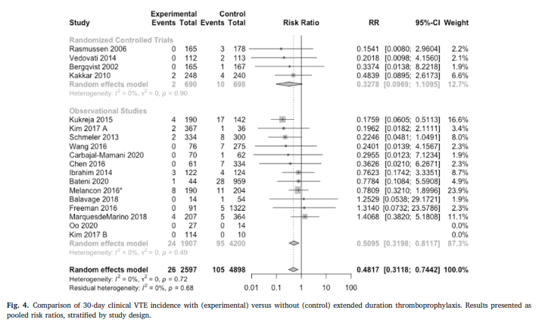
Extended LMWH thromboprophylaxis after major abdominopelvic cancer surgery was associated with a reduced incidence of clinical VTE without a clinically relevant increase in bleeding.
Extended thromboprophylaxis following major abdominal/pelvic cancer-related surgery: A systematic review and meta-analysis of the literature Knoll W, Fergusson N, Ivankovic V et al Thrombosis Research 204 (2021) 114–122

Slide 19
Case 1 continued
After one week of thromboprophylaxis the patient develops upper gastrointestinal bleeding, and the enoxaparin is discontinued; what course of action would you take?
I would stop all thromboprophylaxis.
I would wait 5 days and restart pharmacological thromboprophylaxis.
I would use only elastic compression stockings
I would use only intermittent pneumatic compression
I would use both compression stockings and intermittent pneumatic compression, depending on availability

Slide 20
Should pneumatic compression prophylaxis or graduated compression stockings be used in patients for whom mechanical thromboprophylaxis is preferred?
In patients for whom mechanical thromboprophylaxis is preferred, the Latin American panel suggests mechanical compression devices in lieu of graduated compression stockings (conditional recommendation based on low certainty arising from the evidence provided by the ⨁⨁◯◯ effects).
Outcomes (Quality of Evidence) | Relative risk (95% CI) | Anticipated absolute effects (95% CI)
 |  | Compression stockings | Intermittent pneumatic compression
Mortality | RR 1.04 (0.16 to 6.63) | 2 more per 1000 (from 46 fewer to 310 more) | 2 fewer per 1000 (from 41fewer to 274 more)
AE | RR 0.56 (0.17 to 1.86) | 0 fewer per 1000 (from 0 fewer to 0 more) | 7 fewer per 1000 (from 14 fewer to 14 more)
Proximal symptomatic DVT (any) | RR 0.48 (0.25 to 0.92 | 0 fewer per1000 (from 0 fewer to 0 fewer) | 26 fewer per1000 (from 37 fewer to 4 fewer
Distal symptomatic DVT (any) | RR 0.55 (0.25 to 1.22) | 0 fewer per 1000 (from 0 fewer to 0 fewer) | 66 fewer per1000 (from 111 fewer to 33 more)
Remarks
Pneumatic compression devices are not available in all health centers in Latin America.
The difference between mechanical devices and compression stockings is probably small; therefore, compression stockings are a reasonable alternative for patients for whom mechanical prophylaxis is preferred and there is limited availability of compression devices.
This recommendation did not change its direction or strength.
Quality of Evidence (GRADE): Low Moderate Strong

Slide 21
Other specific recommendations
Surgery | The panel Recommends ( Number Rec ) | Remarks or Rationale
Surgery following major trauma | Thromboprophylaxis over no prophylaxis (2) | Patients with moderate or low risk of bleeding can be treated with pharmacological prophylaxis; for patients with high bleeding risk, mechanical prophylaxis may be a better option.
Prostate Surgery | Against thromboprophylaxis (4 and 5 ) | Transurethral resection or radical prostatectomy may have a higher risk of bleeding than the average surgical patient (benign cases) with low risk of VTE, cancer or previous VTE that would require mechanical prophylaxis.
Laparoscopic Cholecystectomy | The panel suggests not to use pharmacological prophylaxis (3). | Very low baseline risk of VTE. Specific high-risk groups (thrombophilia, prior VTE, cancer) may benefit.
Major neurosurgical surgery | Thromboprophylaxis recommended versus no prophylaxis (6) | High risk of VTE and bleeding, when bleeding is high in the first days, mechanical prophylaxis is an option, once the risk of bleeding decreases, pharmacological prophylaxis can be used.

Slide 22
Thromboprophylaxis in hospitalized clinical patients
Half of all PTE events occur in surgical (24%) or critically ill (22%) patients.
Risk factors for PTE in the hospital include cancer, advanced age group, previous PTE, central catheterization, immobility.
40% of patients have 3 or more risk factors for PTE.
There is an increased risk of thrombosis in clinical patients that persists 45 to 60 days after hospital discharge.

Slide 23
Which patients are at risk for PTE in the hospital?
Risk Assessment Models (RAMs) can identify high risk patients
Exemples: Padua, IMPROVE-VTE Scores
Padua RAM: Factors
Previous PTE Thrombophilia Active cancer Age > 70 years Immobility Recent trauma/surgery Heart or respiratory failure AMI or CVA Hormonal treatment Obesity (BMI > 30) Infection/collagenosis
IMPROVE-VTE RAM: Factors
Previous PTE Thrombophilia active cancer Age > 60 years Immobilization ≥ 7 days Leg paralysis UTI hospitalization
These RAMs are not widely validated for guided decision making for prophylaxis.
Spyropoulos Chest 2011
Leizorovicz Circulation 2004

Slide 24
Clinical Case 2: Hospitalized Medical Patient
72 years old male
Medical history: COPD, hypertension, type 2 diabetes, obesity (BMI 41 kg/m2), PTE 15 years ago (minor orthopedic surgery).
Medication: metformin, amlodipine, losartan, bronchodilator
Admitted: Medicine Department with diagnosis of pneumonia.
Treatment: antibiotics, oxygen therapy.
Patient was admitted to the hospital due to significant deterioration of his general condition, with weakness, dyspnea and immobility. Curbs Index greater than 3 pts

Slide 25
Which of the following would you suggest as thromboprophylaxis during your hospital stay?
Low Molecular Weight Heparin (LMWH) or UFH
Direct oral anticoagulants ( Rivaroxaban, or Apixaban)
Graduated compression stockings
No prophylaxis because of low risk of thrombosis.

Slide 26
Risk factors for PTE in our patient.
Padua RAM: Factors
Previous PTE Thrombophilia Active cancer age > 70 years Immobility Recent trauma/surgery Respiratory failure AMI or CVA Hormonal treatment Obesity (BMI > 30) Infection/colagenosis
IMPROVE-VTE RAM: Factors
Previous PTE Thrombophilia Active cancer Age > 60 years Immobilization ≥ 7 days Lower limb paralysis ICU admission

Slide 27
Recommendation
Should unfractionated heparin or low molecular weight heparin be used in hospitalized patients with acute or critical illness requiring pharmacological prophylaxis?
The Latin American panel suggests the use of either unfractionated heparin or low-molecular-weight heparin (conditional recommendation based on low certainty arising from the evidence provided by the ⨁⨁◯◯ effects).
Remarks
The difference between unfractionated heparin and low molecular weight heparin in venous thrombosis and bleeding events is very small.
Unfractionated heparin may be a reasonable alternative in settings where the price of low molecular weight heparin is a problem.
In situations where access to LMWH is not an issue, this option is a more convenient alternative for patients, physicians and providers.
Outcomes | Relative effect: RR (95% CI) | Anticipated absolute effects (95% CI)
 |  | Risk with UHF | Risk with LMWH
Mortality | 0.99 (0.82 to 1.19) | 1 fewer per 1000 (from 2 fewer to 5 more) | 1 fewer per 1,000 (9 fewer to 5 more)
AE | RR 0.82 (0.40 to 1.68 | 1 fewer per 1000 (from 0 fewer to 0 more) | 1 fewer per 1000 (from 4 fewer to 4 more)
Proximal symptomatic DVT | RR 0.80 (0.21 to 2.96) | 0 fewer per 1000 (from 1 fewer to 4 more) | 1 fewer per1000 (from 2 fewer to 5 more)
Major bleeding | RR 0.80 (0.48 to 1.31) |  | 2 more per1000 (from 5 fewer to 3 more)
This recommendation changed directions. The original panel made a conditional recommendation in favor of LMWH, but the Latin American panel made a conditional recommendation in favor of either.
Quality of Evidence (GRADE): Low Moderate Strong

Slide 28


During the Specialist and resident review on the internal medicine floor, the possibility of, at some point, making the switch to the use of direct anticoagulant agents in this patient is discussed.
Do you agree?
YES
NO

Slide 29
Recommendation
Should low-molecular-weight heparin be used in preference to direct oral anticoagulant agents in patients with acute illness requiring pharmacological thromboprophylaxis?
The Latin American panel suggests using low-molecular-weight heparin over direct oral anticoagulant agents in medical thromboprophylaxis (conditional recommendation based on moderate certainty arising from the evidence provided by the ⨁⨁⨁◯ effects).
Evidence from 3 trials showed that short course of LMWH vs short course and prolonged DOACs increase bleeding without significant impact on VTE reduction.
Original panel gave strong recommendation against DOAC. (Absolute ↑ in bleeding is small:
0.2 to 1.2% .
The Latin American panel considered that some patients may trade the small increase in bleeding for convenience of oral agent.
A conditional recommendation was issued
Any DOAC compared to prophylactic LMWH:
Outcomes | Relative effect: RR (95% CI) | Anticipated absolute effects (95% CI)
 |  | Risk with prophylactic LMWH | Risk with difference with any DOAC
Mortality | 0.64 (0.21 to 1.98) | 1 per 1,000 | 0 fewer deaths per 1,000 (1 fewer to 1 more)
AE | 1.01 (0.29 to 3.53) | 0 fewer per 1000 (from 3 fewer to 10 more) | 0 fewer AE per 1000 (1 fewer to 3 more)
Proximal symptomatic DVT | 1.03 (0.34 to 3.08) | 0 fewer per 1000 (from 1 fewer to 2 more) | 0 fewer per 1000 (from 1 fewer to 4 more)
Major bleeding | 1.70 (1.02 to 2.82) | 2 bleedings more per 1000 (0 fewer to 4 more)* | 8 more per 1000 (from 0 fewer to 22 more)
°° This recommendation changed strength vs original
* These estimates apply to a low baseline bleeding risk.
Quality of Evidence : Low Moderate Strong

Slide 30
The patient has recent gastrointestinal bleeding. You decide to discontinue thromboprophylaxis to ensure hemostasis.
Which of the following options for thromboprophylaxis would you suggest at this time?
Elastic Compression Stockings
Pneumatic compression devices
Calf exercises (physical therapy)
No mechanical prophylaxis required
Both Compression Stockings and Pneumatic Compression Devices are valid

Slide 31
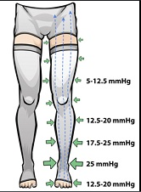
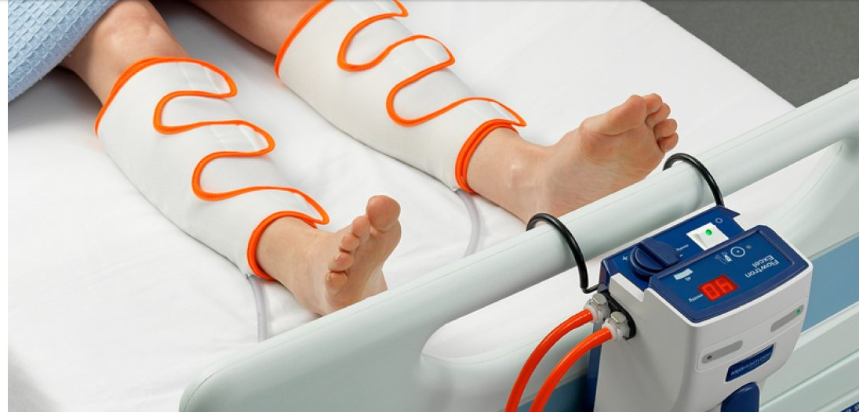
Vs

Slide 32
Recommendation 14
In patients with acute and critical illness who cannot receive pharmacologic prophylaxis, the Latin American panel suggests the use of mechanical prophylaxis rather than no prophylaxis (conditional recommendation based on moderate certainty arising from the evidence provided by the ⨁⨁⨁◯ effects).
Recommendation 15
In hospitalized patients with acute and critical illness requiring mechanical prophylaxis, the Latin American panel suggests either of these two options: pneumatic compression devices or graduated compression stockings (conditional recommendation based on very low certainty arising from the evidence provided by the ⨁◯◯◯ effects).

Slide 33
Recommendation 15 cont.
Remarks
The absolute differences between the two modalities in thrombotic events and bleeding are probably small.
Final decision depends on cost, availability and physician-patient preference.
Intermittent pressure devices are generally noisy and can disrupt sleep, and stockings exert continuous pressure that can be uncomfortable.
Both modalities should be used according to the manufacturer's instructions..
Outcomes | Relative effect: RR (95% CI) | Anticipated absolute effects (95% CI)
 |  | Risk with pneumatic compression | Risk with elastic compression stockings
Mortality | RR 3.43 (0.15 to 79.74) | 1 per 1,000 | 0 fewer deaths per 1,000 (0 fewer to 0 more)
AE | RR 0.38 (0.02 to 8.86) | 27 fewer per 1000 (de 43 menos a 342 more) | 1 fewer per 1000 (from 1 fewer to 8 more )
Proximal symptomatic DVT | RR 0,16 (0,01 to 2,98) | 110 fewer per 1000 (from 129 fewer to 258 more) | 2 fewer per 1000 (from 2 fewer to 4 more)
Distal Symptomatic DVT | RR 0.16 (0.01 to 2.98) | 110 fewer per 1000 (from 129 fewer to 258 more) | 6 fewer per 1000 (from 7 fewer to 14 more)
°° This recommendation did not change either recommendation or strength
Quality of Evidence: Low Moderate Strong

Slide 34
The GI bleeding resolved and a few days later thromboprophylaxis with LMWH was restarted. The patient was hospitalized for 9 days and was discharged with pneumonia in the process of resolution. His usual medication was prescribed.
Would you recommend discharge prophylaxis against PTE?
Discontinue LMWH on the day of hospital discharge.
Maintain LMWH for 3 weeks
Change LMWH to DOAC, and continue DOAC for 3 weeks
Graduated compression stockings for 3 weeks

Slide 35
What is the rationale for extending thromboprophylaxis beyond hospital discharge?
Most in-hospital events occur outside the hospital, in the first month after discharge.
The risk of PTE in medical patients is elevated even 45-60 days after discharge.
The duration of inpatient prophylaxis is coordinated as the average length of hospital stay decreases.
Huang Am J Med 2014
Cohen NEJM 2016
Cohen NEJM 2014
Goldhaber NEJM 2011

Slide 36
Recommendation
Should thromboprophylaxis be used for a short course or for an extended one in patients with acute or critical illness requiring pharmacological prophylaxis?
In patients with acute or critical illness, the panel recommends a short course of thromboprophylaxis in inpatients over an extended course (conditional recommendation, moderate certainty arising from evidence provided by the effects).
Outcomes | Relative effect: RR (95% CI) | Anticipated absolute effects (95% CI)
 |  | Difference in risk with extended prophylaxis
Mortality | RR 0.97 (0.87 to 1.08) | 1 fewer per1000 (from 4 fewer to 3 more)
AE | RR 0,62 (0,39 to 0,99) | 1 fewer per 1000 (from 2 fewer to 0 fewer)
Proximal symptomatic DVT | RR 0.77 (0.64 to 0.93) | 6 fewer per 1000 (from 10 fewer to 2 fewer)
Major Bleeding | RR 1.84 (1.33 to 2.55) | 2 más por 1000 (from 1 more to 4 more)
REMARKS
The panel considered that there was some uncertainty regarding baseline VTE risk. While for most patients the baseline risk of VTE is small.
Extended prophylaxis will not result in significant benefit, there are some patients at increased baseline risk of VTE who maintain this risk after discharge, especially if they require rehabilitation and are unable to ambulate.
Such patients may benefit from extended prophylaxis.
This recommendation changed its strength. The original panel made a strong recommendation in favor of short prophylaxis, while the Latin American panel made a conditional recommendation.
Quality of Evidence (GRADE): Low Moderate Strong

Slide 37
Why is routine extended thromboprophylaxis not currently recommended?
CONSIDERATIONS
Extended thromboprophylaxis can reduce PE and DVT, but the absolute impact on PTE reduction is small (1 for 3 PTE per 1,000 treated patients) and is similar to the number of bleeding events caused.
Extended prophylaxis has no impact on mortality.
Possibly the three most important studies (APEX, MAGELLAN, ADOPT) did not select patients at sufficiently high risk of PTE.
However, the MARINER trial (Spyropoulos NEJM 2018) also showed no significant reduction in PTE despite the use of the modified IMPROVE VTE risk score to select clinically high-risk patients using extended thromboprophylaxis with rivaroxaban.

Slide 38
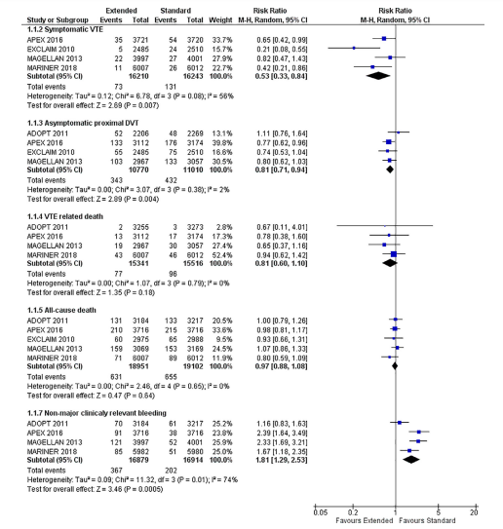
"Among hospitalized medical patients, prolonged venous thromboprophylaxis was associated with a decreased risk of VTE events but an increased risk of bleeding with no significant difference in VTE-related death."
Extended duration of thromboprophylaxis for medically ill patients: a systematic review and meta-analysis of randomised controlled trials
Zayed Y, Kheiri B, Barbarawi M Internal Medicine Journal 50 (2020) 192–199

Slide 39
Clinical Case 3
Long distance travelers
53-year-old woman with a history of unprovoked DVT 4 years ago, obese BMI of 38 kg/m2. She is not on anticoagulant or antiplatelet medication.
She has to travel by plane to Madrid, it will be a long flight (> 4 hours).
Which of the following options would you recommend as an antithrombotic method?
HBPM
Graduated compression stockings
Aspirin
No prophylaxis needed
A and B are correct

Slide 40
Air travel and DVT
Long distance travel: 4 hours flight time or more
Air travel is associated with a 2.8 increased risk of developing PTE, which is proportional to the duration of the flight.
Who is at elevated risk for VTE in travel?
Recent surgery Previous PET Postpartum women Active malignancy 2+ risk factors include the combination of the above with hormone replacement therapy, obesity, or pregnancy.

Slide 41
Recommendation
In persons at increased risk for DVT, the panel suggests the use of graduated compression stockings or LMWH prophylaxis for long-distance travel (conditional recommendation based on very low certainty arising from evidence provided by the effects).
In persons at low risk of DVT, the panel suggests NOT to use thromboprophylaxis (conditional recommendation based on very low certainty arising from the evidence provided by the effects).
Intervention | Relative Effects (RR, 95% CI) on VTE Prevention (compared with no intervention) | Absolute Risk Difference with each intervention (compared with no prophylaxis)
Graduated Compression Stockings | 0.10 (0.04 to 0.25) | 3 fewer PE per 1,000,000 (3 fewer to 3 fewer) 1.8 fewer asymptomatic DVT per 10,000 (1.9 fewer to 1.5 fewer)
LMWH | 0.10 (0.10 to 2.11) | 3 fewer PE per 1,000,000 (3 fewer to 4 more) 17.8 fewer asymptomatic DVT per 10,000 (1.9 fewer to 2.2 more)
Aspirin | 0.75 (0.13 to 4.32) | 1 fewer PE per 1,000,000 (3 fewer to 12 more) 0.5 fewer asymptomatic DVT per 10,000 (1.7 fewer to 6.5 more)
Remarks
LMWH, graded stockings and ASA have a small uncertain benefit.
There is no evidence regarding the use of DOACs for in-flight thromboprophylaxis.

Slide 42
Applying these Guidelines to the patient:
Why are these recommendations "conditional"?
53 years old female with previous unprovoked DVT and obesity.
What is her risk of DVT associated to her risk factors when flying?
Baseline annual risk ≈ 1 in 1,000 (age) x 2 (obesity) x 5 (prior VTE) ≈ 1 in 100 per year
Daily VTE risk ≈ 1 in 100 x 1 in 365 days per year ≈ 1 in 3,650
VTE risk per flight ≈ 1 in 3,650 (daily risk) x 30 days of risk x 3 (RR with flight) ≈ 3%
What is the benefit of LMWH thromboprophylaxis?
RR 0.10 (95% CI 0.01-2.11) compared with no intervention
Approximate VTE risk per flight with LMWH = 3% x 0.10 = 0.3% (high uncertainty, 95% CI 0.03% to 6.3%)
REMARKS
Graduated compression stockings, LMWH and aspirin have a small, uncertain effect on DVT prevention and the absolute benefit is very small.
Physicians should take into account the patient's related risk factors.
Eichinger Arch Int Med 2008
Silverstein Arch Int Med 1998

Slide 43
Case 3: Continued
Given that the patient has a prior history of PTE and is obese, the indication for thromboprophylaxis with either graduated compression stockings or LMWH during her flight is warranted.
She received thromboprophylaxis with LMWH in the morning for her 7-hour flight and did not develop DVT.

Slide 44
Summary Part 1: Returning to our objectives
1. Establish indication for thromboprophylaxis in surgical patients.
- Use of prophylaxis in general surgery with moderate to high risk of DVT, in post-trauma surgery and in major neurological surgery.
2. Understand the use of mechanical prophylaxis and its types in surgery.
- Patients with active or high risk of bleeding. Both options (elastic stockings and pneumatic compression are valid in our environment).
3. Beginning and duration of prophylaxis in surgery.
- Late start prophylaxis is more widely accepted in Latin America. Prefer short duration prophylaxis in general surgery. Reserve extended prophylaxis for oncologic and orthopedic surgeries.

Slide 45
Summary Part 2: Returning to our objectives
1. To describe recommendations for thromboprophylaxis in inpatients with clinical or acute disease
- Risk assessment models (RAMs), LMWH compared to DOACs
2. To describe the thromboprophylaxis recommendations for patients discharged from the hospital after acute illness
- Extended prophylaxis versus in-hospital prophylaxis. LMWH compared to DOACs
3. To identify patients who may benefit from receiving thromboprophylaxis when traveling long distances
- Graduated compression stockings or LMWH for those with strong risk factors for DVT.

Slide 46
Changes to the source recommendations
The Latin American panel agreed on 21 recommendations. Compared to the original guideline, 6 recommendations changed direction and 4 changed strength.
Four recommendations changed direction (recommendations 9, 10, 11 and 13) and two changed strength (12 and 16) because the Latin American panel considered that the small differences in the synthesis of evidence did not justify the resources needed to implement changes.
There were concerns regarding access and the impact on health equity in some settings in the region.
Two recommendations changed direction (2 and 6) because the Latin American panel considered additional indirect evidence from the effects of mechanical prophylaxis (the original panelists limited their recommendation to pharmacological prophylaxis).
Two recommendations (18 and 19) changed in strength due to value and preference considerations.
Latin American panelists placed more importance on how patients may value oral alternatives.

Slide 47
Acknowledgments
ASH Latin American VTE Guidelines Panel team members
ASH Team Members
McMaster University GRADE Centre
ASH VTE kit slide authors:
  Mario Luis Tejerina Valle, MD, Caja Petrolera de Salud - Bolivia
  Juan Carlos Serrano Casas, MD, Universidad Central de Venezuela Unidad Hematológica Especializada
More information on the ASH VTE Guidelines: www.hematology.org/VTE

