Slide 1

Use of Anticoagulation in Patients with COVID-19
An Educational Slide Set
American Society of Hematology Guidelines on Use of Anticoagulation in Patients with COVID-19
Slide set authors:
Deborah Siegal, MD, MSc, University of Ottawa Robby Nieuwlaat, PhD, MSc, McMaster University Adam Cuker, MD, MS, University of Pennsylvania
Erik Klok, MD, PhD, Leiden University Medical Center

Slide 2
Clinical Guidelines
American Society of Hematology living guidelines on the use of anticoagulation for thromboprophylaxis in patients with COVID-19
Deborah M. Siegal, Eric K. Tseng, Holger J. Schünemann, Pantep Angchaisuksiri, Clifton Blair, Adam Cuker, Kathryn Dane, Maria T. DeSancho, David Diuguid, Daniel O. Griffin, Frederikus A. Klok, Alfred Ian Lee, Ignacio Neumann, Ashok Pai, Marc Righini, Kristen M. Sanfilippo, Mike Skara, Deirdra R. Terrell, Kamshad Touri, Elie A. Akl, Reyad Al Jabiri, Yazan Al Jabiri, Romina Brignardello-Petersen, Luis E. Colunga-Lozano, Karin Dearness, Andrea J. Darzi, Samer G. Karam, Gian Paolo Morgano, Rami Z. Morsi, Binu A. Philip, Yetiani Roldan Benitez, Adrienne Stevens, Karla Solo, Wojtek Wiercioch, Reem A. Mustafa, and Robby Nieuwlaat

Slide 3
ASH Clinical Practice Guidelines on VTE
Prevention of VTE in Surgical Hospitalized Patients
Prophylaxis in Hospitalized and Non-Hospitalized Medical Patients
Treatment of Acute VTE (DVT and PE)
Optimal Management of Anticoagulation Therapy
Prevention and Treatment of VTE in Patients with Cancer
Heparin-Induced Thrombocytopenia (HIT)
Thrombophilia
Pediatric VTE
VTE in the Context of Pregnancy
Diagnosis of VTE
Use of Anticoagulation in Patients with COVID-19

Slide 4
How were these ASH guidelines developed?
PANEL FORMATION
Each guideline panel was formed following these key criteria:
Balance of expertise (including disciplines beyond hematology, and patients)
Close attention to minimization and management of COI
CLINICAL QUESTIONS
5 clinically-relevant questions generated in PICO format (population, intervention, comparison, outcome)
EVIDENCE SYNTHESIS
Evidence summary generated for each PICO question via systematic review of health effects plus:
Resource use
Feasibility
Acceptability
Equity
Patient values and preferences
MAKING RECOMMENDATIONS
Recommendations made by guideline panel members based on evidence for all factors.
The guidelines will be updated using a living recommendation approach as new evidence becomes available.
Example: PICO question
“In patients with COVID-19 related critical illness who do not have suspected or confirmed VTE, should intermediate- or therapeutic intensity anticoagulation versus prophylactic-intensity anticoagulation be used for thromboprophylaxis?”
ASH guidelines are reviewed annually by expert work groups convened by ASH. Resources, such as this slide set, derived from guidelines that require updating are removed from the ASH website.

Slide 5
How patients and clinicians should use these recommendations
 | STRONG Recommendation (“The panel recommends…”) | CONDITIONAL Recommendation (“The panel suggests…”)
For patients | Most individuals would want the intervention. | A majority would want the intervention, but many would not.
For clinicians | Most individuals should receive the intervention. | Different choices will be appropriate for different patients, depending on their values and preferences. Use shared decision making.

Slide 6



Patient groups addressed in this chapter
Acutely ill medical patients
  Patients hospitalized for medical illness
Critically ill patients
  Patients with immediately life-threatening illness requiring admission to intensive care unit
Discharged patients
  Patients who have been discharged after hospitalization for COVID-19

Slide 7
What these guidelines are about
Anticoagulants carry benefits (reducing venous thromboembolism) and risks (life-threatening bleeding)
Recognizing and mitigating risk for harm from anticoagulants requires evidence-based approach to management
This guideline focuses on anticoagulant dose intensity for critically ill and acutely ill hospitalized patients with COVID-19 and patients who were discharged after hospitalization for COVID-19 who do not have suspected or confirmed venous thromboembolism

Slide 8
Objectives
By the end of this session you will be able to:
Describe VTE prophylaxis recommendations for hospitalized patients with COVID-19 related critical illness who do not have suspected or confirmed VTE
  Intermediate- or therapeutic-intensity versus prophylactic intensity anticoagulation
Describe VTE prophylaxis recommendations for hospitalized patients with COVID-19 related acute illness who do not have suspected or confirmed VTE
  Intermediate- or therapeutic-intensity versus prophylactic intensity anticoagulation
Describe VTE prophylaxis recommendations for Patients who have been discharged after hospitalization for COVID-19 who do not have suspected or confirmed VTE
  Post-discharge prophylactic intensity anticoagulation

Slide 9

Methods
Overall
Initial Phase
Living Phase
Sunset
  GRADE methodology for recommendation development
  Cochrane methodology for systematic reviews
  PICO question generation and prioritization
  Selection of critical outcomes
  Systematic review for baseline risk estimates
  Systematic review for effect of different anticoagulation intensities
  Monthly updated searches for baseline risk estimates, prognostic factors, effect of anticoagulation strategies
  Revisiting guideline recommendations if new evidence meets pre-specified criteria

Slide 10





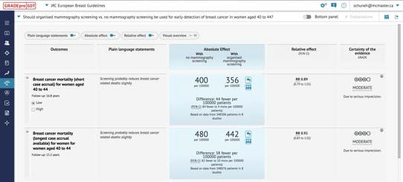
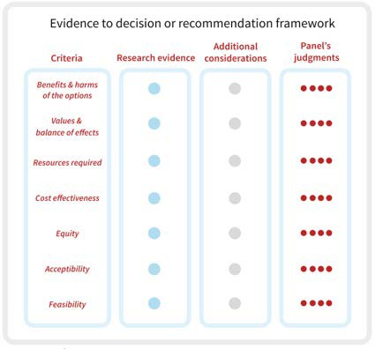
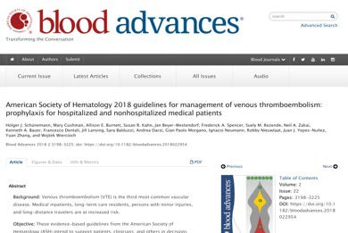












Synthesize and Create
evidence profile & Evidence to Decision Table with GRADEpro
Rate certainty
of evidence for
each outcome and
other criteria
Formulate question
Assess single studies
P I C O
Outcome Critical
Outcome Critical Outcome Important Outcome Not
Recommendation/Decision
Guideline/coverage decision
Grade recommendations
(Evidence to Recommendation)
For or against (direction)
Strong or conditional/weak (strength)
Evidence synthesis (systematic review/HTA)
Panel
© GRADE Working Group/EP 2008 - 2021
Notes:
Presenter
2021-05-10 11:00:33
--------------------------------------------
The Grading of Recommendations Assessment, Development and Evaluation approach, in short GRADE, is a systematic and transparent approach to developing guideline recommendations. The ASH guideline panel was at the heart of the whole process. They prioritized well-defined PICO questions that represent important questions in practice. With that, the panel selected which patient-important outcomes were critical, or important but not critical, for decision-making. The evidence synthesis team then searched, screened, extracted and synthesized the best available studies in Evidence Profiles to answer these questions. The certainty of this evidence was assessed using the GRADE criteria, per outcome as well as for the overall body of evidence. Evidence-to-Decision (EtD) tables were then used to summarize the evidence for all relevant domains to generate a recommendation, including required resources, cost-effectiveness, equity, acceptability and feasibility. Using the EtD judgments the panel then went from evidence to a recommendation, specifying the direction and strength of the recommendation.

Slide 11
PICO Question Generation & Prioritization
Brainstorming: inclusive list of potential PICO questions to address
Importance rating: selecting the PICO questions with the most critical importance
Critically ill COVID-19
Acutely ill COVID-19
Discharged COVID-19
Prophylactic intensity
Prophylactic intensity
Post-discharge anticoagulation
No post-discharge anticoagulation
Intermediate intensity
Therapeutic intensity
Intermediate intensity
Therapeutic intensity
Notes:
Presenter
2021-05-10 11:00:34
--------------------------------------------
Illustrations:
The panel judged that in both critically and acutely ill COVID-19 patients the standard of care will be prophylactic intensity anticoagulation, based on previous ASH recommendations for all critically and acutely ill patients.(Schünemann 2018) As intermediate and therapeutic intensities were being used in practice for COVID-19 patients, both were selected for comparison with prophylactic intensity. The ASH guideline panel created specific definitions for prophylactic, intermediate, and therapeutic intensity anticoagulation.

Slide 12
Outcome Selection
Brainstorming
Importance rating
Critical outcomes
List of potential outcomes
Most critical for key stakeholders
All-cause mortality
Pulmonary embolism
Deep venous thrombosis
Major bleeding
Multi-organ failure
Ischemic stroke
Intracranial hemorrhage
Invasive mechanical ventilation
Limb amputation
ICU admission
STEMI
Notes:
Presenter
2021-05-10 11:00:34
--------------------------------------------
List of ‘Critical Outcomes’:
All listed outcomes were prioritized as being Critical for anticoagulation decision-making. The outcomes in orange were considered of highest importance for decision-making, and carried the most weight when judgments about the available evidence.

Slide 13
Evidence for Effect of the Intervention
Baseline risk
Relative effect
Absolute effect
5 per 1,000
3 per 1,000
fewer
RR 0.40

Slide 14
Evidence-to-decision framing
Certainty of Evidence
Our confidence that the effect estimate is adequate to support a recommendation (high, moderate, low, very low)
Reflects strengths and limitations of the evidence (study design, risk of bias, imprecision, inconsistency, indirectness, publication bias)
Strength of Recommendation
Extent to which we can be confident that the desirable effects of an intervention outweigh its undesirable effects
Categorized as strong or conditional

Slide 15


GRADE Certainty of Evidence
Table: Grade’s approach to rating quality of evidence (aka confidence in effect estimates)
For each outcome based on a systematic review and across outcomes (lowest quality across the outcomes critical for decision making)
1. Establish initial level of confidence
2. Consider lowering or raising level of confidence
3. Final level of confidence rating
Initial confidence in an estimate of effect
Reasons for considering lowering or raising confidence
Confidence in an estimate of effect across these considerations
Study design
Randomized trials ►
High Confidence
▼Lower if
▲Higher if*
High
●●●●
Risk of Bias
Inconsistency
Large effect Dose Response All plausible confounding &
Moderate
●●●●
Indirectness
Imprecision Publication bias
bias
Would reduce a demonstrated effect
or
Would suggest spurious effect if no effect was observed
Observational studies ►
Low confidence
Low
●●●●
Very Low
●●●●
*upgrading criteria are usually applicable to observational studies only.

Slide 16
Baseline Risk – Systematic Review
Incidence rate of selected outcomes:
  In the three populations of interest (critically ill; acutely ill; discharged from hospitalization for COVID-19)
  Baseline risk assessed among patients receiving prophylactic intensity anticoagulation (for critically ill and acutely ill) and no anticoagulation (for patients discharged from hospital)
Required:
  Not high risk of bias (according to simplified QUIPS)
  Reporting duration of follow-up
Initial search date:
Screened through:
Screened:
Included:
Analysis:
23-JUL-2020
31-MAY-2023
28,104 citations
148 Studies
Pooled estimates using generalized linear mixed model
Descriptive, if only one study identified, or when pooling was considered inappropriate

Slide 17
Effect of Anticoagulation – Systematic Review
Comparison of two or more anticoagulation intensities for prevention of VTE:
  In the three populations of interest
  Addressing Prophylactic vs. Intermediate/Therapeutic intensity (for critically and acutely ill) and prophylactic-intensity vs no anticoagulation (for patients discharged from hospital)
Required:
  Pre-defined definitions for Prophylactic, Intermediate, Therapeutic intensity
  Risk of bias assessed with ROBINS-I
Initial search date:
Screened through:
Screened:
Included:
Analysis:
20-AUG-2020
31-MAY-2023
17,590 citations
22 trials
Descriptive analysis of adjusted relative effect estimates
Pooling unadjusted relative effect estimates in meta-analysis

Slide 18
Evidence for Other Domains
The panel considered additional Evidence-to-Decision domains to generate the recommendations:
  Resource use
  Cost-effectiveness
  Health equity
  Acceptability
  Feasibility
Evidence for these domains was also sought in the two reviews
COVID-19 specific evidence not yet identified – the panel mainly relied on evidence from the ASH guidelines for the management of hospitalized medically ill patients, and their expertise

Slide 19
Living Phase – Systematic Reviews
Overall
Monthly search updates
Using explicit criteria for updating analyses and publication with new important information
Baseline risk
Add evidence on prognostic factors
Search strategy & eligibility criteria may become narrower as quantity and quality of evidence increases
Use of machine learning to make regular screening manageable
Effect of anticoagulation intensity
Search strategy & eligibility criteria may focus on RCTs as they become available
Update analyses with new important data (explicit criteria)

Slide 20
Living Phase – Recommendations
Continued to work closely with panel and systematic review team
Reconsidered recommendations when important new evidence was identified
Used explicit criteria for reconsidering recommendations
  Changes in the evidence of effects (certainty, direction, magnitude)
  Changes in the evidence for other Evidence-to-Decision domains (cost-effectiveness, equity, others)
  Face validity (inclusion of new important trials)
Published updated recommendations and supporting documents
Timely advice for decision-makers

Slide 21
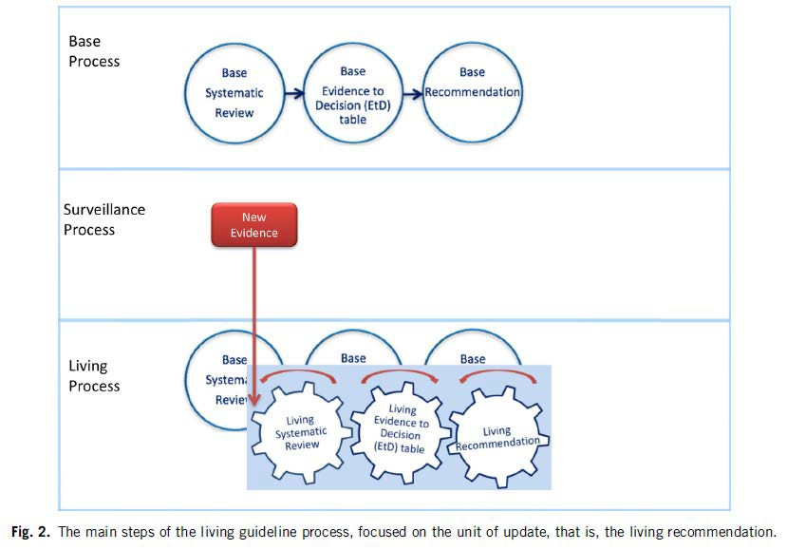
Living Recommendations
Process
Akl EA, et al. Living systematic reviews: 4. Living guideline recommendations. J Clin Epidemiol. 2017;91:47-53.

Slide 22
Main Methodological Challenges
Evidence
Large number of citations
Incomplete reporting
Risk of bias
Imprecision
Evolving field in Living phase
Recommendation formulation process
Very low certainty evidence
Not relying on non-COVID-19 evidence
Criteria to reconsider recommendations with important new evidence in Living phase
Provide timely and stable guidance

Slide 23
COVID-19 Thrombosis Challenges
ASH Guidelines Chair
Defining COVID-19 hypercoagulability
1
Anticoagulation for patients hospitalized for COVID-19
2
Anticoagulation after hospitalization for COVID-19
3

Slide 24
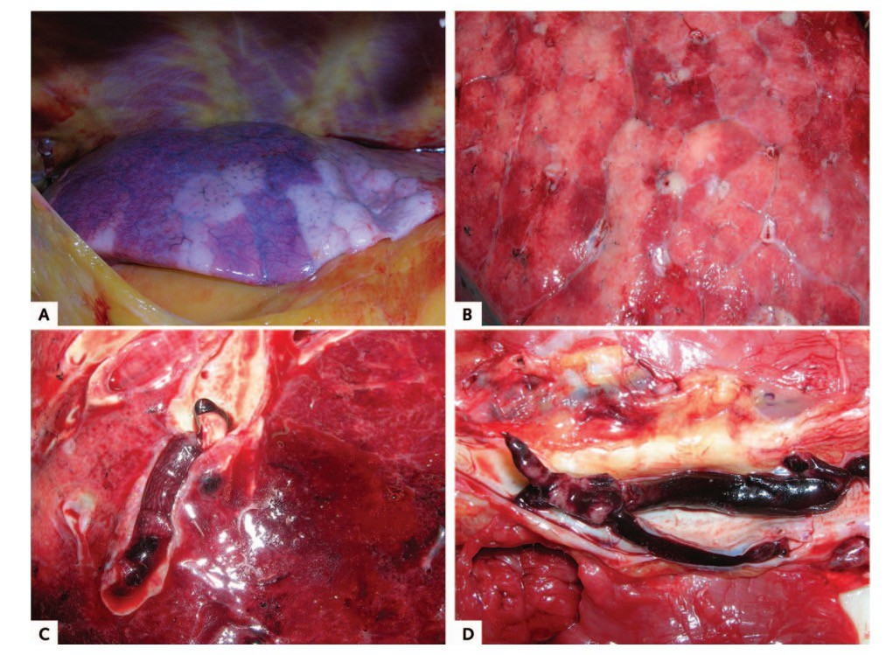
COVID-19
coagulopathy: autopsy studies
Macroscopic autopsy findings
Patchy aspect of the lung surface (case1).
Cutting surface in (case 4).
Pulmonary embolism (case 3).
Deep venous thrombosis (case 5).
Wichmann D et al, Ann Int Med 2020

Slide 25
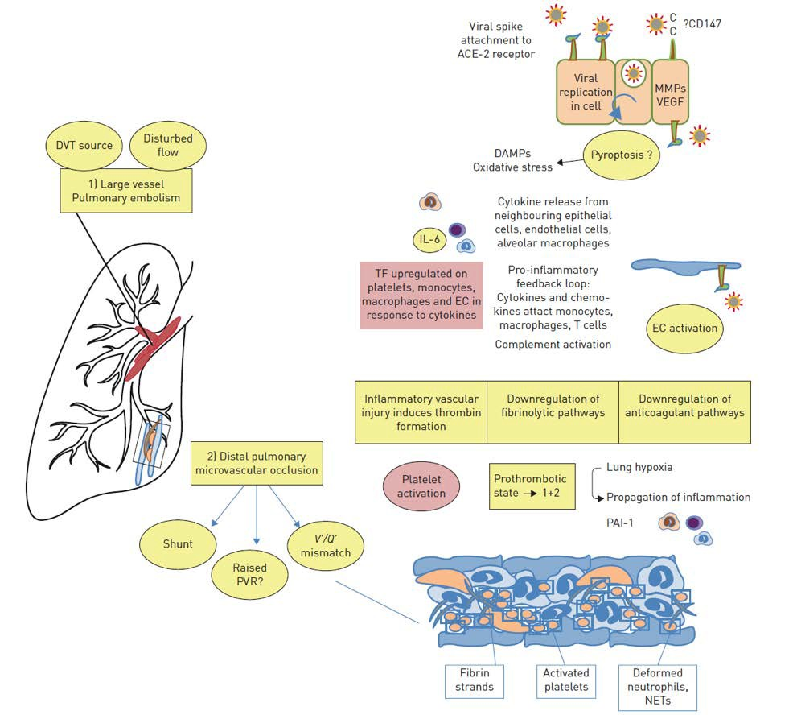
Pathophysiology of increased VTE risk
Price LC et al, Eur Respir J 2020

Slide 26
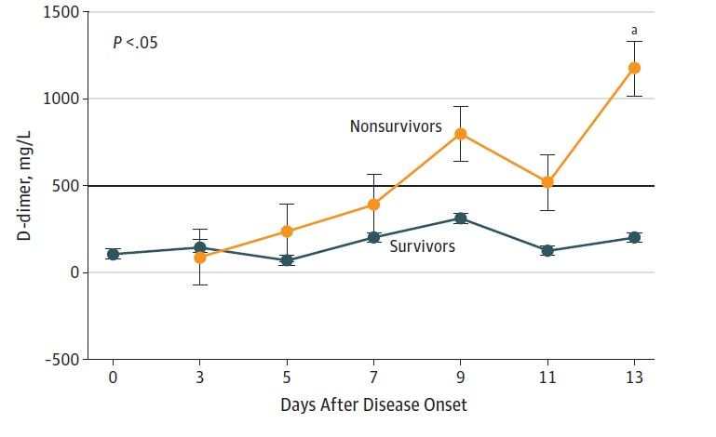
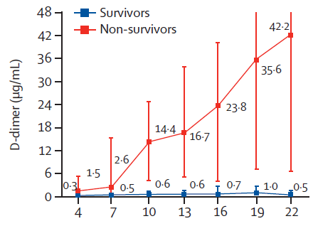
COVID-19 coagulopathy: initial reports (China)
Wang D et al, JAMA 2020
Zhou F et al, Lancet 2020

Slide 27
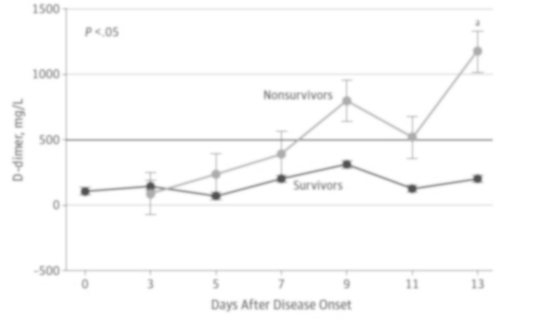
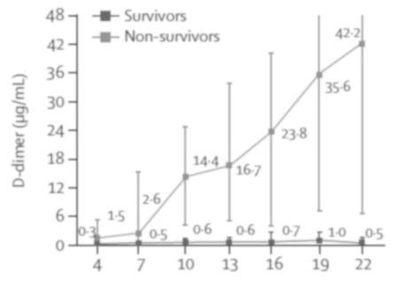

COVID-19 coagulopathy: initial reports (China)
Occurrence of VTE not mentioned
Wang D et al, JAMA 2020
Zhou F et al, Lancet 2020

Slide 28


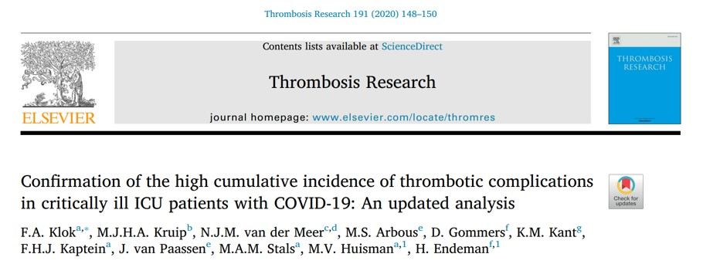
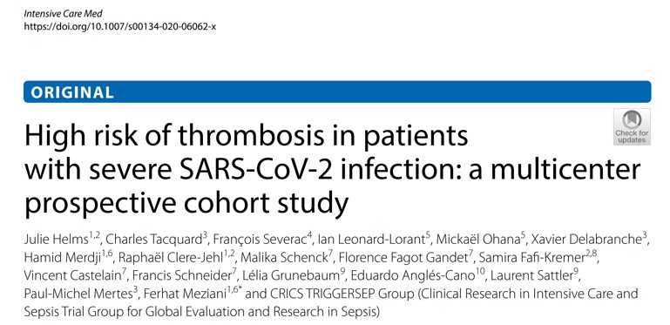



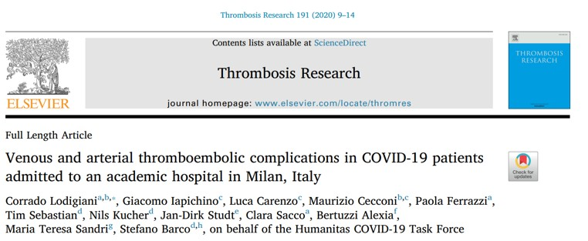
COVID-19 coagulopathy: initial reports (Europe)

Slide 29
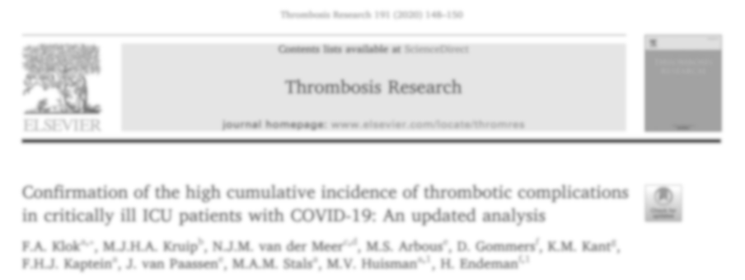
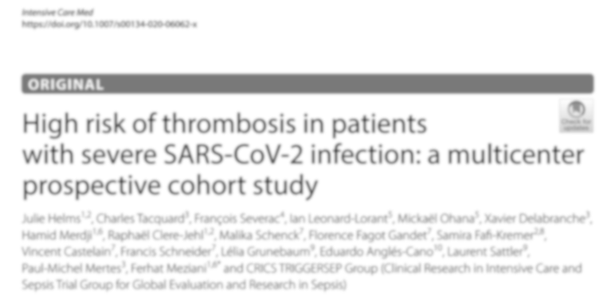

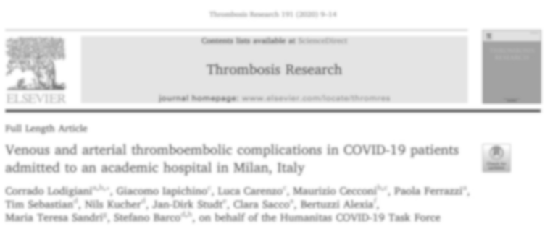
COVID-19 coagulopathy: initial reports (Europe)
Incidence of VTE in ICU 17-70%

Slide 30
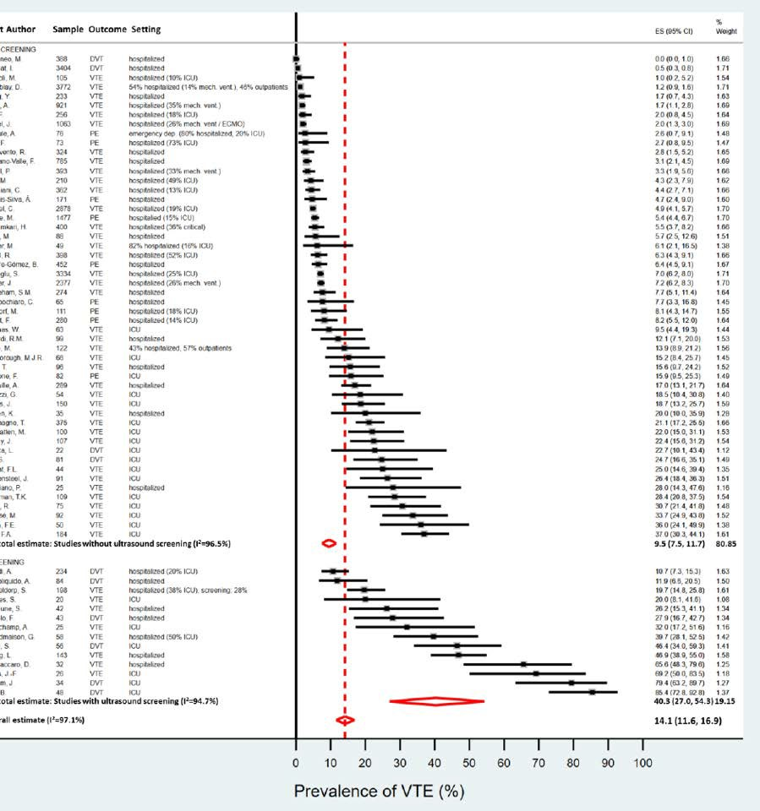
COVID-19: incidence of VTE
9.5% (95%CI 7.5-12)
40% (95%CI 27-54)
Nopp S et al, RPTH 2020

Slide 31
Precise rates of VTE were (are?) uncertain
COVID
Non-COVID
Limitations
Many small studies, few RCTs
Most have high likelihood of bias
Differences/challenges in diagnosis (e.g. screening vs. symptomatic)
Definition of VTE (e.g. proximal vs. distal)
Different prophylaxis strategies
New variants and treatments over time
Blood Adv (2018) 2 (22): 3198–3225. Middeldorp et al, J Thromb Haemost 2020. Schunemann et al., Blood Adv 2018;2:3198-225. Cook et al, N Engl J Med 2011;364:1305-14.

Slide 32
Uncertainty of evidence = ongoing challenge
Evolving evidence over time highlights rationale for “living guideline”
Baseline risk studies
Effect of anticoagulation
Large number of studies (many low quality, few trials)
Lack of definitions and/or descriptions of outcomes and measurement
Incomplete/missing follow-up
Uncertain baseline risk in 2024
Disparities across populations
Confounding with use of different intensities in selected patients
Lack of details regarding anticoagulant intensities
Pragmatic open-label trial design (co-interventions)
Uncertain benefit/harm in 2024
Individualized assessment of thrombosis and bleeding

Slide 33



Beneficial non-anticoagulant mechanisms?
X
Reduces viral entry to host cells
Reduces NET formation
Inhibits heparanase

Slide 34
Intensive anticoagulant therapy beneficial?
+
-
High incidence of VTE
Beneficial non-anticoagulant mechanisms (?)
Immunothrombosis
Overdiagnosis of VTE (?)

Slide 35
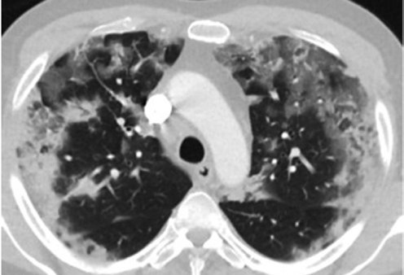
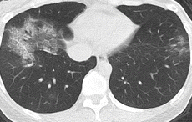
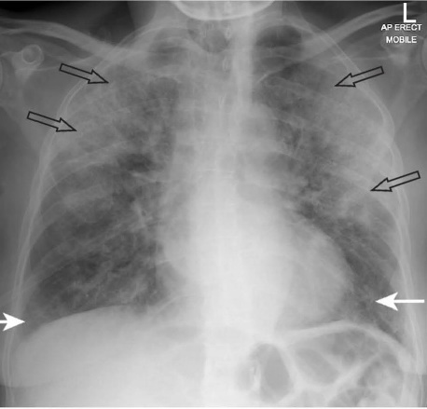
Case Presentations
Patient T |  | Patient K
♂, Chinese, 73 years |  | ♂, White, 52 years
BMI 34 kg/m², DM, hypertension |  | BMI 23 kg/m², Asthma
COVID-19 day 10 |  | COVID-19 day 6
High fever, dyspneic at rest |  | Anosmia, shortness of breath with exercise
HR 123/min, RR 42/min, Sat 83% at 15L O2 |  | HR 95/min, RR 20/min, sat 90% at room air
Patient X
♀, Black, 68 years
BMI 31 kg/m², rheumatoid arthritis
COVID-19 day 10
Hospitalized x 6 days, supplemental oxygen by nasal cannula, remdesivir
Off oxygen, mobilizing well

Slide 36
Million Dollar Question
What would be the optimal anticoagulant strategy in these 3 patients?

Slide 37

Case 1: COVID-19 Related Critical Illness
Patient T
♂, Chinese, 73 years
BMI 34 kg/m², DM, hypertension
COVID-19 day 10
High fever, dyspneic at rest
HR 123/min, RR 42/min, Sat 83% at 15L O2

Slide 38
Question #1
Should DOACs, LMWH, UFH, fondaparinux, argatroban, or bivalirudin at intermediate- or therapeutic-intensity vs. prophylactic-intensity be used for patients with COVID-19 related critical illness who do not have suspected or confirmed VTE?

Slide 39
Which ONE of the following options would you suggest for thromboprophylaxis in a hospitalized patient with COVID-19 related critical illness who does not have suspected or confirmed VTE?
Intermediate- or therapeutic-intensity anticoagulation
Prophylactic-intensity anticoagulation
Graduated compression stockings
No prophylaxis because patient is at low thrombosis risk

Slide 40
Which ONE of the following options would you suggest for thromboprophylaxis in a hospitalized patient with COVID-19 related critical illness who does not have suspected or confirmed VTE?
Intermediate- or therapeutic-intensity anticoagulation
Prophylactic-intensity anticoagulation
Graduated compression stockings
No prophylaxis because patient is at low thrombosis risk

Slide 41
Should DOACs, LMWH, UFH, Fondaparinux, Argatroban, or Bivalirudin at intermediate-intensity vs. Prophylactic intensity be used for Patients with COVID-19 related critical illness who do not have suspected or confirmed VTE?
POPULATION: | Patients with COVID-19 related critical illness who do not have suspected or confirmed VTE
INTERVENTION: | DOACs, LMWH, UFH, Fondaparinux, Argatroban, or Bivalirudin at intermediate-intensity
COMPARISON: | Prophylactic-intensity
MAIN OUTCOMES: | Mortality; Pulmonary embolism; Deep Venous Thrombosis of the upper leg (Proximal lower extremity DVT); Major bleeding; Multiple Organ Failure; Ischemic stroke (severe); Intracranial hemorrhage; Invasive mechanical ventilation; Limb amputation; ST-elevation myocardial infarction; Length of hospital admission; Length of ICU admission;

Slide 42
Outcomes | № of participants (studies) | Certainty of the evidence (GRADE) | Relative effect (95% CI) | Anticipated absolute effects (95% CI)
 |  |  |  | Risk with Prophylactic intensity | Risk with DOACs, LMWH, UFH, Fondaparinux, Argatroban, or Bivalirudin at intermediate-intensity
MORTALITY follow up: range 7 days to 30 days | 891 (3 RCTs) | ●●●● VERY LOW | OR 0.92 (0.62 to 1.37) | 278 per 1,000 | 16 fewer per 1,000 (from 85 fewer to 67 more)
PE follow up: range 7 days to 30 days | 891 (3 RCTs) | ●●●● VERY LOW | OR 0.55 (0.12 to 2.62) | 78 per 1,000 | 34 fewer per 1,000 (from 68 fewer to 103 more)
PROXIMAL LOWER EXTREMITY DVT follow up: range 7 days to 30 days | 891 (3 RCTs) | ●●●● VERY LOW | OR 0.93 (0.23 to 3.80) | 41 per 1,000 | 3 fewer per 1,000 (from 31 fewer to 99 more)
MAJOR BLEEDING follow up: range 7 days to 30 days | 891 (3 RCTs) | ●●●● LOW | OR 1.50 (0.63 to 3.58) | 34 per 1,000 | 16 more per 1,000 (from 12 fewer to 78 more)

Slide 43
Should DOACs, LMWH, UFH, Fondaparinux, Argatroban, or Bivalirudin at therapeutic-intensity vs. Prophylactic intensity be used for Patients with COVID-19 related critical illness who do not have suspected or confirmed VTE?
POPULATION: | Patients with COVID-19 related critical illness who do not have suspected or confirmed VTE
INTERVENTION: | DOACs, LMWH, UFH, Fondaparinux, Argatroban, or Bivalirudin at therapeutic-intensity
COMPARISON: | Prophylactic-intensity
MAIN OUTCOMES: | Mortality; Pulmonary embolism; Deep Venous Thrombosis of the upper leg (Proximal lower extremity DVT); Major bleeding; Multiple Organ Failure; Ischemic stroke (severe); Intracranial hemorrhage; Invasive mechanical ventilation; Limb amputation; ST-elevation myocardial infarction; Length of hospital admission; Length of ICU admission;

Slide 44
Outcomes | № of participants (studies) | Certainty of the evidence (GRADE) | Relative effect (95% CI) | Anticipated absolute effects (95% CI)
 |  |  |  | Risk with Prophylactic intensity | Risk with DOACs, LMWH, UFH, Fondaparinux, Argatroban, or Bivalirudin at intermediate-intensity
MORTALITY follow up: range 7 days to 30 days | 1951 (7 RCTs) | ●●●● VERY LOW | OR 0.90 (0.70 to 1.17) | 278 per 1,000 | 21 fewer per 1000 (from 66 fewer to 33 more)
PE follow up: range 7 days to 30 days | 1942 (7 RCTs) | ●●●● VERY LOW | OR 0.40 (0.26 to 0.61) | 78 per 1,000 | 45 fewer per 1000 (from 56 fewer to 29 fewer)
PROXIMAL LOWER EXTREMITY DVT follow up: range 7 days to 30 days | 1942 (7 RCTs) | ●●●● VERY LOW | OR 0.73 (0.42 to 1.24) | 41 per 1,000 | 11 fewer per 1000 (from 23 fewer to 9 more)
MAJOR BLEEDING follow up: range 7 days to 30 days | 1944 (7 RCTs) | ●●●● LOW | OR 1.78 (1.00 to 3.18) | 34 per 1,000 | 25 more per 1000 (from 0 fewer to 67 more)

Slide 45
Recommendation
The ASH guideline panel suggests using prophylactic-intensity over intermediate- intensity or therapeutic-intensity anticoagulation in patients with COVID-19 related critical illness who do not have suspected or confirmed VTE (Conditional recommendation based on very low certainty in the evidence about effects)
The panel agreed that there was less uncertainty regarding the influence on undesirable effects (bleeding) compared with desirable effects (mortality and VTE). This was driven by extensive indirect evidence of dose-dependent effects of anticoagulation on bleeding.
Individualized assessment
No validated risk assessment models for in patients with COVID-19
No direct high-quality evidence comparing different anticoagulants

Slide 46
Case 2: COVID-19 related acute illness
Patient K
♂, White, 52 years
BMI 23 kg/m², Asthma
COVID-19 day 6
Anosmia, shortness of breath with exercise
HR 95/min, RR 20/min, sat 90% at room air

Slide 47
Question #2
Should DOACs, LMWH, UFH, fondaparinux, argatroban, or bivalirudin at intermediate-intensity or therapeutic-intensity vs. prophylactic-intensity be used for patients with COVID-19 related acute illness who do not have suspected or confirmed VTE?

Slide 48
Which ONE of the following options would you suggest for thromboprophylaxis in a hospitalized patient with COVID-19 related acute illness who does not have suspected or confirmed VTE?
Intermediate- or therapeutic-intensity anticoagulation
Prophylactic-intensity anticoagulation
Graduated compression stockings
No prophylaxis because patient is at low thrombosis risk

Slide 49
Which ONE of the following options would you suggest for thromboprophylaxis in a hospitalized patient with COVID-19 related acute illness who does not have suspected or confirmed VTE?
Intermediate- or therapeutic-intensity anticoagulation
Prophylactic-intensity anticoagulation
Graduated compression stockings
No prophylaxis because patient is at low thrombosis risk

Slide 50
Should DOACs, LMWH, UFH, Fondaparinux, Argatroban, or Bivalirudin at Intermediate-intensity vs. Prophylactic-intensity be used for Patients with COVID-19 related acute illness who do not have suspected or confirmed VTE (PICO 2a)?
POPULATION: | Patients with COVID-19 related acute illness who do not have suspected or confirmed VTE
INTERVENTION: | DOACs, LMWH, UFH, Fondaparinux, Argatroban, or Bivalirudin at Intermediate-intensity
COMPARISON: | Prophylactic-intensity
MAIN OUTCOMES: | All-cause mortality; Pulmonary embolism - Moderate severity; Deep Venous Thrombosis of the upper leg - Moderate severity; Major bleeding; Multiple organ failure; Ischemic stroke - Severe; Intracranial hemorrhage; Invasive mechanical ventilation - Long-term; Limb amputation; ICU hospitalization; ST-elevation myocardial infarction

Slide 51
Outcomes | № of participants (studies) | Certainty of the evidence (GRADE) | Relative effect (95% CI) | Anticipated absolute effects (95% CI)
 |  |  |  | Risk with prophylactic- intensity | Risk difference with anticoagulation at intermediate-intensity
ALL-CAUSE MORTALITY follow-up: range 5 to 50 days | 445 (3 RCTs) | ●●●● VERY LOW | OR 1.49 (0.82 to 2.72) | 97 per 1,000 | 41 more per 1000 (from 16 fewer to 129 more)
PE follow-up: range 4 to 34 days | 445 (3 RCTs) | ●●●● VERY LOW | OR 0.51 (0.10 to 2.67) | 26 per 1,000 | 13 fewer per 1000 (from 23 fewer to 41 more)
PROXIMAL LOWER EXTREMITY DVT follow up: range 4 to 34 days | 445 (3 RCTs) | ●●●● VERY LOW | not estimable | 8 per 1,000 | --
MAJOR BLEEDING follow up: range 5 to 30 days | 445 (3 RCTs) | ●●●● VERY LOW | OR 1.01 (0.06 to 16.41) | 13 per 1,000 | 0 fewer per 1000 (from 12 fewer to 165 more)
MULTIPLE ORGAN FAILURE follow up: mean 30 days | 183 (1 RCT) | ●●●● VERY LOW | OR 1.53 (0.25 to 9.40) | 49 per 1,000 | 24 more per 1000 (from 36 fewer to 277 more)

Slide 52
Should DOACs, LMWH, UFH, Fondaparinux, Argatroban, or Bivalirudin at Therapeutic-intensity vs. Prophylactic-intensity be used for Patients with COVID-19 related acute illness who do not have suspected or confirmed VTE (PICO 2b)?
POPULATION: | Patients with COVID-19 related acute illness who do not have suspected or confirmed VTE
INTERVENTION: | DOACs, LMWH, UFH, Fondaparinux, Argatroban, or Bivalirudin at Therapeutic-intensity
COMPARISON: | Prophylactic-intensity
MAIN OUTCOMES: | All-cause mortality; Pulmonary embolism - Moderate severity; Deep Venous Thrombosis of the upper leg - Moderate severity; Major bleeding; Multiple organ failure; Ischemic stroke - Severe; Intracranial hemorrhage; Invasive mechanical ventilation - Long-term; Limb amputation; ICU hospitalization; ST-elevation myocardial infarction;

Slide 53
Outcomes | № of participants (studies) | Certainty of the evidence (GRADE) | Relative effect (95% CI) | Anticipated absolute effects (95% CI)
 |  |  |  | Risk with prophylactic- intensity | Risk difference with anticoagulation at therapeutic-intensity
ALL-CAUSE MORTALITY follow-up: range 5 to 50 days | 7287 (9 RCTs) | ●●●● LOW | OR 0.80 (0.55 to 1.16) | 97 per 1,000 | 18 fewer per 1000 (from 41 fewer to 14 more)
PE follow-up: range 4 to 34 days | 7085 (9 RCTs) | ●●●● LOW | OR 0.53 (0.33 to 0.83) | 26 per 1,000 | 12 fewer per 1000 (from 17 fewer to 4 fewer)
PROXIMAL LOWER EXTREMITY DVT follow up: range 4 to 34 days | 7085 (9 RCTs) | ●●●● MODERATE | OR 0.58 (0.30 to 1.08) | 8 per 1,000 | 3 fewer per 1000 (from 6 fewer to 1 more)
MAJOR BLEEDING follow up: range 5 to 30 days | 7295 (9 RCTs) | ●●●● MODERATE | OR 1.92 (1.10 to 3.36) | 13 per 1,000 | 12 more per 1000 (from 1 more to 29 more)
MULTIPLE ORGAN FAILURE follow up: mean 30 days | 700 (3 RCTs) | ●●●● VERY LOW | OR 0.46 (0.03 to 6.59) | 49 per 1,000 | 26 fewer per 1000 (from 47 fewer to 204 more)

Slide 54
Recommendation
The guideline panel suggests using prophylactic-intensity over intermediate- intensity or therapeutic-intensity anticoagulation in patients with COVID-19 related acute illness who do not have suspected or confirmed VTE.
The ASH guideline panel suggests using prophylactic-intensity over intermediate- intensity or therapeutic-intensity anticoagulation in patients with COVID-19 related acute illness who do not have suspected or confirmed VTE. (Conditional recommendation based on very low certainty in the evidence about effects)
The panel agreed that there was less uncertainty regarding the influence on undesirable effects (bleeding) compared with desirable effects (mortality and VTE).
This was driven by extensive indirect evidence of dose- dependent effects of anticoagulation on bleeding.
Individualized assessment
No validated risk assessment models for in patients with COVID-19
No direct high-quality evidence comparing different anticoagulants

Slide 55

Case 3: Discharge from hospital
Patient X
♀, Black, 68 years
BMI 31 kg/m², rheumatoid arthritis on methotrexate and TNF inhibitor
COVID-19 day 10
Hospitalized x 6 days, supplemental oxygen by nasal cannula, remdesivir
Off oxygen, mobilizing well
Cleverley et al. BMJ 2020;370:bmj.m2426

Slide 56
Question #3
Should prophylactic-intensity DOACs, LMWH, UFH, Fondaparinux vs. no anticoagulation be used for post-discharge thromboprophylaxis in patients with COVID-19 who are being discharged from the hospital and who do not have suspected or confirmed VTE or another indication for anticoagulation?

Slide 57
Which ONE of the following options would you suggest for a patient with COVID-19 being discharged from the hospital and who does not have suspected or confirmed VTE or another indication for anticoagulation?
A. Intermediate- or therapeutic-intensity anticoagulation
B. No anticoagulation
C. Prophylactic-intensity anticoagulation
D. Aspirin

Slide 58
Which ONE of the following options would you suggest for a patient with COVID-19 being discharged from the hospital and who does not have suspected or confirmed VTE or another indication for anticoagulation?
A. Intermediate- or therapeutic-intensity anticoagulation
B. No anticoagulation
C. Prophylactic-intensity anticoagulation
D. Aspirin

Slide 59
Should prophylactic-intensity DOACs, LMWH, UFH, Fondaparinux vs. no anticoagulation be used for post-discharge thromboprophylaxis in patients with COVID-19 who are being discharged from the hospital and who do not have suspected or confirmed VTE or another indication for anticoagulation?
POPULATION: | patients with COVID-19 who are being discharged from the hospital and who do not have suspected or confirmed VTE or another indication for anticoagulation
INTERVENTION: | prophylactic-intensity DOACs, LMWH, UFH, Fondaparinux
COMPARISON: | No anticoagulation
MAIN OUTCOMES: | Mortality; Pulmonary Embolism; Deep Venous Thrombosis; Venous Thromboembolism; Major Bleeding; Ischemic Stroke; ST-elevation Myocardial Infarction; Readmission

Slide 60
Outcomes | № of participants (studies) | Certainty of the evidence (GRADE) | Relative effect (95% CI) | Anticipated absolute effects (95% CI)
 |  |  |  | Risk with no anticoagulation | Risk difference with anticoagulation at prophylactic-intensity
ALL-CAUSE MORTALITY follow up: range 6 to 90 days | 1535 (2 RCTs) | ●●●● LOW | OR 0.84 (0.37 to 1.89) | 19 per 1,000 | 3 fewer per 1000 (from 12 fewer to 16 more)
PE follow up: range 30 to 90 days | 1535 (2 RCTs) | ●●●● LOW | OR 0.66 (0.08 to 5.44) | 7 per 1,000 | 2 fewer per 1000 (from 6 fewer to 30 more)
PROXIMAL LOWER EXTREMITY DVT follow up: range 30 to 42 days | 1535 (2 RCTs) | ●●●● MODERATE | OR 0.51 (0.08 to 3.29) | 3 per 1,000 | 1 fewer per 1000 (from 3 fewer to 7 more)
MAJOR BLEEDING follow up: range 30 to 92 days | 1535 (2 RCTs) | ●●●● LOW | OR 1.99 (0.18 to 22.04) | 3 per 1,000 | 3 more per 1000 (from 2 fewer to 59 more)

Slide 61
Recommendation
The ASH guideline panel suggests against using outpatient anticoagulant thromboprophylaxis in patients with COVID-19 who are being discharged from the hospital and who do not have suspected or confirmed VTE or another indication for anticoagulation (conditional recommendation based on very low certainty in the evidence about effects).
The panel acknowledged that post-discharge thromboprophylaxis may be reasonable in patients judged to be at high thrombotic risk and low
bleeding risk.
An individualized assessment of the patient’s risk of thrombosis and bleeding and shared decision-making is important when deciding whether to use post-discharge thromboprophylaxis.

Slide 62
Very low certainty of evidence
Baseline risk studies
Effect of anticoagulation studies
Lack of definitions and/or descriptions of outcome measurement
Incomplete/missing follow-up
Incidence rates not reported (i.e. events per unit of follow-up)
Confounding with use of higher intensities in selected patients
Lack of details regarding reported anticoagulant intensities

Slide 63
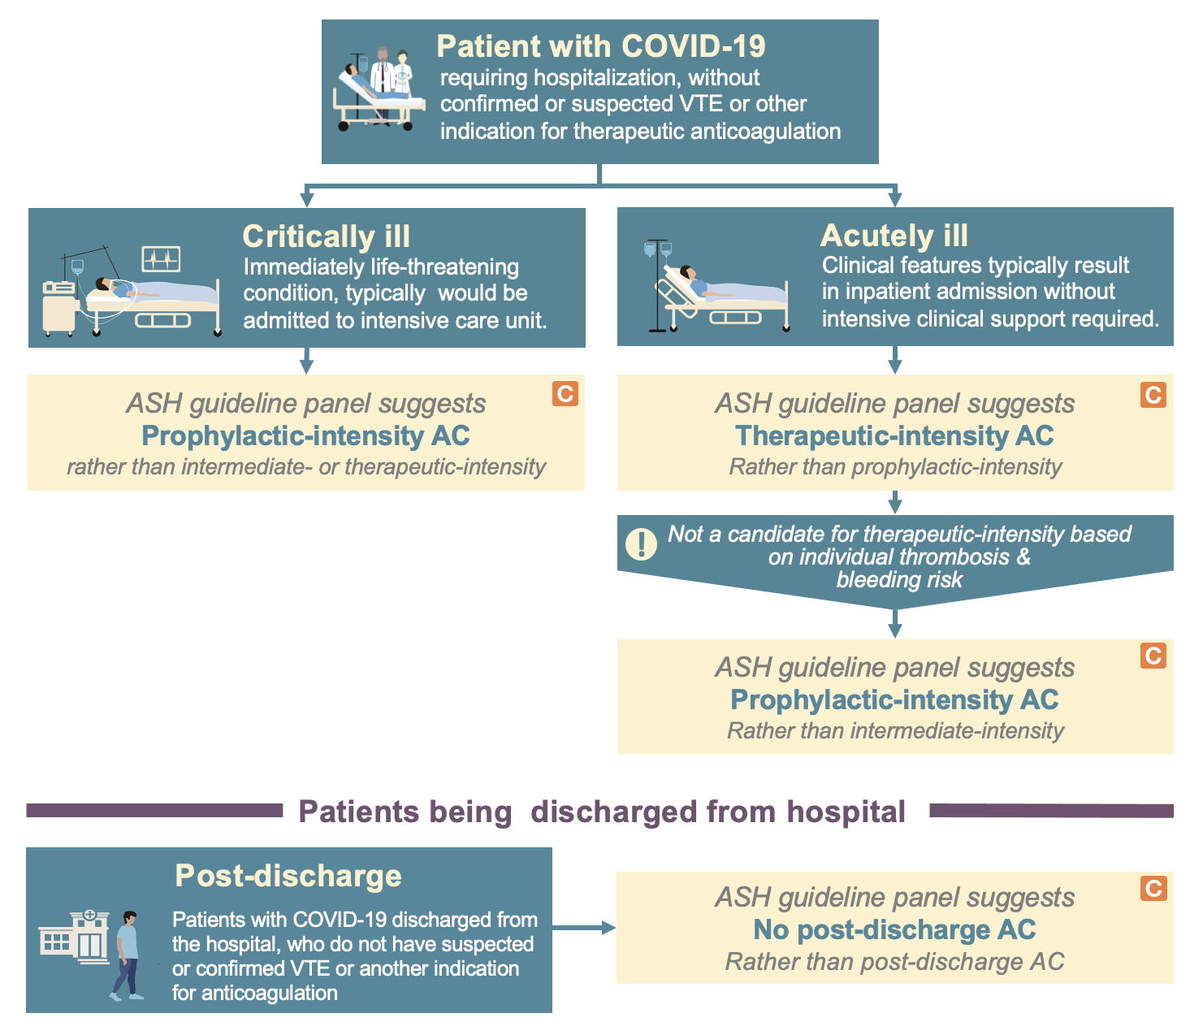
Putting it all together:
Executive summary and algorithm

Slide 64
In Summary: Back to our Objectives
Describe VTE prophylaxis recommendations for hospitalized patients with COVID-19 related critical illness who do not have suspected or confirmed VTE
  Intermediate- or therapeutic-intensity versus prophylactic intensity anticoagulation
Describe VTE prophylaxis recommendations for hospitalized patients with COVID-19 related acute illness who do not have suspected or confirmed VTE
  Intermediate- or therapeutic-intensity versus prophylactic intensity anticoagulation
Describe VTE prophylaxis recommendations for Patients who have been discharged after hospitalization for COVID-19 who do not have suspected or confirmed VTE
  Post-discharge prophylactic intensity anticoagulation

Slide 65
Acknowledgements
ASH Guideline Panel team members
Knowledge Synthesis team members
McMaster University GRADE Centre
Author of ASH VTE Slide Sets: Deborah Siegal, MD, MSc, Robby Nieuwlaat, PhD, MSc, Adam Cuker, MD, MS, Erik Klok, MD, PhD
See more about the ASH VTE guidelines at www.hematology.org/COVIDguidelines

