Slide 1
Stem Cell Transplantation for Sickle Cell Disease
An Educational Slide Set
American Society of Hematology 2021 Guidelines for Sickle Cell Disease Stem Cell Transplantation
Slide Set Authors: Akshay Sharma, MBBS, St. Jude Children’s Research Hospital, Memphis, TN and John Tisdale, MD, Cellular and Molecular Therapeutics Branch, NHLBI, National Institutes of Health, Bethesda, MD

Slide 2
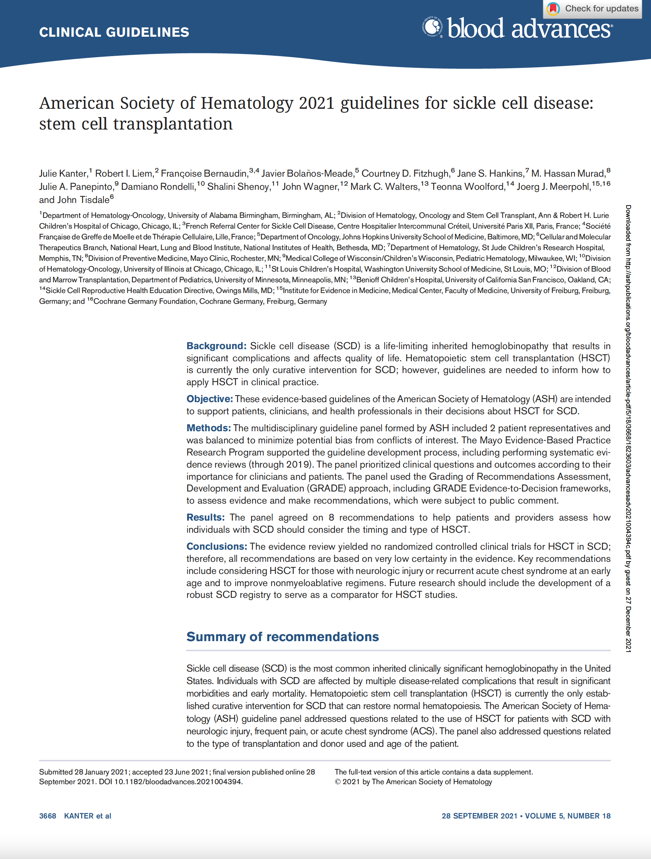
Clinical Guidelines
American Society of Hematology 2021 guidelines for sickle cell disease: stem cell transplantation
Julie Kanter, Robert I. Liem, Francoise Bernaudin, Javier Bolanos-Meade, Courtney D. Fitzhugh, Jane S. Hankins, M. Hassan Murad, Julie A. Panepinto, Damiano Rondelli, Shalini Shenoy, John Wagner, Mark C. Walters, Teonna Woolford, Joerg J. Meerpohl, and John Tisdale
Julie Kanter, Robert I. Liem, Françoise Bernaudin, Javier Bolaños-Meade, Courtney D. Fitzhugh, Jane S. Hankins, M. Hassan Murad, Julie A. Panepinto, Damiano Rondelli, Shalini Shenoy, John Wagner, Mark C. Walters, Teonna Woolford, Joerg J. Meerpohl, John Tisdale; American Society of Hematology 2021 guidelines for sickle cell disease: stem cell transplantation. Blood Adv 2021; 5 (18): 3668–3689. doi: https://doi.org/10.1182/bloodadvances.2021004394C

Slide 3
ASH Clinical Practice Guidelines on SCD
1. Cardiopulmonary and Kidney Disease
2. Transfusion Support
3. Cerebrovascular Disease
4. Acute and Chronic Pain
5. Stem Cell Transplantation

Slide 4
How were these ASH guidelines developed?
PANEL FORMATION
Each guideline panel was formed following these key criteria:
Balance of expertise (including disciplines beyond hematology, and patients)
Close attention to minimization and management of conflicts of interest
CLINICAL QUESTIONS
10 clinically-relevant questions generated in PICO format (population, intervention, comparison, outcome)
EVIDENCE SYNTHESIS
Evidence summary generated for each PICO question via systematic review of health effects plus:
Resource use
Feasibility
Acceptability
Equity
Patient values and preferences
MAKING RECOMMENDATIONS
Recommendations made by guideline panel members based on evidence for all factors.
Example: PICO question
“Should individuals with SCD and neurologic injury, including overt stroke, SCI, or abnormal TCD, undergo MSD transplantation??”
ASH guidelines are reviewed annually by expert work groups convened by ASH. Resources, such as this slide set, derived from guidelines that require updating are removed from the ASH website.

Slide 5
How to use these recommendations

Slide 6
Key terms: SCD related adverse events
Stroke
acute neurologic injury of the brain, retina, or spinal cord that occurs as a result of ischemia or hemorrhage that last longer than 24 hours.
Silent cerebral infarction (SCI)/silent stroke
a lesion visible by magnetic resonance imaging (MRI) images with no associated findings on neurologic exam.
can be correlated with neurocognitive and behavioral deficits.
Acute chest syndrome (ACS)
a new radiodensity on chest radiograph together with fever and/or respiratory symptoms.

Slide 7
Key terms in stem cell transplantation
Matched donor
A donor who is at least identical to the recipient at 8/8 or 10/10 human leucocyte antigen (HLA) loci.
A matched donor can be a sibling (matched sibling donor or MSD) or unrelated (matched unrelated donor or MUD).
Graft versus host disease (GVHD)
An immunological complication of allogeneic hematopoietic stem cell transplantation (HSCT).
Graft failure
A condition wherein the blood cell counts decrease following HSCT, or the proportion of the donor cells declines below a critical level in the peripheral blood and bone marrow.

Slide 8
Objectives
By the end of this session, you should be able to:
Describe recommendations for HSCT in individuals with SCD in high-income settings.
Describe recommendations for choice of:
conditioning regimen
alternative donor
graft source
… in individuals undergoing HSCT for SCD.

Slide 9
Background and Introduction

Slide 10
Comparing HSCT and Standard of Care for SCD
HSCT is a potential 1-time curative therapy for SCD.
HSCT for SCD is evolving - new conditioning regimens, alternative donors and methods of cell harvesting, and strategies for GVHD prevention.
Success rates after HSCT are improving, but survival rates in children and adults with SCD receiving disease-modifying medication and supportive therapy are improving as well.
Short- and long-term risks of HSCT must be considered in comparison to the currently approved therapies and new potentially curative therapies under development.

Slide 11
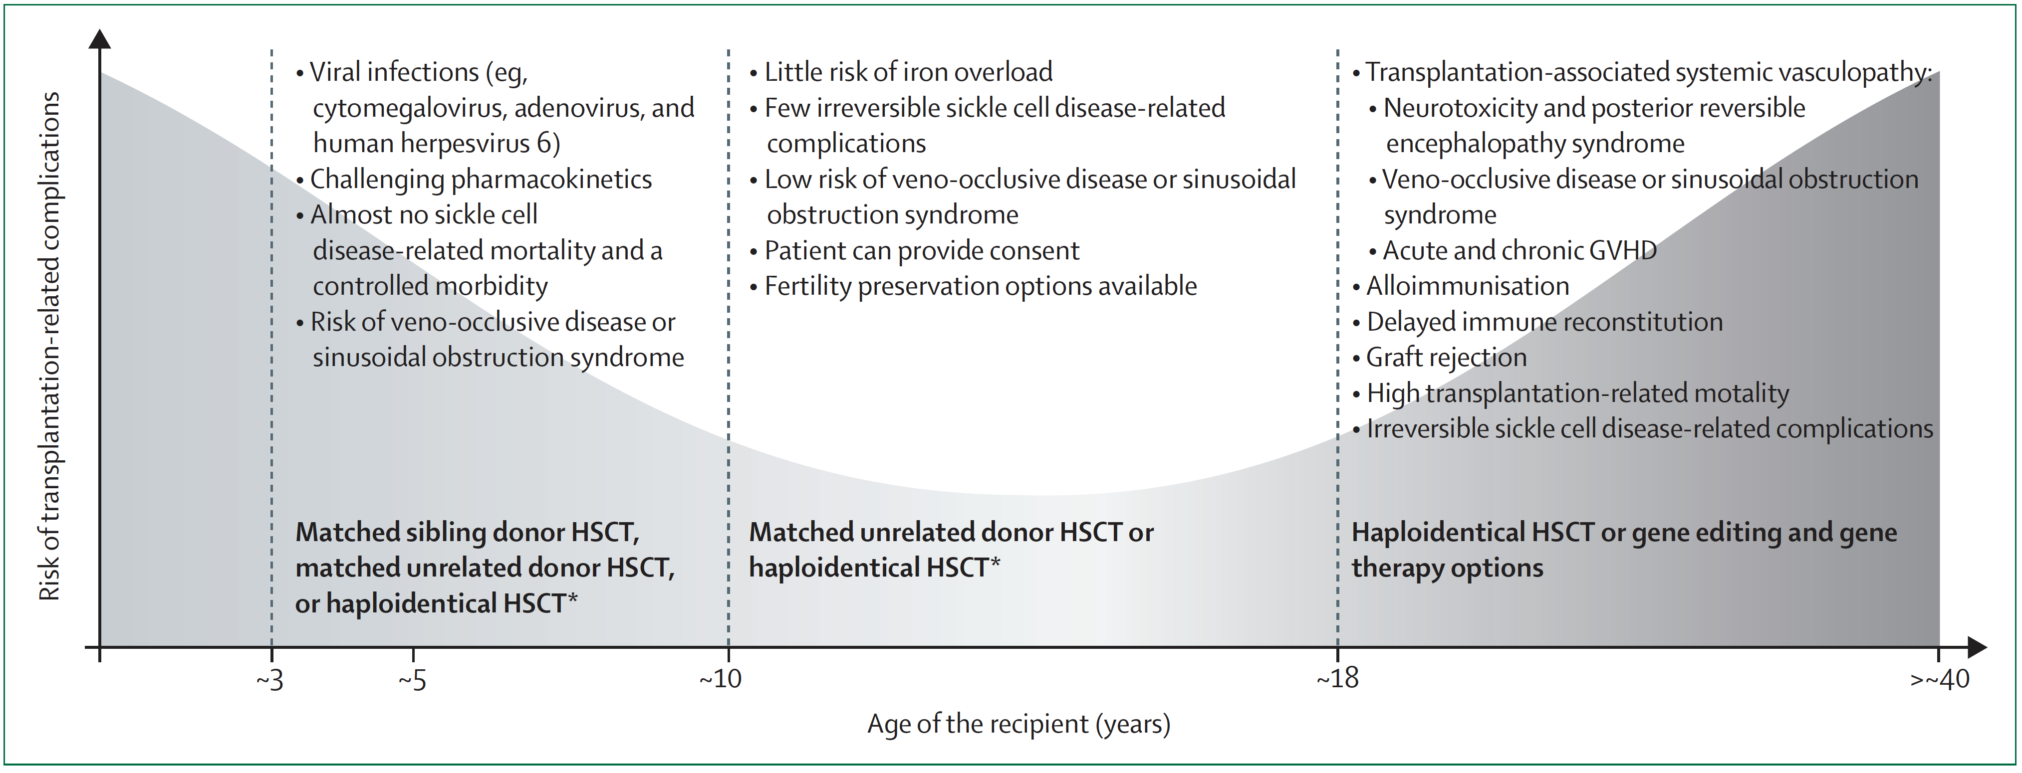
Risk of HSCT related complications with age
aa
de la Fuente et al. Lancet Haematol 2020.

Slide 12
Case 1: Patient with neurological injury
A 4-year-old male with HbSS living in the United States, presents to your clinic for an annual visit. The child has recently had two abnormal TCD measurements (high MCA velocity). He is receiving hydroxyurea with good compliance since he was 2 years old. He has an HLA-matched 8-year-old sibling who has sickle cell trait. What is the next best step?
Repeat TCD in 1 year.
Continue hydroxyurea, but increase the dose.
Start transfusion/apheresis to reduce sickle hemoglobin level.
Discuss hematopoietic cell transplantation using the HLA-matched sibling as a donor.

Slide 13
HSCT for SCD patients with neurological injury: Recommendations
HLA-matched related HSCT is suggested over standard of care (hydroxyurea/transfusion) in patients with SCD who have experienced an overt stroke or have an abnormal transcranial Doppler ultrasound (TCD) (conditional recommendation. very low certainty in the evidence).
When considering transplantation for neurologic injury, children younger than age 16 years who receive matched sibling donor (MSD) HSCT have better outcomes than those older than age 16 years.

Slide 14
HSCT for SCD patients with neurological injury: Rationale
Neurologic injury caused by overt stroke and SCI is a major complication of SCD.
Up to 24% SCD patients could be affected by stroke.
Chronic red cell transfusion (CRCT) and other supportive care therapy are useful in stroke prevention but not curative.
Long-term CRCT is associated with risks such as alloimmunization and transfusional iron overload.
Therefore, efforts to prevent primary or secondary stroke have focused on curative options such as HSCT.

Slide 15
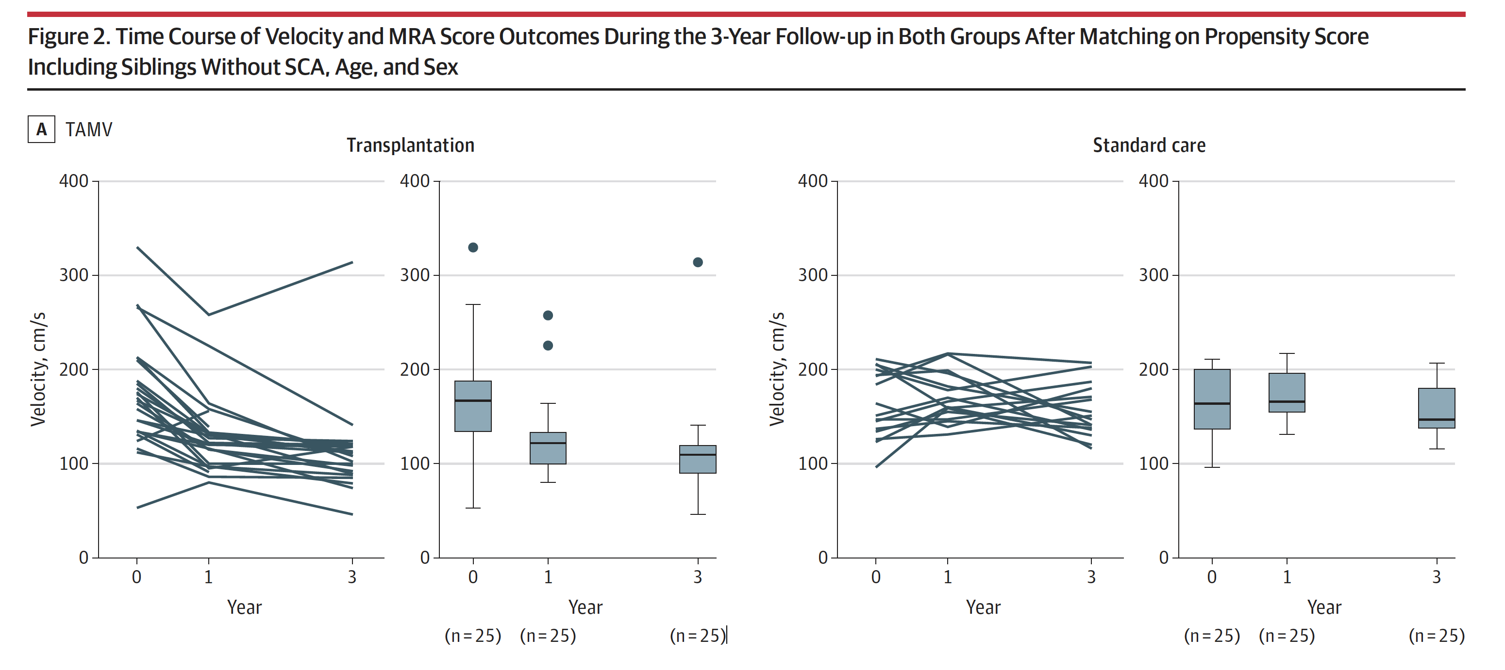
HSCT vs CRCT for SCD patients with neurological injury
TCD improved in those who received HSCT. New SCI developed in 3 patients who were receiving CRCT.
Bernaudin et al. JAMA 2019.

Slide 16
Case 2: Patient with severe symptoms
A 9-year-old female with HbSβ⁰ thalassemia has had 2 episodes of acute chest syndrome in the last 1 year. During the last episode, she required intensive care treatment and intubation. She has 3 siblings who do not have SCD. What is the next best step?
Continue current management.
Refer for gene therapy on a clinical trial.
Start transfusion/apheresis to reduce sickle hemoglobin level.
Perform HLA typing of the siblings to find a potential donor for HSCT.

Slide 17
HSCT for SCD patients with severe symptoms: Recommendations
For patients with frequent pain or recurrent episodes of acute chest syndrome, consideration for transplantation should be given to patients who do not respond or have an inadequate response to standard of care, such as HU, new targeted therapies, or chronic transfusion therapies.
For patients with SCD with an indication for HSCT who lack an MSD, suggest using transplants from alternative donors in the context of a clinical trial.
Alternative donor transplantation has the potential to improve or resolve disease manifestations in patients with severe SCD.
The risks related to transplantation complications should be balanced with benefits derived from successful transplantation.

Slide 18
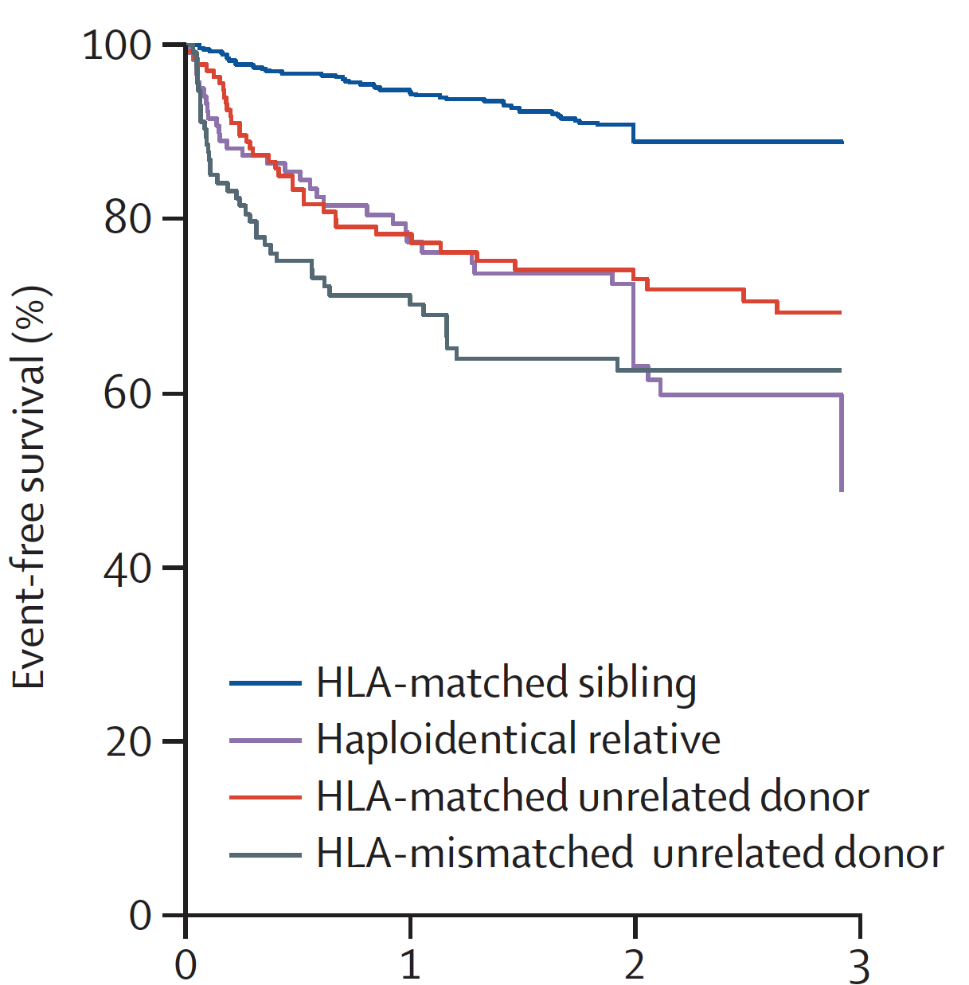
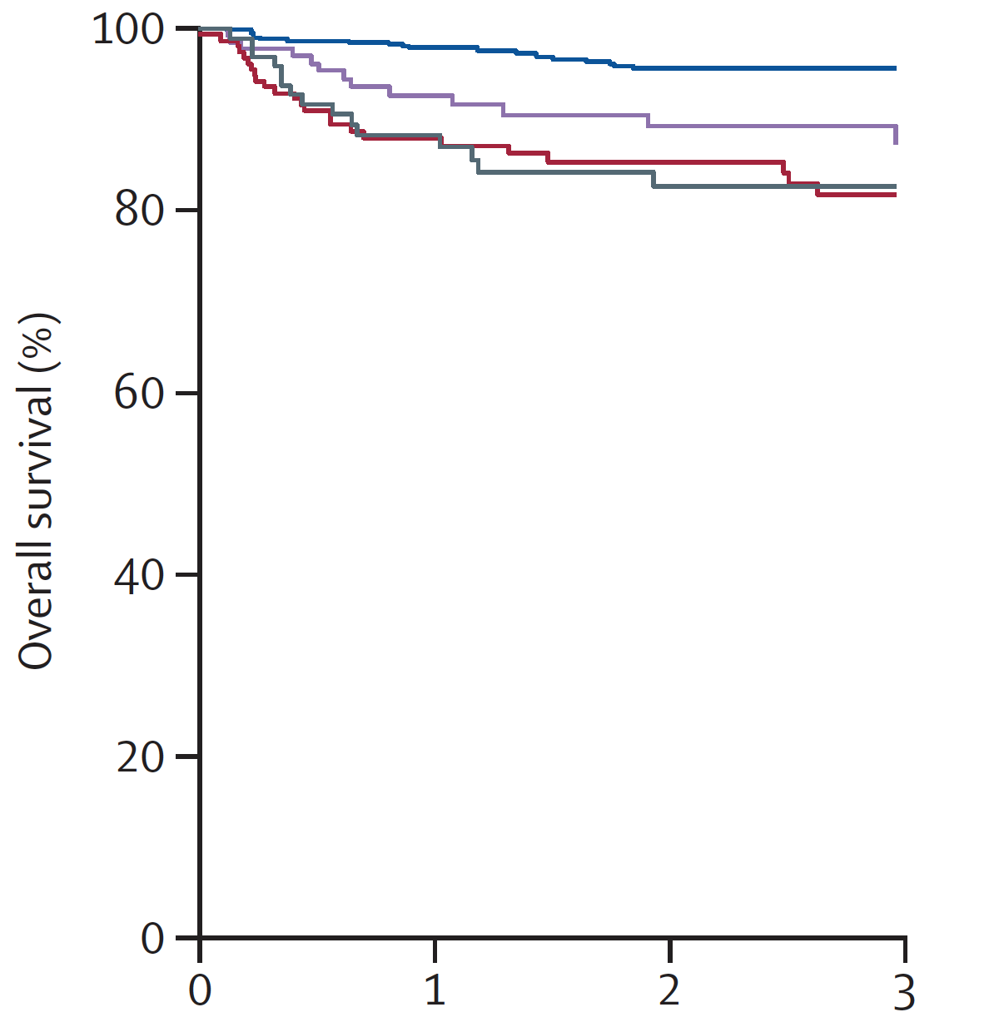
HSCT using alternative donors
Eapen et al. Lancet Haematology 2019.

Slide 19
HSCT for SCD patients with severe symptoms: Rationale
Patient-reported outcomes of pain intensity and pain impact improved post-HSCT in a subset of patients with only intermittent pain pre-HSCT.
However, some patients (~40%) continue to experience pain post-HSCT. HSCT may not ameliorate chronic pain.
ACS events no longer occur in patients in whom HSCT is successful.
HSCT offers prospect of improved quality of life and prolonged survival when standard of care therapy is not successful.

Slide 20
Considerations for an allogeneic HSCT (conditional recommendations)
Suggest using either total-body irradiation (TBI) #400 cGy or chemotherapy-based conditioning regimens for allo HSCT.
In children with MSD, use myeloablative conditioning regimens over reduced intensity conditioning (RIC).
In adults with MSD, use non-myeloablative conditioning over RIC.
In patients with an indication, perform transplant at an earlier age than at an older age (no recommendation if no MSD available, impact of age on outcome may be related to conditioning regimen used).
If HLA-identical sibling cord blood unit is available with good cell dose and viability, it is preferred over bone marrow .

Slide 21
Considerations for an allogeneic HSCT: Conditioning regimen
Chemotherapy-based myeloablative conditioning with busulfan and cyclophosphamide, with or without serotherapy with anti-thymocyte globulin, is the standard of care for pediatric patients with SCD undergoing MSD HSCT.
Incidence of graft failure is higher after RIC compared to myeloablative conditioning.
Nonmyeloablative regimens based on low-dose TBI have been developed and seem highly effective in reversing the disease in adult patients.
Better tolerated than chemotherapy-based conditioning in adults.
Potential for fertility preservation.

Slide 22
Age at HSCT and relationship to conditioning intensity
With myeloablative conditioning, EFS was highest in children younger than age 13 years and with an MSD.
Patients older than age 13 years had not only lower EFS but also lower OS and higher chronic GVHD risk.
With myeloablative conditioning, the risk of chronic GVHD is significantly higher in those older than 15 years of age.
Nonmyeloablative conditioning demonstrated no chronic GVHD or associated transplantation-related mortality.
However, EFS was only 87%, because 13% had graft rejection.

Slide 23
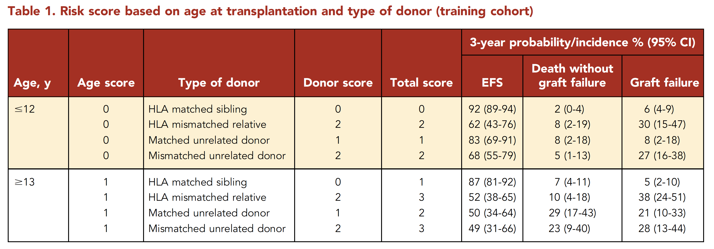
Risk score to predict outcomes after HSCT
Brazauskas et al. Blood 2020.

Slide 24
Cord blood transplantation
Neutrophil and platelet recovery delayed after cord blood transplantation compared to bone marrow transplantation, but no increase in infections or non engraftment.
Trend towards lower acute and chronic GVHD with cord blood transplantation.
No difference in overall survival or event free survival with cord blood transplantation.
Hence cord blood transplantation preferred over bone marrow for SCD, provided sufficient cell dose is available.

Slide 25
Good Practice Statements
Ensure that potential patients have been seen and counseled by an SCD specialist in addition to a specialist in HSCT to review all available treatment options.
Providers should be adequately trained in the specialized care required by SCD patients, including supportive care, which differs from that of other disease states.
Disease and transplantation-related outcomes should be monitored in the short (<2 years) and long term (10-15 years) in all patients after HSCT.
Care providers should consider health literacy levels of patients and their families when advising on HSCT.
Care providers should consider the burdens of the HSCT procedure on patients and their families.
Shared decision making between patients and providers is suggested to establish optimal HSCT plans.
Notes:
A 'good practice' statement is one where there is high level of certainty that the recommendation will do more good than harm, but where there is little direct evidence

Slide 26
Acknowledgements
ASH guideline panel members
Mayo Clinic Evidence-Based Practice Research Program
ASH support team: Starr Webb, Kendall Alexander, Robert Kunkle
See more about the ASH SCD guidelines: https://hematology.org/SCDguidelines
Disclosures: Akshay Sharma is the St. Jude Children’s Research Hospital site principal investigator of clinical trials for genome editing of sickle cell disease sponsored by Vertex Pharmaceuticals/CRISPR Therapeutics (NCT03745287) and by Novartis (NCT04443907). The industry sponsors provide funding for the clinical trial, which includes salary support paid to Akshay Sharma’s institution. Akshay Sharma has received consultant fee from Spotlight Therapeutics, Medexus Inc. and Vertex Pharmaceuticals. He has also received research funding from CRISPR Therapeutics and honoraria from Vindico Medical Education.

