Slide 1
Diagnosis and Management of Severe and Very Severe Acquired Aplastic Anemia
An Educational Slide Set
American Society of Hematology 2026 guidelines for diagnosis and management of severe and very severe acquired aplastic anemia
Slide set authors: Dr. HyoJeong Han, Dr. Akshay Sharma

Slide 2
American Society of Hematology 2026 guidelines for the diagnosis and management of Severe and Very Severe Acquired Aplastic Anemia
Phillip Scheinberg, Debra A. O’Neal, Ana Lisa Basquiera, Michael T. Byrne, Rodrigo Calado, Ruchi Desai, Amy E. DeZern, Carlo Dufour, Emma M. Groarke, HyoJeong Han, Kohei Hosokawa, Rina Kansal, Austin Kulasekararaj, Sherif Beniameen Mossad, Petra Muus, Bhumika Patel, Antonio M. Risitano, Hubert Schrezenmeier, Akshay Sharma, Akiko Shimamura, Kristin A. Shimano, Fernando Tortosa, Camila Avila, Martin Ragusa, Ariel Izcovich, Ignacio Neumann

Slide 3
ASH Clinical Practice Guidelines on Aplastic Anemia (AA)
Diagnosis of AA
Frontline therapy
Second Line Therapy for Relapsed or Refractory AA
Timing of Second Line Therapy
Antimicrobial Prophylaxis for patients with AA
Use of Eltrombopag in Immunosuppressive Therapy (IST)

Slide 4
How were these guidelines developed?
PANEL FORMATION
Guideline panel was formed following these key criteria:
Balance of expertise (including disciplines beyond hematology)
Close attention to minimization and management of conflicts of interest
CLINICAL QUESTIONS
37 clinically-relevant questions generated in PICO format (population, intervention, comparison, outcome)
EVIDENCE SYNTHESIS
Evidence summary generated for each PICO question via systematic review of health effects plus:
Resource use
Feasibility
Acceptability
Equity
Patient values and preferences
MAKING RECOMMENDATIONS
Recommendations made by guideline panel members based on evidence for all factors.
Example: PICO question
“Should somatic mutation testing should be performed versus not performed in patients with severe or very severe aplastic anemia?”
ASH guidelines are reviewed annually by expert work groups convened by ASH. Resources, such as this slide set, derived from guidelines that require updating are removed from the ASH website.

Slide 5




How patients and clinicians should use these recommendations
 | STRONG Recommendation |  | CONDITIONAL Recommendation
 | “The panel recommends…” | “The panel recommends against…” | “The panel suggests…” | “The panel suggests against…”
For patients | Most individuals would want the intervention. |  | A majority would want the intervention, but many would not.
For clinicians | Most individuals should receive the intervention. |  | Different choices will be appropriate for different patients, depending on their values and preferences. Use shared decision making.

Slide 6
Objectives
Describe recommendation for the addition of eltrombopag to immunosuppressive therapy (IST) in children with severe or very severe AA
Describe recommendation for timing of second-line treatment for individuals who do not respond to IST
Describe recommendation for matched unrelated donor (MUD) hematopoietic cell transplant (HCT) as front-line therapy in individuals ≤40 years old with severe or very severe AA

Slide 7
Aplastic Anemia: Introduction
Aplastic anemia (AA) is rare
Incidence ranges from 1.5 to 7 cases per million per year
AA affects both children and adults
Characterized by acquired bone marrow failure and pancytopenia
Approach to diagnostic work-up and treatment remains heterogenous

Slide 8
About this guideline
Addresses diagnostic work-up, therapy selection and management
Intended to guide individuals with AA, caregivers, and clinicians on diagnostic work-up and management of AA in children and adults
Systematically reviewed and analyzed data using the Grading of Recommendations Assessment, Development and Evaluation (GRADE) methodology

Slide 9
Case 1: Management of a child with new diagnosis of severe AA
4-year-old previously healthy boy presented to the ED with vomiting, diarrhea, petechiae and fever
Complete blood count (CBC) notable for WBC 0.88 x 10³/μL, Hemoglobin 5.9 g/dL, platelet 6 x 10³/μL, absolute reticulocyte count (ARC) 7.1 x 10³/μL and absolute neutrophil count (ANC) 0.13 x 10³/μL
Medication exposure/history: None
Family history: unremarkable
Physical examination: Petechiae on lower extremities, otherwise unremarkable

Slide 10
Case 1: Management of a child with new diagnosis of severe AA
Additional Labs
Peripheral smear and bone marrow (BM) flow cytometry: No blasts
BM Biopsy and aspirate: markedly hypocellular marrow (<5% cellularity) with trilineage hypoplasia
FISH MDS/Myeloid panel: negative
PNH by flow cytometry: not detected
Chromosome breakage analysis: negative with diepoxybutane (DEB) assay
Telomere length: normal
Diagnosis: very severe acquired AA

Slide 11
This child has very severe AA.
He does not have HLA matched sibling donor (MSD). Therefore, plan is to start IST.
What would be the best recommended IST regimen?
Anti-thymocyte globulin (ATG) + Cyclosporine ONLY
ATG + Cyclosporine + intravenous immunoglobulin (IVIG)
ATG + Cyclosporine + Eltrombopag
ATG + Cyclosporine + Romiplostim

Slide 12

Recommendation
The ASH guideline panel suggests the addition of eltrombopag to IST for children with severe or very severe AA (conditional recommendation, based on low certainty of evidence of the effects)
For this analysis, randomized and non-randomized trial data were pooled, which showed:
IST + eltrombopag may be associated with earlier responses and improved complete response
Sensitivity analyses, including meta-regression, showed that the effects of eltrombopag are independent of age, suggesting the benefit extends across all age groups

Slide 13
Case 1, continued:
The patient proceeded with IST plus eltrombopag
About 14 weeks after initiation of therapy, he remains cytopenic and requires transfusion support once a week:
CBC: WBC 4.13 x 10³/μL, Hemoglobin 7.6 g/dL, platelet 8 x 10³/μL, ARC 67.1 x 10³/μL and ANC 0.54 x 10³/μL
He is otherwise clinically stable with no signs of infection

Slide 14
This child continues to have cytopenias with ongoing transfusion needs at week 14.
How long would you wait to consider second-line treatment for this patient?
Do not wait, initiate second-line treatment now
Consider starting second-line treatment no later than 4 months of follow-up
Consider starting second-line treatment no later than 6 months of follow-up
Consider starting second-line treatment no later than 12 months of follow up

Slide 15
Recommendation
The ASH guideline panel suggests initiating second-line treatment no later than six months of follow-up for patients with severe and very severe AA who do not respond to IST (conditional recommendation, based on very low certainty of evidence of the effects)
Guideline panel considered that initiating a second line of treatment before six months, compared to after six months, may offer a net benefit, as the response curve tends to plateau beyond that point
Preparing for a second-line treatment, especially HCT, requires time and coordination; therefore, early identification of non-responders may contribute to better outcomes

Slide 16
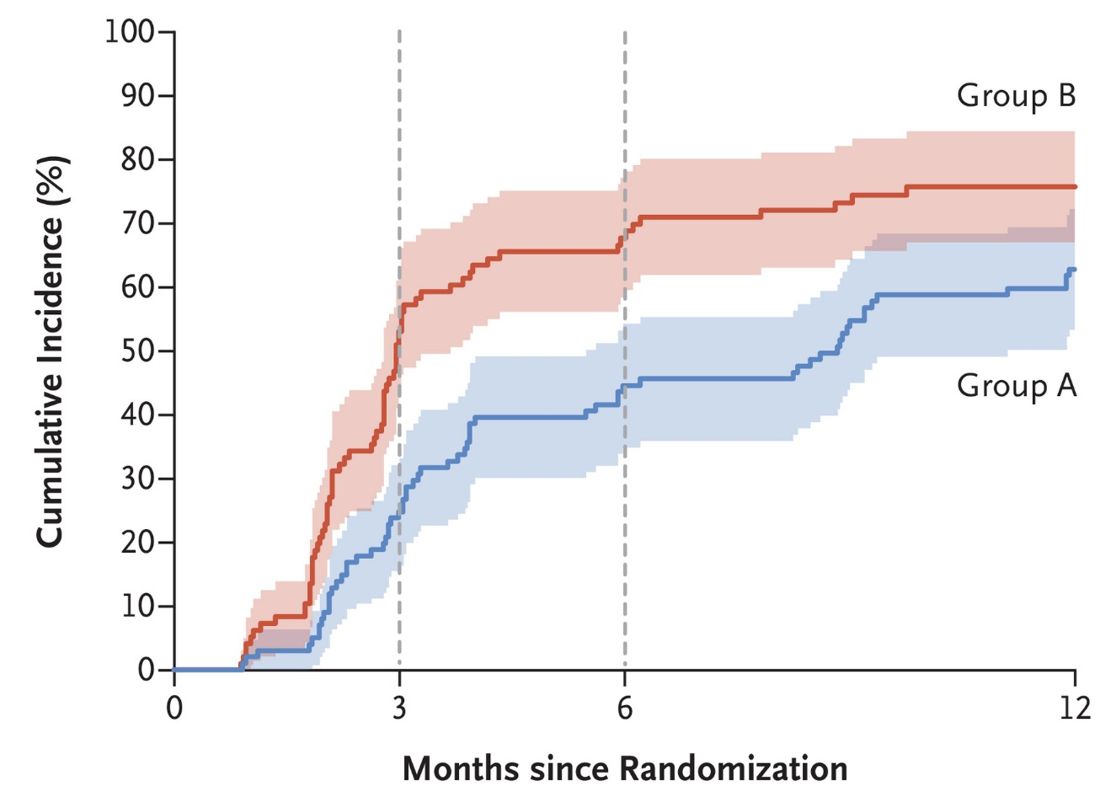
Rationale
RACE trial demonstrated that the majority of individuals in both the IST-alone and IST plus eltrombopag groups achieved responses by month 6
IST + Eltrombopag
Cumulative Incidence of Response (%)
IST
Peffault de Latour R, et al. N Engl J Med. 2022. PMID: 34986284.

Slide 17
Additional remarks
Even though some individuals with very severe AA may respond to IST after three months, individuals with severe cytopenias may warrant earlier decision to initiate second-line treatment
Severe and prolonged neutropenia increase the risk of life-threatening infections
Response assessment at three months for patients with very severe AA may help identify those who have not achieved adequate hematologic improvement and who may benefit from earlier salvage therapy

Slide 18
Case 1: Conclusion
At 6 months follow-up, patient underwent IST-response assessment and determined he was a non-responder
Require transfusion support 3-4 times per month
CBC: WBC 4.1 x 10³/μL, Hemoglobin 7.1 g/dL, platelet 9 x 10³/μL, ARC 65.4 x 10³/μL and ANC 0.55 x 10³/μL
As this patient did not have MSD and matched unrelated donor (MUD), he was referred for a haploidentical donor HCT

Slide 19
Case 1: Summary
The ASH guideline panel suggests the addition of eltrombopag to IST for children with severe or very severe AA
This is a conditional recommendation because most studies in the meta-analysis were non-randomized trials
The ASH guideline panel suggests initiating second-line treatment no later than six months of follow-up for patients who do not respond to IST
Individuals with very severe AA may be at increased risk of adverse outcomes so this population may warrant earlier decision to initiate second-line treatment
Future areas of study:
Additional randomized clinical trials to evaluate the outcomes of adding of eltrombopag to IST
Long-term studies to characterize the risks of relapse and clonal evolution associated with eltrombopag
Studies investigating the optimal timing for initiation and the ideal duration of eltrombopag
Further research to determine the optimal time for initiating second-line treatment

Slide 20
Case 2: Matched unrelated donor HCT vs. IST as front-line therapy
23-year-old, previously healthy female presented to the ED with syncope
History notable for new-onset petechiae for the past 2-3 weeks
CBC notable for WBC 1.54 x 10³/μL, Hemoglobin 6.5 g/dL, platelet 9 x 10³/μL, ARC 21 x 10³/μL and ANC 0.26 x 10³/μL
Medication history/exposure: None
Family history: unremarkable
Physical Examination: heart rate of 105 bpm, BP 120/66 mm Hg, tachycardia without murmur, bruises and petechiae on lower extremities; remaining exam normal

Slide 21
Case 2: Matched unrelated donor HCT vs IST as front-line therapy
Additional Labs
Peripheral smear and bone marrow (BM) flow cytometry: No blasts
BM Biopsy and aspirate: markedly hypocellular marrow (<10% cellularity) with trilineage hypoplasia
FISH MDS/Myeloid panel: negative
Somatic mutation panel: negative
PNH by flow cytometry: PNH clone with neutrophils (2.9%), monocytes (9.1%) and RBC (0.69%)
Chromosome breakage analysis: negative by DEB assay
Telomere length: normal
Diagnosis: Severe AA

Slide 22
Patient has no matched sibling donor (MSD) but has multiple matched unrelated donor (MUD) available. She is clinically stable with no infections.
What would you recommend for front-line therapy?
No therapy, observation only
IST plus eltrombopag as front-line therapy
MUD HCT as front-line therapy
Haploidentical donor HCT as front-line therapy
Both are reasonable options

Slide 23
Recommendation
The ASH guideline panel suggests either matched unrelated donor HCT or IST for patients under 20 years of age and those between 20 and 40 years old with severe or very severe AA (conditional recommendation, based on very low certainty of evidence of the effects)
IST is the standard front-line therapy for individuals <40 years old who lacks MSD
IST is associated with high rate of treatment failure (~20-30%), relapses (~30%) and clonal evolution
Outcomes of up-front MUD HCT have markedly improved in recent decades due to:
Advancement in high-resolution HLA typing
Improved conditioning regimens
Improved supportive care

Slide 24
Rationale
MUD HCT for individuals under 20 years old may be associated with:
Moderate decrease in mortality (66 fewer per 1,000, 95% CI: 129 fewer to 85 more)
Large decrease in treatment failure (417 fewer per 1,000, 95% CI: 456 fewer to 333 fewer)
Large increase in complete response (364 more per 1,000, 95% CI: 11 more to 1,000 more)
In individuals aged 20-40 years, MUD HCT may be associated with an increase in mortality (176 more per 1,000; 95% CI: 92 fewer to 1,000 more), BUT the evidence for this age group is very limited

Slide 25
Recommendation
Studies informing these recommendations are based on
Non-randomized, small cohort studies
Population consisting mostly of children
Decision to pursue MUD HCT versus IST as front-line treatment should be guided by:
Patient’s clinical status
Availability of and access to a suitable donor
Resource availability, including cost
Patient and caregiver preference
MUD may be less readily available than MSD, and prolonged neutropenia increases the risk of life-threatening infections

Slide 26
Case 2: Conclusion
Other than requiring platelet transfusion once every other week, she remains clinically stable
After a thorough discussion weighing the risks and benefits of MUD HCT versus IST, the patient elected to proceed with MUD HCT
The patient was referred for MUD HCT

Slide 27
Case 2: Summary
Outcomes of MUD HCT have significantly improved with possibility of similar results to the MSD HCT
The benefit of MUD HCT compared to IST is the cure of AA and prevent the possibility of clonal evolution
HCT carries the risk of GVHD, infection, infertility and organ toxicity
Studies informing these recommendations are from non-randomized, small cohort studies
Decision to pursue MUD HCT versus IST as frontline therapy should consider patient’s clinical status, resource availability, and patient’s preference
Future areas of study:
Randomized clinical trial comparing outcomes of MUD HCT versus IST in both adults and children with severe AA
Long-term safety data on MUD HCT for AA

Slide 28
Other guideline recommendations that were not covered in this presentation
For these topics, conditional recommendations were made based on very low certainty of evidence
Diagnostic testing
Front-line therapy including MSD HCT and haploidentical donor HCT
Second-line therapy after IST failure
Antimicrobial prophylaxis

Slide 29
Future Priorities for Research
In addition to the research priorities listed on slides 21 and 29, the following areas require further investigation:
Comparative studies evaluating the effectiveness of antimicrobial prophylaxis
Determination of the optimal duration of antimicrobial prophylaxis
Identification of ideal treatment options for patients with relapsed or refractory AA following IST
Outcomes of alternative donor HCT as front-line therapy for both adults and children

Slide 30
In Summary: Back to our Objectives
Describe recommendation for the addition of eltrombopag to immunosuppressive therapy (IST) in children with severe or very severe AA
Addition of eltrombopag to IST is suggested for children with severe or very severe AA
Describe recommendation for timing of second-line treatment for individuals who do not respond to IST
ASH guideline panel suggests initiating second-line treatment no later than six months of follow-up if there is no response
Describe recommendation for matched unrelated donor (MUD) hematopoietic cell transplant (HCT) as front-line therapy in individuals ≤40 years old with severe or very severe AA
Either MUD HCT or IST is suggested for individuals ≤40 years old with severe of very severe AA

Slide 31
Acknowledgements
ASH guideline panel team members
Evidence synthesis team
See more about the ASH AA guidelines at hematology.org/aplasticanemia

