Slide 1
Prevention and treatment of VTE in patients with cancer
An Educational Slide Set
American Society of Hematology 2020 Guidelines for Management of Venous Thromboembolism
Slide set author: Siraj Mithoowani MD, MHPE (McMaster University)

Slide 2
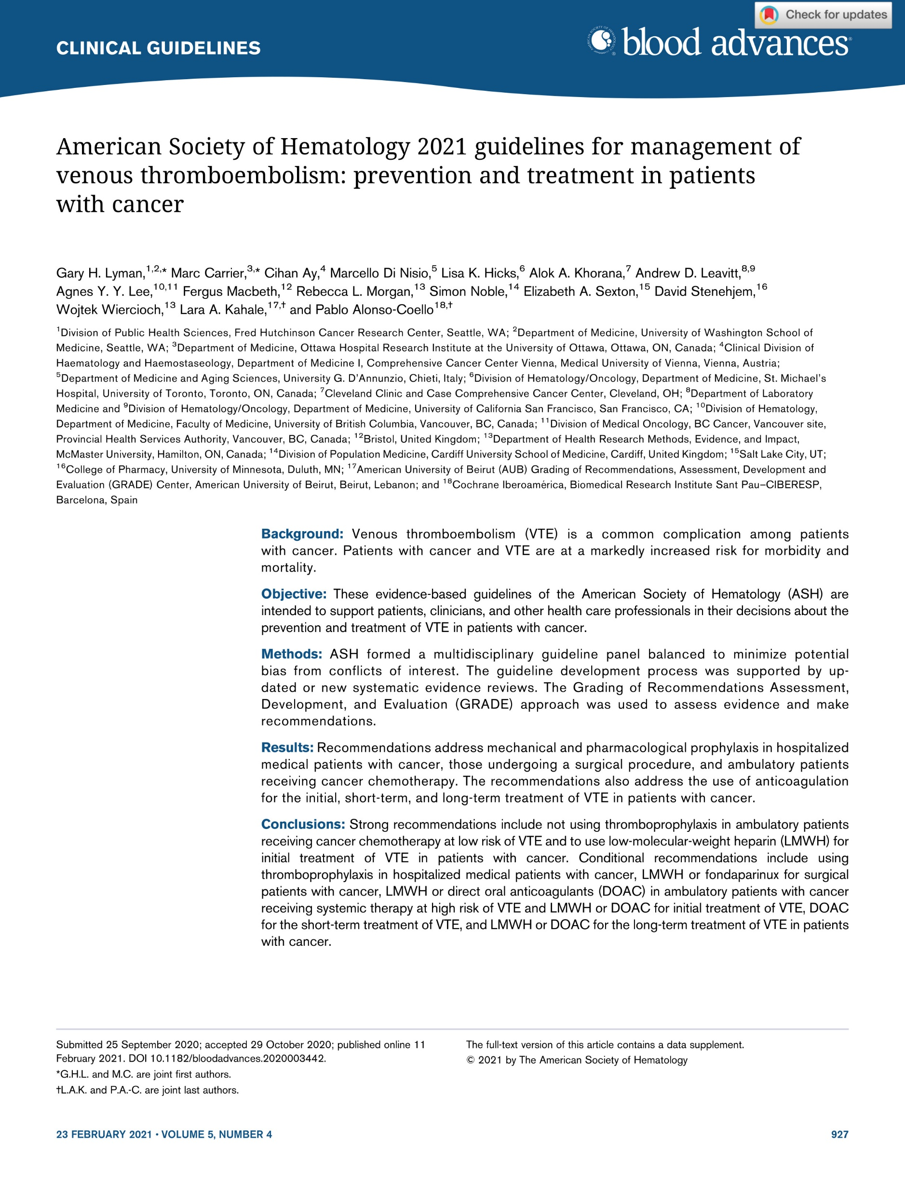
Clinical Guidelines
American Society of Hematology 2020 Guidelines for Management of Venous Thromboembolism: Prevention and Treatment in Patients with Cancer
Gary H. Lyman, Marc Carrier, Cihan Ay, Marcello Di Nisio, Lisa K. Hicks, Alok A. Khorana, Andrew Leavitt, Agnes Y Y Lee, Fergus Macbeth, Rebecca L. Morgan, Simon Noble, Elizabeth Sexton, David Stenehjem, Wojtek Wiercioch, Lara A. Kahale, Pablo Alonso-Coello

Slide 3
ASH Clinical Practice Guidelines on VTE
Prevention of VTE in Surgical Hospitalized Patients
Prevention of VTE in Medical Hospitalized Patients
Treatment of Acute VTE (DVT and PE)
Optimal Management of Anticoagulation Therapy
Prevention and Treatment of VTE in Patients with Cancer
Heparin-Induced Thrombocytopenia (HIT)
Thrombophilia
Pediatric VTE
VTE in the Context of Pregnancy
Diagnosis of VTE
VTE in Latin America
Anticoagulation in Patients with COVID-19

Slide 4
How were these ASH guidelines developed?
PANEL FORMATION
Each guideline panel was formed following these key criteria:
Balance of expertise (including disciplines beyond hematology, and patients)
Close attention to minimization and management of COI
CLINICAL QUESTIONS
10 to 20 clinically-relevant questions generated in PICO format (population, intervention, comparison, outcome)
EVIDENCE SYNTHESIS
Evidence summary generated for each PICO question via systematic review of health effects plus:
Resource use
Feasibility
Acceptability
Equity
Patient values and preferences
MAKING RECOMMENDATIONS
Recommendations made by guideline panel members based on evidence for all factors.
Example: PICO question
“Should pre-operative thromboprophylaxis vs. post-operative thromboprophylaxis be used in patients with cancer undergoing a surgical procedure?”
ASH guidelines are reviewed annually by expert work groups convened by ASH. Resources, such as this slide set, derived from guidelines that require updating are removed from the ASH website.

Slide 5
How patients and clinicians should use these recommendations
 | STRONG Recommendation (“The panel recommends…”) | CONDITIONAL Recommendation (“The panel suggests…”)
For patients | Most individuals would want the intervention. | A majority would want the intervention, but many would not.
For clinicians | Most individuals should receive the intervention. | Different choices will be appropriate for different patients, depending on their values and preferences. Use shared decision making.

Slide 6
Objectives
By the end of this session, you should be able to
Describe recommendations for primary prophylaxis in patients with cancer undergoing surgery
Describe recommendations for primary prophylaxis in ambulatory patients with cancer receiving systemic therapy
Select appropriate anticoagulant therapy for VTE in patients with cancer
Describe recommendations for treatment of incidental PE in patients with cancer

Slide 7
What is this chapter about?
Patients with cancer are at greater risk for VTE than the general population resulting in considerable morbidity, mortality and costs
Treatment decisions should be individualized taking into account consequences of VTE and/or bleeding events
This chapter provides evidence-based recommendations on prevention and treatment of VTE in patients with cancer

Slide 8
Case 1: Primary prophylaxis in patients with cancer undergoing surgery
67 year old female with newly diagnosed stage IIIa colorectal cancer (T1N2aM0)
Past Medical History: Hypertension, dyslipidemia
Medications: Amlodipine, rosuvastatin
Admitted to hospital:
Planned laparoscopic hemicolectomy
No symptoms of VTE or bleeding
Weight 80 kg

Slide 9
You judge that your patient is at moderate to high risk of perioperative VTE and low risk of surgical bleeding.
What strategy do you recommend for thromboprophylaxis?
Mechanical thromboprophylaxis only
Dalteparin 5,000 units SC daily post-operatively
Dalteparin 5,000 units SC daily starting 12 hours pre-operatively
Unfractionated heparin 5,000 units SC BID post-operatively

Slide 10
Recommendation
In patients with cancer undergoing a surgical procedure, the ASH guideline panel suggests using either LMWH or fondaparinux for thromboprophylaxis rather than UFH (conditional recommendation based on low certainty in the evidence about effects).
LMWH versus UFH for thromboprophylaxis
Outcomes (Quality of Evidence) | Relative effect (95% CI) | Anticipated absolute effects (95% CI)
 |  | Risk with UFH | Risk difference with LMWH
Mortality | RR 0.82 (0.63 to 1.07) | 109 out of 2155 (5.1%) | 9 fewer deaths per 1,000 (19 fewer to 4 more)
PE | RR 0.52 (0.20 to 1.34) | 19 out of 3138 (0.6%) | 3 fewer PEs per 1,000 (5 fewer to 2 more)
Symptomatic DVT | RR 0.67 (0.27 to 1.69) | 11 out of 1144 (1.0%) | 3 fewer DVTs per 1,000 (7 fewer to 7 more)
Major bleeding | RR 1.01 (0.69 to 1.48) | Not reported (5.6%) | 1 more bleed per 1,000 (17 fewer to 27 more)
Reoperation for bleeding | RR 1.01 (0.69 to 1.48) | 32 out of 627 (5.1%) | 4 fewer re-operations per 1,000 (22 fewer to 26 more)
Quality of Evidence (GRADE): Low Moderate High

Slide 11
Recommendation
In patients with cancer undergoing a surgical procedure, the ASH guideline panel suggests using either LMWH or fondaparinux for thromboprophylaxis rather than UFH (conditional recommendation based on low certainty in the evidence about effects).
Fondaparinux versus LMWH for thromboprophylaxis
Outcomes (Quality of Evidence) | Relative effect (95% CI) | Anticipated absolute effects (95% CI)
 |  | Risk with LMWH | Risk difference with Fondaparinux
Mortality | Not reported
PE | RR 0.40 (0.14 to 1.12) | 72 per 1,000 | 43 fewer PEs per 1,000 (62 fewer to 9 more)
Symptomatic DVT | RR 0.40 (0.14 to 1.12) | 72 per 1,000 | 43 fewer DVTs per 1,000 (62 fewer to 9 more)
Major bleeding | RR 1.34 (0.81 to 2.22) | 22 per 1,000 | 7 more bleeds per 1,000 (4 fewer to 27 more)
Quality of Evidence (GRADE): Low Moderate High

Slide 12
Remarks
UFH is generally preferred over LMWH for patients with cancer with severe renal impairment (defined as a creatinine clearance < 30 mL/min)
If planning for extended thromboprophylaxis (continuing pharmacological thromboprophylaxis at home), the guideline panel suggests the use of LMWH

Slide 13
Recommendation
In patients with cancer undergoing a surgical procedure, the ASH guideline panel suggests using post-operative thromboprophylaxis over pre-operative thromboprophylaxis (conditional recommendation based on low certainty in the evidence about effects).
Outcomes (Quality of Evidence) | Relative effect (95% CI) | Anticipated absolute effects (95% CI)
 |  | Risk with immediate post-op prophylaxis | Risk difference with pre-operative prophylaxis
Mortality | RR 0.74 (0.50 to 1.09) | 27 per 1,000 | 7 fewer deaths per 1,000 (13 fewer to 2 more)
PE | RR 0.20 (0.01 to 4.16) | 1 per 1,000 | 1 fewer PE per 1,000 (1 fewer to 3 more)
Symptomatic DVT | RR 0.86 (0.62 to 1.19) | 51 per 1,000 | 7 fewer DVTs per 1,000 (19 fewer to 10 more)
Major bleeding | RR 1.55 (1.14 to 2.12) | 29 per 1,000 | 16 more bleeds per 1,000 (4 more to 32 more)
Quality of Evidence (GRADE): Low Moderate Strong

Slide 14
Case 1, continued
You prescribe dalteparin 5,000 IU subcut daily post-operatively
Your patient’s post-operative course is uneventful and discharge is planned on post-operative day 3
What duration of pharmacological thromboprophylaxis do you recommend?
Discontinue pharmacological thromboprophylaxis at discharge
Discontinue pharmacological thromboprophylaxis once your patient is ambulatory
Continue pharmacological thromboprophylaxis at home for 7 days
Continue pharmacological thromboprophylaxis at home for 4 weeks

Slide 15
Recommendation
In patients with cancer who had undergone a major abdominal/pelvic surgical procedure, the ASH guideline panel suggests continuing pharmacological thromboprophylaxis post discharge rather than discontinuing at the time of hospital discharge (conditional recommendation based on very low certainty in the evidence about effects).
Outcomes (Quality of Evidence) | Relative effect (95% CI) | Anticipated absolute effects (95% CI)
 |  | Risk with limited prophylaxis | Risk difference with extended prophylaxis
Mortality | RR 1.14 (0.73 to 1.78) | Not stated | 6 more deaths per 1,000 (12 fewer to 35 more)
PE | RR 0.18 (0.02 to 1.46) | 17 per 1,000 | 14 fewer PEs per 1,000 (17 fewer to 8 more)
Symptomatic DVT | RR 0.67 (0.11 to 4.06) | 29 per 1,000 | 10 fewer DVTs per 1,000 (26 fewer to 89 more)
Major bleeding | RR 0.83 (0.29 to 2.35) | Not stated | 2 fewer bleeds per 1,000 (7 fewer to 14 more)
Quality of Evidence (GRADE): Low Moderate Strong

Slide 16
Remarks
We only identified evidence to assess the benefits and harms of extended thromboprophylaxis in patients undergoing major abdominal/pelvic surgery.
This recommendation should not be extended to other surgical procedures.
Patients should be provided comprehensive anticoagulation education including self-injection technique during hospitalization to facilitate continuation of thromboprophylaxis after discharge.

Slide 17
Case 1, Continued:
Four weeks later, your patient is seen in the Oncology clinic
Adjuvant chemotherapy (oxaliplatin, leucovorin, fluorouracil) is planned
Physical examination: Weight 80 kg, BMI 25 kg/m² Well healed surgical incisions No evidence of DVT or PE
Laboratory Investigations (pre-chemotherapy) Hemoglobin 115 g/L Leukocyte count 13 x 10⁹/L Platelet count 405 x 10⁹/L Creatinine 55 µmol/L

Slide 18
You judge that your patient is at moderate to high risk of VTE and low risk of bleeding.
What strategy do you recommend for thromboprophylaxis?
No thromboprophylaxis
Mechanical thromboprophylaxis only
Apixaban 2.5 mg twice daily
Dalteparin 5,000 IU SC daily

Slide 19
Khorana risk score
 | Score
Site of primary tumor Very high risk (stomach, pancreas) High risk (lung, lymphoma, gyne, bladder, testicular) All others | 2 1 0
Platelet count > 350 x 10⁹/L | 1
Hemoglobin < 100 g/L or use of ESAs | 1
WBC > 11 x 10⁹/L | 1
BMI > 35 kg/m² | 1
Khorana et al. Blood. 2008; 111:4902.
Notes:
Reference: Khorana AA, Kuderer NM, Culakova E, et al. Development and validation of a predictive model for chemotherapy-associated thrombosis. Blood 2008; 111:4902.

Slide 20
Khorana risk score
 | Score | Our patient
Site of primary tumor Very high risk (stomach, pancreas) High risk (lung, lymphoma, gyne, bladder, testicular) All others | 2 1 0 | Colorectal cancer
Platelet count > 350 x 10⁹/L | 1 | 405 x 10⁹/L
Hemoglobin < 100 g/L or use of ESAs | 1 | 115 g/L
WBC > 11 x 10⁹/L | 1 | 13 x 10⁹/L
BMI > 35 kg/m² | 1 | 25 kg/m²
Khorana et al. Blood. 2008; 111:4902.
Notes:
Reference: Khorana AA, Kuderer NM, Culakova E, et al. Development and validation of a predictive model for chemotherapy-associated thrombosis. Blood 2008; 111:4902.

Slide 21
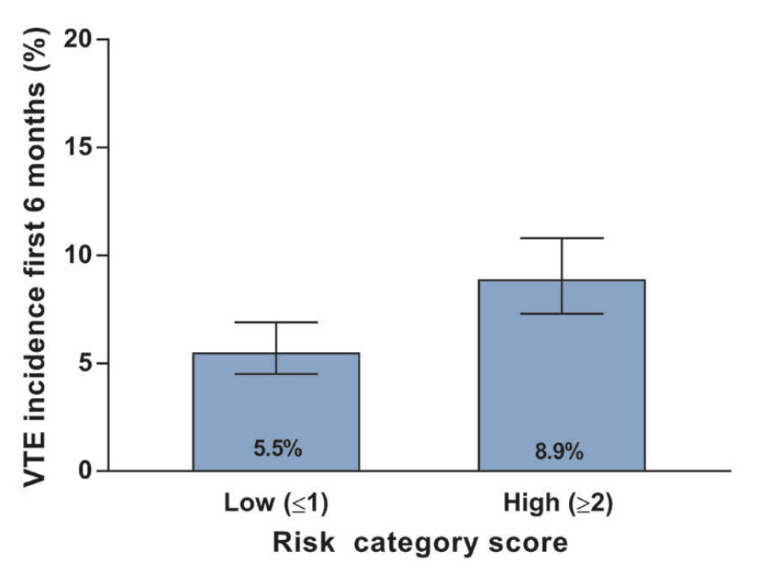
Khorana risk score
What is this patient’s risk of VTE?
Mulder et al, Haematologica. 2019 Jun;104(6):1277-1287.
Notes:
Reference:
Mulder et al. The Khorana score for prediction of venous thromboembolism in cancer patients: a systematic review and meta-analysis. Haematologica. 2019 Jun;104(6):1277-1287

Slide 22
Recommendations
In ambulatory patients with cancer at low risk of thrombosis receiving systemic therapy, the ASH guideline panel suggests no thromboprophylaxis over oral thromboprophylaxis with a DOAC (apixaban or rivaroxaban) (conditional recommendation based on moderate certainty in the evidence about effects).
In ambulatory patients with cancer at intermediate risk of thrombosis receiving systemic therapy, the ASH guideline panel suggests either thromboprophylaxis with a DOAC (apixaban or rivaroxaban) or no thromboprophylaxis (conditional recommendation based on moderate certainty in the evidence about effects).
In ambulatory patients with cancer at high risk of thrombosis receiving systemic therapy, the ASH guideline panel suggests thromboprophylaxis with a DOAC (apixaban or rivaroxaban) over no thromboprophylaxis (conditional recommendation based on moderate certainty in the evidence about effects).

Slide 23
Recommendation
In ambulatory patients with cancer at high risk of thrombosis receiving systemic therapy, the ASH guideline panel suggests thromboprophylaxis with a DOAC (apixaban or rivaroxaban) over no thromboprophylaxis (conditional recommendation based on moderate certainty in the evidence about effects).
Outcomes (Quality of Evidence) | Relative effect (95% CI) | Anticipated absolute effects (95% CI)
 |  | Risk with no thromboprophylaxis | Risk difference with DOAC thromboprophylaxis
Mortality | RR 0.94 (0.64 to 1.38) | 185 per 1,000 | 11 fewer deaths per 1,000 (67 fewer to 70 more)
PE | RR 0.24 (0.12 to 0.47) | 60 per 1,000 | 46 fewer PEs per 1,000 (53 fewer to 32 fewer)
Symptomatic DVT | RR 0.61 (0.31 to 1.21) | 95 per 1,000 | 37 fewer DVTs per 1,000 (66 fewer to 20 more)
Major bleeding | RR 1.65 (0.72 to 3.80) | 14 per 1,000 | 9 more bleeds per 1,000 (4 fewer to 40 more)
Quality of Evidence (GRADE): Low Moderate High

Slide 24
Other considerations
Classification of patients as low, moderate or high-risk for VTE should be based on a validated score (i.e. Khorana score) complemented by clinical judgment and experience.
In patients at high risk for thrombosis, thromboprophylaxis should be used with caution in those with a high risk of bleeding.

Slide 25
Case 2: Treatment of cancer associated VTE
A 44 year old female presents to the ED with a 3-day history of right leg swelling and pain
A doppler ultrasound of the right leg reveals an occlusive DVT in the right superficial femoral, popliteal and trifurcation veins
Past Medical History: Locally advanced breast cancer, grade 3 invasive ductal carcinoma, ER/PR negative, HER2 negative, grade 3 invasive ductal carcinoma
Medications: Neo-adjuvant dose dense AC/T (doxorubicin, cyclophosphamide, paclitaxel)
Laboratory investigations in the ED:
Hemoglobin 109 g/L Leukocyte count 11 x 10⁹/L Platelet count 334 x 10⁹/L Creatinine 60 µmol/L

Slide 26
Case 2
What initial treatment do you recommend?
IVC filter insertion
Tinzaparin 175 IU/kg once daily
Edoxaban 60mg once daily
Unfractionated heparin infusion

Slide 27
Definitions
The ASH guideline panel divided the treatment course of VTE in cancer patients into three phases:
Initial treatment (within the first week of diagnosis)
Short-term treatment (3 to 6 months from diagnosis)
Long-term treatment (> 6 months from diagnosis)

Slide 28
Recommendation
In patients with cancer and VTE, the ASH guideline panel suggests either DOAC (apixaban or rivaroxaban) or LMWH be used for initial treatment of VTE in patients with cancer (conditional recommendation based on very low certainty in the evidence about effects). If a DOAC is not used, we recommend LMWH over UFH for initial treatment of VTE in patients with cancer (strong recommendation based on moderate certainty in the evidence about effects).
Outcomes (Quality of Evidence) | Relative effect (95% CI) | Anticipated absolute effects (95% CI)*
 |  | Risk with LMWH | Risk difference with DOAC
Mortality | RR 3.00 (0.12 to 73.21) | 0 per 1,000 | 0 fewer deaths per 1,000 (0 fewer to 0 fewer)
Recurrent VTE | RR 0.20 (0.01 to 4.04) | 14 per 1,000 | 11 fewer recurrent events per 1,000 (14 fewer to 43 more)
Major bleeding | RR 0.33 (0.01 to 8.13) | 3 per 1,000 | 2 fewer bleeds per 1,000 (3 fewer to 21 more)
* Based on results of the SELECT-D and ADAM-VTE trials only
Quality of Evidence (GRADE): Low Moderate Strong

Slide 29
Remarks
Only two DOACs (apixaban and rivaroxaban) have been approved for the initial treatment period.
DOACs should be used carefully in patients with gastrointestinal cancers because of a higher risk of GI bleeding.
UFH might be preferred over LMWH for the patient with cancer with severe renal impairment (defined as creatinine clearance < 30 mL/min).
The use of fondaparinux might be considered in patients with cancer and VTE and a prior history of heparin induced thrombocytopenia.

Slide 30
Case 2, continued
Four weeks later, your patient undergoes an uncomplicated right modified radical mastectomy.
She is seen in your outpatient clinic one week post-operatively.
Her right leg swelling and pain has improved and she has no bleeding.
What is your recommendation?
Continue tinzaparin 175 IU/kg once daily
Switch to VKA (warfarin) with target INR 2.5
Switch to rivaroxaban 20mg once daily
Discontinue anticoagulation

Slide 31
Recommendation
For the short-term treatment of VTE (first 3-6 months) in patients with active cancer, the ASH guideline panel suggests DOAC (apixaban, edoxaban or rivaroxaban) over LMWH (conditional recommendation based on low certainty in the evidence about effects).
DOAC is also suggested over VKA (conditional recommendation based on very low certainty in the evidence about effects).
If a DOAC is not used, the ASH guideline panel suggests LMWH over VKA (conditional recommendation based on moderate certainty in the evidence about effects).

Slide 32
Recommendation
For the short-term treatment of VTE (first 3-6 months) in patients with active cancer, the ASH guideline panel suggests DOAC (apixaban, edoxaban or rivaroxaban) over LMWH (conditional recommendation based on low certainty in the evidence about effects).
Outcomes* (Quality of Evidence) | Relative effect (95% CI) | Anticipated absolute effects (95% CI)*
 |  | Risk with LMWH | Risk difference with DOAC
Mortality | RR 0.99 (0.83 to 1.18) | 245 per 1,000 | 2 fewer deaths per 1,000 (42 fewer to 44 more)
Recurrent VTE | RR 0.62 (0.43 to 0.90) | 83 per 1,000 | 32 fewer recurrent events per 1,000 (47 fewer to 8 fewer)
Major bleeding | RR 1.31 (0.83 to 2.06) | 34 per 1,000 | 10 more bleeds per 1,000 (6 fewer to 36 more)
* Follow-up: 12 months
Quality of Evidence (GRADE): Low Moderate Strong

Slide 33
Case 2, continued
Three months later, your patient has a surveillance CT scan showing metastatic deposits in the liver and bone
An MRI brain is negative for intracranial metastases
Palliative chemotherapy is planned
Laboratory investigations:
Hemoglobin 99 g/L Leukocyte count 13 x 10⁹/L Platelet count 89 x 10⁹/L Creatinine 84 µmol/L

Slide 34
Case 2, continued
What duration of anticoagulation do you recommend?
Discontinue anticoagulation now
Discontinue anticoagulation after 3 months
Discontinue anticoagulation after 6 months
Continue anticoagulation indefinitely

Slide 35
Recommendation
In patients with active cancer and VTE, the ASH guideline panel suggests long-term anticoagulation for secondary prophylaxis (longer than 6 months) rather than short term treatment alone (3-6 months) (conditional recommendation based on low certainty in the evidence about effects).
Outcomes* (Quality of Evidence) | Relative effect (95% CI) | Anticipated absolute effects (95% CI)
 |  | Risk with short term treatment (3-6 mos) | Risk difference with long term treatment (longer than 6 mos)
Mortality | RR 1.38 (0.85 to 2.23) | 24 per 1,000 | 9 more deaths per 1,000 (4 fewer to 30 more)
PE | RR 0.66 (0.29 to 1.51) | 50 per 1,000 | 17 fewer recurrent PE per 1,000 (35 fewer to 25 more)
Recurrent VTE | RR 0.54 (0.23 to 1.27) | 138 per 1,000 | 63 fewer recurrent events per 1,000 (106 fewer to 36 more)
Major bleeding | RR 1.25 (0.68 to 2.30) | 15 per 1,000 | 4 more bleeds per 1,000 (5 fewer to 20 more)
* Mean follow-up: 31 months
Quality of Evidence (GRADE): Low Moderate Strong

Slide 36
Recommendation
In patients with active cancer and VTE receiving long-term anticoagulation for secondary prophylaxis, the ASH guideline panel suggests continuing indefinite anticoagulation over stopping after completion of a definitive period of anticoagulation (conditional recommendation based on very low certainty in the evidence about effects).
Outcomes (Quality of Evidence) | Relative effect (95% CI) | Anticipated absolute effects (95% CI)
 |  | Risk with definite duration (< 12 mos) | Risk difference with indefinite duration of therapy
Mortality | RR 0.70 (0.45 to 1.09) | 15 per 1,000 | 5 fewer deaths per 1,000 (8 fewer to 1 more)
PE | RR 0.23 (0.12 to 0.44) | 27 per 1,000 | 21 fewer recurrent PE per 1,000 (24 fewer to 15 fewer)
Recurrent VTE | RR 0.20 (0.11 to 0.38) | 95 per 1,000 | 76 fewer recurrent events per 1,000 (85 fewer to 59 fewer)
Major bleeding | RR 2.21 (1.32 to 3.44) | 7 per 1,000 | 9 more bleeds per 1,000 (3 more to 18 more)
Quality of Evidence (GRADE): Low Moderate Strong

Slide 37
Remarks
Long-term anticoagulation can be discontinued when patients are no longer at high risk of recurrent VTE or if patients are entering the last weeks of life.
The decision to anticoagulate for a prolonged period will be dependent on the type and stage of cancer (e.g., metastatic cancer or not), long-term prognosis, and periodic re-evaluation of risk of thrombosis and bleeding, comorbidities, costs and patient preferences and values.
The choice of anticoagulant must also be based on the specific clinical setting to minimize risk, after careful consideration of bleeding risk, drug-drug interactions, patient’s preference, and the availability of treatment options including cost considerations.

Slide 38
Anticoagulation at the end of life
Observational data support stopping anticoagulants and antithrombotic drugs as death approaches.
Observational data have shown:
A high risk of clinically relevant bleeding (7-10%) in the last weeks of life
That bleeding is strongly associated with use of anticoagulants (HR 1.48, 95% CI 1.02-2.15) and antiplatelet drugs (HR 1.67, 95% CI 1.15-2.44)
Notes:
Noble S, Banerjee S, Pease NJ. Management of venous thromboembolism in far-advanced cancer: current practice. BMJ supportive & palliative care. 2019:bmjspcare-2019-001804.
Tardy B, Picard S, Guirimand F, et al. Bleeding risk of terminally ill patients hospitalized in palliative care units: the RHESO study. Journal of Thrombosis and Haemostasis. 2017;15(3):420- 428.

Slide 39
Case 2, Summary
Initial treatment (within first week of diagnosis)
Short-term treatment
(3 to 6 mos. from diagnosis)
Long-term treatment
(> 6 mos. from diagnosis)
End of life
Recommendation 20
DOAC or LMWH
Recommendation 23
DOAC over LMWH
Recommendation 32, 33
Long-term, indefinite anticoagulation rather than short-term treatment
Discontinue anticoagulant therapy

Slide 40
Case 3: Treatment of incidental PE
53 year old male with metastatic renal cell carcinoma (to bones, liver)
Past Medical History: Hypothyroidism, depression
Medications: Levothyroxine, escitalopram, cabozantinib (TKI drug)
Seen in outpatient clinic:
Routine staging CT shows bilateral segmental/subsegmental pulmonary emboli
Bilateral leg doppler ultrasound negative for DVT
He is asymptomatic with normal vital signs
Laboratory investigations:
Hemoglobin 129 g/L Leukocyte count 12 x 10⁹/L Platelet count 330 x 10⁹/L Creatinine 94 µmol/L
Notes:
Warnings on cabozantinib product label – severe hemorrhage (avoid in patients with recent hemorrhage); thromboembolic events (discontinue the drug in patients who develop serious arterial/venous event); hematologic toxicity (low counts)
Cabozantinib: Substrate of CYP 2C9 (minor) and CYP 3A4 (major)

Slide 41
What is your treatment recommendation?
Clinical observation only
IVC filter insertion
Start apixaban 10mg BID x 1 week, followed by apixaban 5mg BID
Start warfarin (target INR 2.5)

Slide 42
Recommendation
In patients with cancer and incidental (unsuspected) PE, the ASH guideline panel suggests short-term anticoagulation treatment rather than observation (conditional recommendation based on very low certainty in the evidence about effects).
Outcomes (Quality of Evidence) | Relative effect (95% CI) | Anticipated absolute effects (95% CI)
 |  | Risk with observation | Risk difference with treatment
Mortality | RR 0.81 (0.67 to 0.98) | 369 per 1,000 | 70 fewer deaths per 1,000 (122 fewer to 7 fewer)
Symptomatic PE* | RR 0.36 (0.18 to 0.72) | 60 per 1,000 | 39 fewer recurrent PE per 1,000 (49 fewer to 17 fewer)
Symptomatic recurrent DVT* | RR 0.19 (0.08 to 0.48) | 48 per 1,000 | 39 fewer recurrent events per 1,000 (44 fewer to 25 fewer)
Major bleeding* | RR 3.00 (1.21 to 7.47) | 22 per 1,000 | 44 more bleeds per 1,000 (5 more to 414 more)
* Follow-up: 3 months
Quality of Evidence (GRADE): Low Moderate Strong

Slide 43
Remarks
Clinicians should use clinical judgment when considering anticoagulation for incidental PE, sub-segmental PE or splanchnic vein thrombosis.
Factors that should be considered include diagnostic certainty, chronicity (age of thrombus), extent of thrombosis, associated symptoms and bleeding risks.
If therapeutic anticoagulation is warranted, the ASH guideline panel recommends use of the same anticoagulants recommended for treatment of cancer-associated thrombosis.

Slide 44
Other guideline recommendations that were not covered in this session
Primary prophylaxis in hospitalized medical patients with cancer
Primary prophylaxis for patients with cancer and a central venous catheter
Treatment versus observation for patients with cancer and SSPE or visceral/splanchnic vein thrombosis
Treatment of patients with cancer and recurrent VTE despite anticoagulation

Slide 45
Some future priorities for research
Optimal choice, dosing and duration of parenteral anticoagulation to prevent VTE in hospitalized patients with cancer
Cost effectiveness of primary prophylaxis for ambulatory patients with cancer
Primary prophylaxis for patients with cancer and a central venous catheter (treatment duration, agent of choice)
Comparative safety, efficacy and cost effectiveness of oral agents versus parenteral therapy for VTE in patients with cancer
Treatment versus observation for patients with cancer and incidental/subsegmental PE or splanchnic vein thrombosis

Slide 46
In Summary: Back to our Objectives
Describe recommendations for primary prophylaxis in patients with cancer undergoing surgery
Prophylaxis with LMWH or fondaparinux recommended over UFH
Extended thromboprophylaxis (4 weeks) for major abdominal/pelvic surgery
Describe recommendations for primary prophylaxis in ambulatory patients with cancer receiving systemic therapy
Pharmacological prophylaxis (DOACs) for patients at moderate to high risk of VTE
Select appropriate anticoagulant therapy for VTE in patients with cancer
Initial treatment (within 1 week): LMWH or DOACs
Short-term treatment (3-6 months): DOACs over LMWH
Long-term treatment (> 6 months): Indefinite anticoagulation
Describe recommendations for treatment of incidental PE in patients with cancer
Anticoagulation rather than observation

Slide 47
Acknowledgements
ASH Guideline Panel team members
Knowledge Synthesis team members
McMaster University GRADE Centre
Author of this ASH VTE Slide Set: Siraj Mithoowani MD, MHPE (McMaster University)
See more about the ASH VTE guidelines at www.hematology.org/vte

