Slide 1
Treating newly diagnosed acute myeloid leukemia in older adults
An Educational Slide Set
American Society of Hematology 2025 guidelines for treating newly diagnosed acute myeloid leukemia in older adults
Slide set authors:
Dr. Chyn Chua, Dr. Luke Fletcher

Slide 2
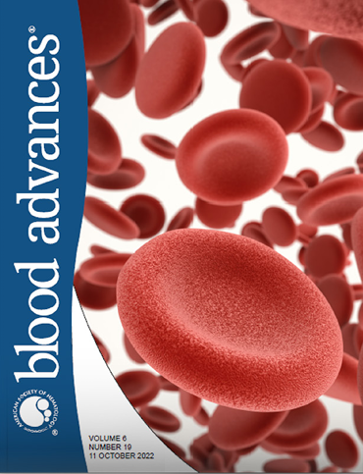
American Society of Hematology 2025 guidelines for treating newly diagnosed acute myeloid leukemia in older adults
Mikkael A. Sekeres, Ryan Mattison, Andrew Artz, Maria R. Baer, Chong Chyn Chua, Roberta Demichelis-Gómez, Pamela C. Egan, Luke Fletcher, Charles Foucar, Jacqueline S. Garcia, Linda Gilberto, Andres Gómez de León, Jeffrey Lancet, Kah Poh Loh, Luca Malcovati, Bernard Marini, Uwe Platzbecker, Mohamed L. Sorror, Sara Tinsley-Vance, John Treitz, Maria Jose Oliveros, Sara Ibrahim, Yetiani Roldan, Gordon Guyatt, Romina Brignardello-Petersen

Slide 3
How were these guidelines updated?
PANEL FORMATION
The guideline panel was formed following these key criteria:
Balance of expertise
Close attention to minimization and management of conflicts of interest
CLINICAL QUESTIONS
9 clinically-relevant questions generated in PICO format (population, intervention, comparison, outcome)
EVIDENCE SYNTHESIS
Evidence summary generated for each PICO question via systematic review of health effects plus:
Resource use
Feasibility
Acceptability
Equity
Patient values and preferences
MAKING RECOMMENDATIONS
Recommendations made by guideline panel members based on evidence for all factors.
Example PICO question:
“Should older adults with newly diagnosed AML who are candidates for antileukemic therapy receive antileukemic therapy instead of best supportive care only?”
ASH guidelines are reviewed routinely by expert work groups convened by ASH. Resources, such as this slide set, derived from guidelines that require updating are removed from the ASH website.

Slide 4




How patients and clinicians should use these recommendations
 | Strong Recommendation |  | Conditional Recommendation
 | “The panel recommends…” | “The panel recommends against…” | “The panel suggests…” | “The panel suggests against…”
 | Interpretation of Strong Recommendations |  | Interpretation of Conditional Recommendations
For patients | Most individuals in this situation would want the recommended course of action, and only a small proportion would not. |  | Most individuals in this situation would want the suggested course of action, but many would not.
For clinicians | Most individuals should follow the recommended course of action. |  | Different choices will be appropriate for individual patients; clinicians must help each patient arrive at a management decision consistent with the patient’s values and preferences.

Slide 5
Objectives
By the end of this session, you should be able to
Describe recommendations for post-remission therapy for older adults with AML in three settings
  Candidates for allogeneic stem cell transplantation (allo-HCT)
  Not candidates for allo-HCT post conventional induction therapy
  Not candidates for allo-HCT and responding to HMA- or LDAC-based therapy
Describe recommendations for targeted therapy for older adults with AML

Slide 6
Case 1A: Post remission management for older adults with AML
68M with AML
80% bone marrow blasts at diagnosis
  Normal karyotype
  Mutations in ASXL1, RUNX1, EZH2, TET2
Achieved remission (bone marrow blasts <5%) after 1 cycle of ‘7+3’ induction
  Complications: febrile neutropenia, mucositis, neutropenic colitis
Minimal comorbidities, ECOG 0

Slide 7
Case 1A: Post remission management for older adults with AML
68M in morphological remission after 1 cycle of conventional intensive induction chemotherapy.
AML is adverse risk by European LeukemiaNet (ELN) 2022 risk stratification.
What would you do next?
No further therapy as the patient is already in remission
Work up / refer patient for consideration of allogeneic stem cell transplantation
Switch to azacitidine-venetoclax

Slide 8

Recommendation 8
For older adults with newly diagnosed AML who have responded to initial antileukemic therapy, who are candidates for an allo-HCT during first remission, and who have non-favorable prognosis based on molecular and karyotypic characteristics, the ASH guideline panel suggests an allo-HCT over no transplantation (conditional recommendation based on very low certainty in the evidence of effects ⨁◯◯◯).
*Goldenberg N, et al; JAMA, 2022

Slide 9
Recommendation
Recommendation is based on 1 randomized controlled trial (RCT) and 13 observational studies comparing allo-HCT to no allo-HCT. ¹⁻¹⁴
Total of 4348 older adults, most with intermediate or adverse risk disease
BENEFITS allo-HCT
Reduces rate of mortality over time (HR 0.74, 95% CI 0.58-0.93)
Reduces rate of leukemia recurrence over time (HR 0.46, 95% CI 0.33-0.64)
Most older adults with non-favorable prognosis AML are not cured, will relapse and die from AML. Allo-HCT represent a potentially curative treatment alternative.
HARMS allo-HCT
Increases mortality at 12 months (RR 1.76, 95% CI 0.99-3.15)
Increases duration of hospitalization
Harms are not well measured in these studies: severe toxicities relating to conditioning regimen, non-relapse mortality, organ injury, impact on quality of life and costs implications

Slide 10
Summary of Case 1A
Caution should be exercised in interpreting these results as patients selected for allo-HCT are in general healthier, more fit with less aggressive AML features.
There is a lack of well-designed randomized trials to help guide the decision of allo-HCT versus no allo-HCT in this patient population.
This recommendation places a high value on the potential survival benefits of allo-HCT. Although the certainty of the evidence is very low, and does not capture the heterogeneity of the disease, the panel makes a conditional recommendation based on the overall small, but important benefits observed in the evidence and their clinical experience.

Slide 11
Summary of Case 1A
The potential value of allo-HCT and the decision whether to recommend the procedure is complicated, modulated by multiple factors and should be a shared decision between the patients and their clinicians.
http://hematology.org/decisionaids

Slide 12
Case 1B: Post remission management for older adults with AML
68M with AML in remission after 1 cycle of ‘7+3’ induction
AML is adverse risk by European LeukemiaNet (ELN) 2022 risk stratification.
Further work up found not to be a candidate for allo-HCT
What would you do next?
No further therapy as the patient is already in remission
Repeat conventional intensive induction chemotherapy
Post-remission therapy
Switch to azacitidine-venetoclax

Slide 13
Recommendation 3
For older adults with AML who achieve remission after at least a single cycle of conventional induction therapy and who are not candidates for allo-HCT, the ASH guideline panel recommends post-remission therapy over no additional therapy (strong recommendation based on low certainty in the evidence of effects ⨁⨁◯◯).

Slide 14
Recommendation
Recommendation is based on 4 RCTs comparing no additional therapy / placebo vs:
oral azacitidine,¹⁵ SC/IV azacitidine,^{16,17} gemtuzumab ozogamicin¹⁸
On pooled analysis, receiving additional therapy has the following benefits:
Reduces mortality at 12 months: RR 0.67, 95% CI 0.54-0.84
Increases survival time at longest follow-up (41 months): median difference 9.9 months
Increases disease-free survival at 12 months: RR 1.61, 95% CI 1.31-1.98
Decreases relapse at longest follow-up (mean 51 months): RR 0.83, 95% CI 0.70-0.98
Main harm relates to treatment-related adverse events and resultant hospitalization.

Slide 15
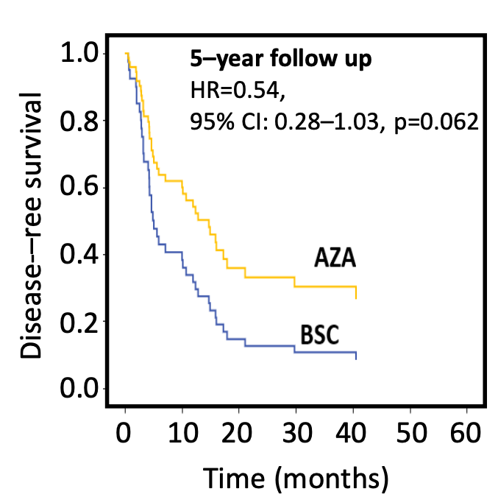
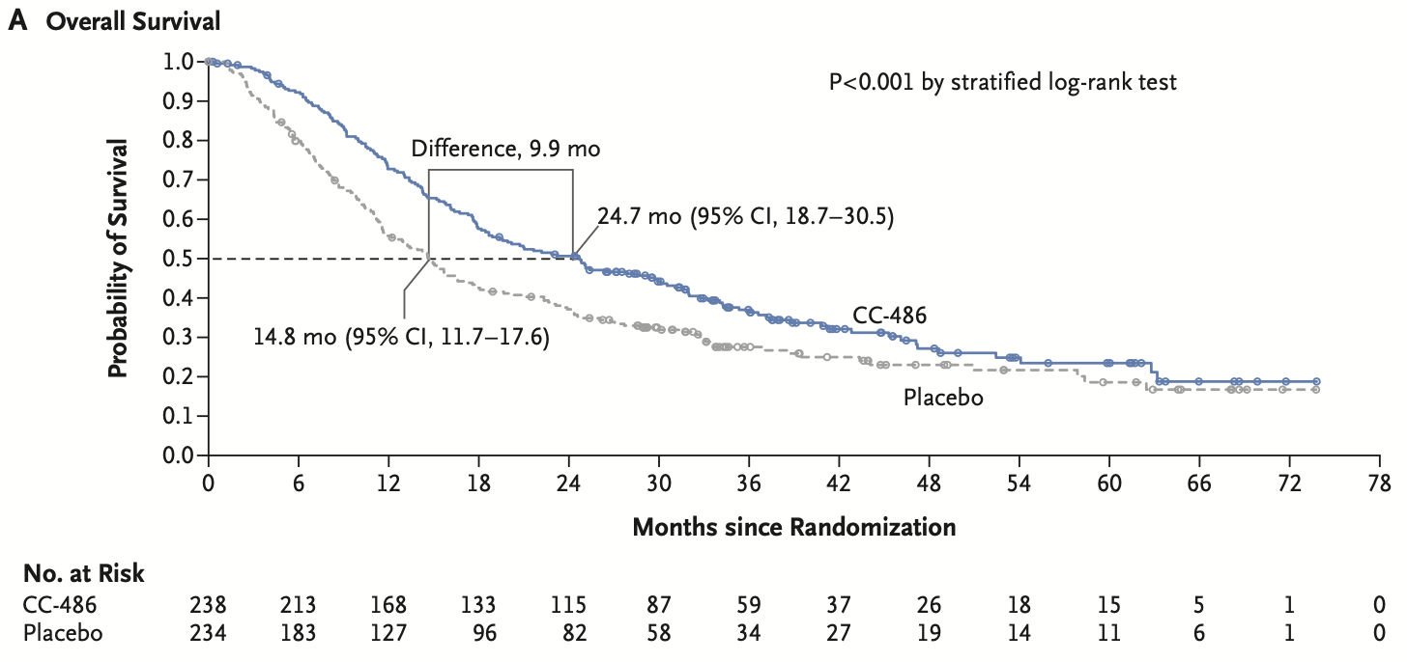
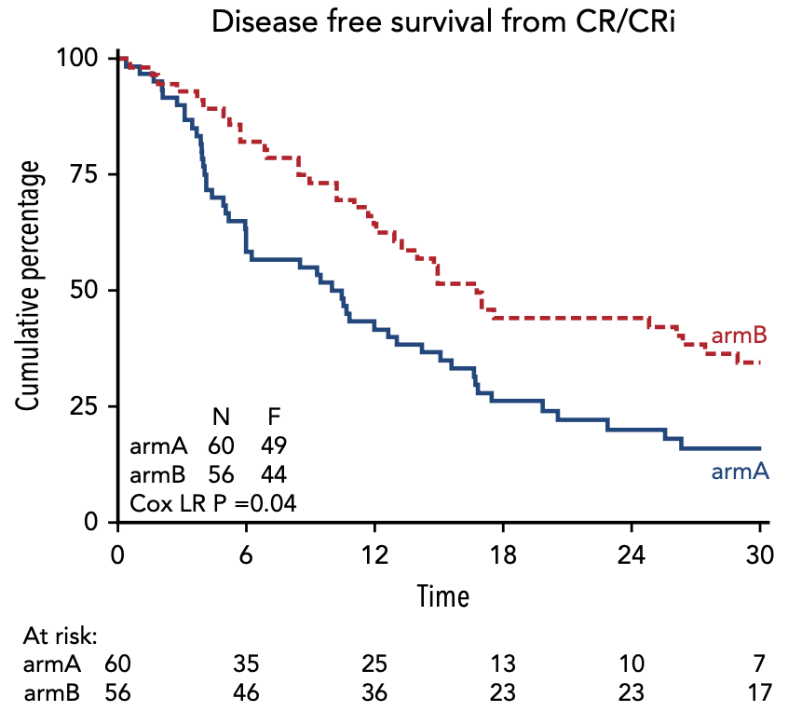
Recommendation
Survival benefit mainly reflects azacitidine maintenance
Oral azacitidine (Wei et al.)¹⁵
SC azacitidine (Hul et al.)¹⁶
SC/IV azacitidine (Oliva et al.)¹⁷
Azacitidine
Oral azacitidine
Placebo
Observation

Slide 16
Summary of Case 1B
Overall, the panel determined that potential benefits of survival outweigh the harms, favoring post-remission therapy.
Important caveats:
Post-remission therapy can consist of cytarabine-based treatment or azacitidine-based treatment
Gemtuzumab ozogamicin alone in the post-remission setting did not result in significant improvement in survival or relapses
Insufficient data for maintenance therapy in patients with core binding factor AML
Limited data on the number of post remission conventional chemotherapy cycles that should be administered beyond one cycle
Optimal duration of post-remission therapy still needs to be further studied

Slide 17
Case 2: Post remission management for older adults with AML
76M with AML
45% bone marrow blasts at diagnosis
  Normal karyotype
  Mutations in NPM1, SRSF2, TET2
Achieved remission (bone marrow blasts <5%) after 1 cycle of Azacitidine-Venetoclax (AZA-VEN)
  Complications: febrile neutropenia
ECOG 1, Comorbidities: T2DM, IHD, HTN, HChol, OSA

Slide 18
Case 2: Post remission management for older adults with AML
76M with AML in remission after 1 cycle of Azacitidine-Venetoclax
AML is favorable risk by European LeukemiaNet (ELN) 2024 risk stratification for less-intensive therapies.
Continued treatment for a total of 6 months with minimal complications.
NPM1 measurable residual disease (MRD) at 4 and 6 months (by RT-qPCR) were undetectable.
Patient is feeling good and now asking “Doc, how long do I need to continue AZA-VEN for?”

Slide 19
Case 2: Post remission management for older adults with AML
76M with AML in MRD negative remission, completed 6 months of AZA-VEN.
AML is favorable risk by European LeukemiaNet (ELN) 2024 risk stratification.
Patient asking re: duration of AZA-VEN therapy.
What would you do next?
Stop now, no further therapy
Continue AZA-VEN until progression or unacceptable toxicity
Continue AZA-VEN until 12 months total then cease
Switch to VEN alone
Switch to AZA alone

Slide 20
Recommendation 6
For older adults with AML who achieve a response after receiving HMA- or LDAC-based induction and post-remission therapy, the ASH guideline panel suggests continuing therapy indefinitely until progression or unacceptable toxicity over stopping therapy after a finite number of cycles (conditional recommendation based on very low certainty in the evidence of effects ⨁◯◯◯).

Slide 21
Recommendation
Systematic review identified only two retrospective observational studies comparing continuous vs finite duration of therapy. ¹⁹⁻²⁰
  One study compared patients receiving ≥12 months of venetoclax-based combinations (with LDAC, azacitidine or decitabine) and reported that a subset of patients can experience durable treatment-free remission after ceasing therapy with trivial to no effect on mortality¹⁹
  One study compared HMA monotherapy (6+3 schedule) and reported that continuing HMA until progression/toxicity is associated with improved overall survival (increase in survival time at longest follow-up (15 months): MD 3.45 months higher (95% CI: 1.36 higher to 5.54 higher)²⁰

Slide 22
Summary of Case 2
Overall, the panel judged that currently there is insufficient evidence to guide routine cessation of therapy after a defined period → conditional recommendation for continuing therapy
  Being retrospective and observational with small patient numbers, the studies provided very low certainty of evidence
  Main harm of continuous treatment are treatment-related toxicities, which should be managed with dose modifications following published guidelines to allow patients to safely remain on therapy
Prospective studies are underway to identify patients receiving HMA- or LDAC- based regimens in whom therapy can be safely stopped^{21,22}

Slide 23
Case 3: AML with IDH1 mutation
77M with AML
44% bone marrow blasts at diagnosis
  Normal karyotype
  Mutation in IDH1
ECOG 1, Comorbidities: T2DM, CKD3, HTN

Slide 24
Case 3: Treatment for older adults with IDH1 mutations
Patient is wondering about next step for treatment
What would you do next?
Ivosidenib alone
Azacitidine + ivosidenib
Azacitidine + venetoclax
Azacitidine alone
B or C

Slide 25
Recommendation 5
A: For older adults with newly diagnosed AML and an IDH1 mutation considered appropriate for antileukemic therapy but not for conventional induction and post-remission therapy, the ASH guideline panel suggests azacitidine in combination with ivosidenib over azacitidine monotherapy (conditional recommendation based on low certainty in the evidence of effects ⨁⨁◯◯).
B: For older adults with newly diagnosed AML and an IDH1 mutation considered appropriate for antileukemic therapy but not for conventional induction and post-remission therapy, the ASH guideline panel suggests using either azacitidine in combination with ivosidenib or HMA in combination with venetoclax (conditional recommendation based on very low certainty in the evidence of effects ⨁◯◯◯).

Slide 26
Recommendation
Systematic review identified only one randomized control trials to answer question of IDH1 therapy²³
  Agile study: 146 patients mean age 75 years, HMA + ivosidenib vs HMA alone
  Results:
    Probably increases CR/CRi (RR, 3.34; 95% CI, 1.91 to 5.85; median 15 months follow-up)
    Reduce mortality at 12 months (RR, 0.64; 95% CI, 0.46 to 0.88; low certainty evidence)
    May increase survival time: median of 24 months compared to 7.9 months (very low certainty evidence)

Slide 27
Recommendation
In answering question of HMA therapy + venetoclax vs. azacitidine + ivosidenib therapy, there were no direct trials comparing these head-to-head. Data was indirectly extrapolated from AGILE study but also from a guideline panel survey.
  Key benefits of HMA in combination with targeted therapy may include a reduction in mortality and an increase in survival. However, the panel was very uncertain about these effects.
  Per survey of full panel, panel judged the benefits of HMA in combination with ivosidenib compared to HMA in combination with venetoclax to be trivial.

Slide 28
Harms
When compared to azacitidine monotherapy, azacitidine in combination with ivosidenib may have trivial to no effect on severe toxicity, particularly differentiation syndrome (low-certainty evidence)
  Given the uncertainty in the evidence, the panel judged these harms as small but important.
The evidence on the undesirable effects of azacitidine in combination with ivosidenib compared to HMA in combination with venetoclax is indirect and of very low certainty.
  Both regimens share common toxicities, and the overall toxicity burden is unlikely to differ meaningfully with supportive care.
  Given the very low certainty of the evidence, the panel judged the harms to be trivial.

Slide 29
Summary of Case 3
Overall, the panel judged that while there was uncertainty in evidence, benefits of azacitidine in combination with ivosidenib including a reduction in mortality at 12 months and the longest follow-up, as well as a probable increase in CR/CRi at the longest follow-up–to be of moderate magnitude.
  The panel placed a higher value on the benefits of azacitidine with ivosidenib and the lack of important variability in patient values and preferences.
After considering all factors of HMA plus ivosidenib versus HMA plus venetoclax versus, the panel judged the benefits to be trivial.
  The panel placed a higher value on the very low certainty in the evidence regarding the relative effects of the options, which was supported by their clinical experience.
  Toxicity profile in relation to the patient’s comorbidities and functional status may help guide the choice between them.

Slide 30
Case 4: AML with IDH2 mutation
79M with AML
54% bone marrow blasts at diagnosis
  Normal karyotype
  Mutation in IDH2, DNMT3A
ECOG 2, Comorbidities: OSA, HLD, HTN, CHF (stable)

Slide 31
Case 4: Treatment for older adults with IDH2 mutations
What therapy do you recommend?
Azacitidine monotherapy
Azacitidine + venetoclax
Azacitidine + enasidenib
Conventional induction (7+3)
Enasidenib alone

Slide 32
Recommendation 5D
For older adults with newly diagnosed AML and an IDH2 mutation considered appropriate for antileukemic therapy but not for conventional induction and post-remission therapy, the ASH guideline panel suggests HMA in combination with venetoclax over HMA in combination with enasidenib (conditional recommendation based on very low certainty in the evidence of effects ⨁◯◯◯).

Slide 33
Recommendation
We identified one RCT comparing enasidenib combined with azacitidine to azacitidine alone.²⁴ This RCT enrolled 101 older adults with a mean age of 75 years (SD 5.3)
Low certainty evidence suggests that azacitidine in combination with enasidenib may increase CR/CRi at the longest follow-up (RR, 2.09; 95% CI, 1.21 to 3.61. with a median of 22 (95% CI, 14.6 to 37.2) compared to 18.6 months (95% CI, 11.9 to 25.7), but trivial to no effect on the rate of mortality over time, though there is uncertainty (HR, 0.99; 95% CI, 0.52 to 1.87; very low certainty evidence.

Slide 34
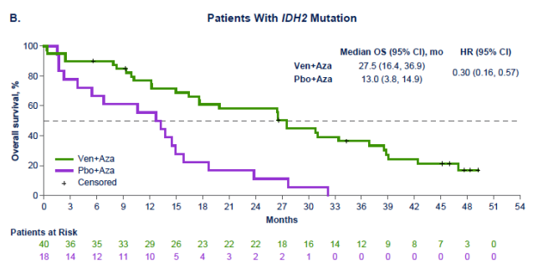
Recommendation
To answer question of enasidenib + azacitidine vs. HMA + venetoclax though, there again was no direct head-to-head comparisons and indirect evidence required along with panel.
Indirect evidence : Panel survey, VIALE-A study, with IDH2 specific data with CRc rate of 86.0% and mOS not reached in longterm data^{25,26}
(Pratz et al Am J Hematol 2024)

Slide 35
Harms
The undesirable effects of azacitidine in combination with enasidenib compared to HMA in combination with venetoclax were assessed using indirect evidence.
  Both regimens share common toxicities such as myelosuppression, fatigue, and infections, and the overall toxicity burden is unlikely to differ meaningfully when appropriate mitigation strategies are in place.
  Given the very low certainty of the evidence, the panel judged the harms to be trivial.

Slide 36
Summary of Case 4
The panel discussed that the benefits of HMA in combination with enasidenib were likely smaller when compared to those of azacitidine in combination with venetoclax. This is supported by evidence that azacitidine in combination with venetoclax provides moderate benefits compared to azacitidine monotherapy.
  This recommendation places a high value on the trivial differences in the net benefits, the very low certainty in the evidence, and the greater clinical experience and acceptability of azacitidine with venetoclax.
HMA-based monotherapy, as opposed to combination therapy with venetoclax, may be equi-efficacious in select subgroups, such as patients whose AML has a TP53 mutation or in areas of the world where venetoclax may not be available.

Slide 37
Case 5: FLT3
72M with AML with new diagnosis of FLT3 ITD mutated AML. Very fit, ECOG 1 without significant comorbidities including cardiac disease, renal disease, or liver disease. He is motivated for aggressive therapy.
What would you do next?
Standard induction chemotherapy (ie 7+3) alone
7+3 plus FLT3 inhibitor (midostaurin or quizartinib)
Azacitidine alone
Gilteritinib alone

Slide 38
Recommendation 7
For older adults with newly diagnosed AML who have a FLT3 mutation, the ASH guideline panel suggests antileukemic therapy in combination with a FLT3 inhibitor over antileukemic therapy alone (conditional recommendation based on low certainty in the evidence of effects ⨁⨁◯◯).
Remark: This recommendation applies primarily to patients receiving conventional induction and post-remission therapy, and may or may not apply to patients receiving HMA or LDAC plus venetoclax, or HMA or LDAC monotherapy. The panel is less confident about the addition of FLT3 inhibitors resulting in net benefit in patients who receive HMA or LDAC plus venetoclax, or HMA or LDAC monotherapy.

Slide 39
Recommendation
Five studies addressed this question, including three RCTs²⁷⁻²⁹ and two NRSs³⁰⁻³¹ and a total of 729 participants.
First RCT (27): quizartinib once daily for 14 days + conventional 7+3 and in ARA-C consolidation, then maintenance for u pto 36 months
  Results: may reduce mortality at 12 months (RR, 0.88; 95% CI, 0.63 to 1.21), increase median of 17.5 months compared to 14.2 months (low certainty evidence).
Second RCT (28) quizartinib + low dose cytarabine
  Very low certainty evidence: may reduce 12-month mortality (RR, 0.41; 95% CI, 0.21 to 0.84; very low certainty evidence), may also increase survival time at the longest follow-up, with a median of 17.5 months compared to 5.1 months (very low certainty evidence).
Third RCT (29) azacitidine combined with gilteritinib vs. azacitidine alone
  Results: no difference in mortality at the longest follow-up (RR, 1.00; 95% CI, 0.82 to 1.47; 30 months follow-up; moderate certainty evidence).
Notes:
Important caveat: Ratify trial (midostaurin + induction) we not included as did not include older adults

Slide 40
Recommendation
Non-randomized study (30): 191 patients midostaurin vs. 7+3 chemotherapy alone
  Very low certainty evidence suggests that the addition of midostaurin may decrease mortality at 12 months (RR, 0.60; 95% CI, 0.46 to 0.78) and may reduce the rate of mortality over time (HR, 0.47; 95% CI, 0.33 to 0.67)
Last study (31): 395 participants with FLT3-ITD, assessing the impact of FLT3-inhibitors in clinical outcomes

Slide 41
Harms
The panel noted that the observed harms of FLT3 inhibitors were based on very low certainty evidence.
The panel further highlighted the variability in toxicity profiles among FLT3 inhibitors, including possible higher rates of gastrointestinal symptoms with midostaurin, cytopenias and QT prolongation with quizartinib, and mild liver function test elevations with gilteritinib.
Given the significant uncertainty in the evidence about key harms and the likely variability in how patients perceive toxicities, the panel judged these harms as small but important.

Slide 42
Recommendation
Panel determined that FLT3 inhibitors in combination with antileukemic therapy may offer a net benefit over antileukemic therapy alone in older adults with newly diagnosed AML who have a FLT3 mutation.
  This recommendation places value on benefits, such as a possible reduction in mortality and increased rates of complete remission, despite the low to very low certainty of evidence.
  The panel also acknowledged small but important harms, including the for increased severe toxicities, such as pneumonia, length of hospitalization, or gastrointestinal side effects.
The panel discussed that the benefit of FLT3 inhibitors applies primarily to patients receiving conventional induction and post-remission therapy.

Slide 43
Recommendation
Optimal FLT3 inhibitor in combination with antileukemic therapy has not been established; thus, differences in toxicity profiles, medication access, and patient preference play a role in the agent selection.
  Type I FLT3 inhibitors (e.g., midostaurin, gilteritinib) have efficacy in AML with both FLT3-ITD and FLT3 TKD mutations, whereas Type II FLT3 inhibitors (e.g., quizartinib, sorafenib) have efficacy only in AML with FLT3-ITD mutations.
Benefit of FLT3 inhibitors added to HMA or LDAC monotherapy, or to venetoclax-based combination therapies, has not been definitively established.
  Clinical trials are ongoing evaluating triplet therapy with FLT3 inhibitors in addition to HMA and venetoclax.

Slide 44
In Summary: Back to our Objectives
Describe recommendations for post-remission therapy for older adults with AML in three settings
  Candidates for allogeneic stem cell transplantation (allo-HCT)
    Rec 8: For older adults with newly diagnosed AML who have responded to initial antileukemic therapy and who have non-favorable prognosis based on molecular and karyotypic characteristics, the ASH guideline panel suggests an allo-HCT over no transplantation.
  Not candidates for allo-HCT post conventional induction therapy
    Rec 3: For older adults with AML who achieve remission after at least a single cycle of conventional induction therapy and who are not candidates for allo-HCT, the ASH guideline panel recommends post-remission therapy over no additional therapy.

Slide 45
In Summary: Back to our Objectives
Describe recommendations for post-remission therapy for older adults with AML in three settings
  Not candidates for allo-HCT and responding to HMA- or LDAC-based therapy
    Rec 6: For older adults with AML who achieve a response after receiving HMA- or LDAC-based induction and post-remission therapy, the ASH guideline panel suggests continuing therapy indefinitely until progression or unacceptable toxicity over stopping therapy after a finite number of cycles

Slide 46
Objectives:
2. Describe recommendations for targeted therapy for older adults with AML
  IDH1
    Rec 5A: For older adults with newly diagnosed AML and an IDH1 mutation considered appropriate for antileukemic therapy but not for conventional induction and post-remission therapy, the ASH guideline panel suggests azacitidine in combination with ivosidenib over azacitidine monotherapy.
    Rec 5B: For older adults with newly diagnosed AML and an IDH1 mutation considered appropriate for antileukemic therapy but not for conventional induction and post-remission therapy, the ASH guideline panel suggests using either HMA in combination with ivosidenib or HMA in combination with venetoclax.

Slide 47
Objectives
2. Describe recommendations for targeted therapy for older adults with AML
  IDH2
    For older adults with newly diagnosed AML and an IDH2 mutation considered appropriate for antileukemic therapy but not for conventional induction and post-remission therapy, the ASH guideline panel suggests HMA in combination with venetoclax over HMA in combination with enasidenib.
  FLT3
    Rec 7: For older adults with newly diagnosed AML who have a FLT3 mutation, the ASH guideline panel suggests antileukemic therapy in combination with a FLT3 inhibitor over antileukemic therapy alone.

Slide 48
Acknowledgements
ASH Guideline Panel team members
Evidence Synthesis team members
McMaster University
See more about the ASH AML guidelines at hematology.org/amlguidelines

Slide 49
References
Sorror ML, Gooley TA, Storer BE, et al. An 8-year pragmatic observation evaluation of the benefits of allogeneic HCT in older and medically infirm patients with AML. Blood. Jan 19 2023;141(3):295-308. doi:10.1182/blood.2022016916
Devillier R, Forcade E, Garnier A, et al. In-depth time-dependent analysis of the benefit of allo-HSCT for elderly patients with CR1 AML: a FILO study. Blood Adv. 2022;6(6):1804-1812. doi:10.1182/BLOODADVANCES.2021004435
Fleischmann M, Schnetzke U, Frietsch JJ, et al. Impact of induction chemotherapy with intermediate-dosed cytarabine and subsequent allogeneic stem cell transplantation on the outcome of high-risk acute myeloid leukemia. J Cancer Res Clin Oncol. 2022;148(6):1481-1492. doi:10.1007/s00432-021-03733-0
Versluis J, Hazenberg CL, Passweg JR, et al. Post-remission treatment with allogeneic stem cell transplantation in patients aged 60 years and older with acute myeloid leukaemia: a time-dependent analysis. The Lancet Haematology. 2015;2(10):e427-36. doi:10.1016/S2352-3026(15)00148-9
Niederwieser D, Hasenclever D, Berdel WE, et al. Hematopoietic cell transplantation for older acute myeloid leukemia patients in first complete remission: results of a randomized phase III study. Haematologica. Jan 1 2025;110(1):68-77. doi:10.3324/haematol.2024.285879
Bouchacourt B, Hospital MA, Zemmour C, et al. Post-remission therapy of adults aged 60 and older with acute myeloid leukemia in first complete remission: role of treatment intensity on the outcome. Annals of hematology. 2020;99(4):773-780. doi:https://dx.doi.org/10.1007/s00277-020-03922-w
Farag SS, Maharry K, Zhang MJ, et al. Comparison of reduced-intensity hematopoietic cell transplantation with chemotherapy in patients age 60-70 years with acute myelogenous leukemia in first remission. Biology of Blood & Marrow Transplantation. 2011;17(12):1796-803. doi:https://dx.doi.org/10.1016/j.bbmt.2011.06.005
Kadia TM, Reville PK, Wang X, et al. Phase II Study of Venetoclax Added to Cladribine Plus Low-Dose Cytarabine Alternating With 5-Azacitidine in Older Patients With Newly Diagnosed Acute Myeloid Leukemia. J Clin Oncol. Nov 20 2022;40(33):3848-3857. doi:10.1200/JCO.21.02823
Kurosawa S, Yamaguchi T, Uchida N, et al. Comparison of allogeneic hematopoietic cell transplantation and chemotherapy in elderly patients with non-M3 acute myelogenous leukemia in first complete remission. Biology of Blood & Marrow Transplantation. 2011;17(3):401-11. doi:https://dx.doi.org/10.1016/j.bbmt.2010.07.013
Schlenk RF, Weber D, Fiedler W, et al. Midostaurin added to chemotherapy and continued single-agent maintenance therapy in acute myeloid leukemia with FLT3-ITD. Blood. 2019;133(8):840-851. doi:https://dx.doi.org/10.1182/blood-2018-08-869453
Shacham-Abulafia A, Itchaki G, Yeshurun M, et al. High-Intensity Induction Chemotherapy Is Feasible for Elderly Patients with Acute Myeloid Leukemia. Acta Haematol. 2016;135(1):55-64. doi:10.1159/000437131
Sun YQ, Zhang XH, Jiang Q, et al. Comparison of haploidentical hematopoietic stem cell transplantation with chemotherapy in older adults with acute myeloid leukemia. Bone Marrow Transplant. 05 2023;58(5):491-497. doi:10.1038/s41409-023-01925-5
Ustun C, Le-Rademacher J, Wang HL, et al. Allogeneic hematopoietic cell transplantation compared to chemotherapy consolidation in older acute myeloid leukemia (AML) patients 60-75 years in first complete remission (CR1): an alliance (A151509), SWOG, ECOG-ACRIN, and CIBMTR study. Leukemia. 2019;33(11):2599-2609. doi:https://dx.doi.org/10.1038/s41375-019-0477-x
Yoon JH, Cho BS, Kim HJ, et al. Outcomes of elderly de novo acute myeloid leukemia treated by a risk-adapted approach based on age, comorbidity, and performance status. American Journal of Hematology. 2013;88(12):1074-81. doi:10.1002/ajh.23576

Slide 50
References
15. Wei AH, Döhner H, Pocock C, et al. Oral Azacitidine Maintenance Therapy for Acute Myeloid Leukemia in First Remission. New England journal of medicine. 2020;383(26):2526‐2537. doi:10.1056/NEJMoa2004444
16. Huls G, Chitu DA, Havelange V, et al. Azacitidine maintenance after intensive chemotherapy improves DFS in older AML patients. Blood. Mar 28 2019;133(13):1457-1464. doi:10.1182/blood-2018-10-879866
17. Oliva EN, Candoni A, Salutari P, et al. Azacitidine Post-Remission Therapy for Elderly Patients with AML: A Randomized Phase-3 Trial (QoLESS AZA-AMLE). Cancers. Apr 24 2023;15(9):24. doi:https://dx.doi.org/10.3390/cancers15092441
18. Lowenberg B, Beck J, Graux C, et al. Gemtuzumab ozogamicin as postremission treatment in AML at 60 years of age or more: results of a multicenter phase 3 study. Blood. Apr 1 2010;115(13):2586-91. doi:10.1182/blood-2009-10-246470
19. Chua CC, Hammond D, Kent A, et al. Treatment-free remission after ceasing venetoclax-based therapy in patients with acute myeloid leukemia. Blood Advances. 07 12 2022;6(13):3879-3883. doi:https://dx.doi.org/10.1182/bloodadvances.2022007083
20. Karakus V, Maral S, Kaya E, Gemici A, Dere Y, Sevindik OG. Survival outcomes of hypomethylating agents maintenance therapy in new diagnosed AML patients: Real experience data. Northern Clinics of Istanbul. 2022;9(4):331-336. doi:https://dx.doi.org/10.14744/nci.2021.42800
21. Chan O. Discontinuation of Hypomethylating Agent and Venetoclax in Patients With Newly Diagnosed Acute Myeloid Leukemia (AML) Who Have Achieved Negative Measurable Residual Disease (MRD). Updated May 23, 2025. Accessed June 10, 2025, https://clinicaltrials.gov/study/NCT06511882
22. Institut Paoli-Calmettes. De-Escalation Study Evaluating Venetoclax and Azacitidine Discontinuation in AML Responding Patients. Updated August 20, 2024. Accessed June 10, 2025, https://clinicaltrials.gov/study/NCT06557421
23. Montesinos P, Recher C, Vives S, et al. Ivosidenib and Azacitidine in IDH1-Mutated Acute Myeloid Leukemia. N Engl J Med. Apr 21 2022;386(16):1519-1531. doi:10.1056/NEJMoa2117344
24. DiNardo CD, Schuh AC, Stein EM, et al. Enasidenib plus azacitidine versus azacitidine alone in patients with newly diagnosed, mutant-IDH2 acute myeloid leukaemia (AG221-AML-005): a single-arm, phase 1b and randomised, phase 2 trial. The lancet Oncology. 2021;22(11):1597‐1608. doi:10.1016/S1470-2045(21)00494-0
25. Pollyea DA, Pratz KW, Wei AH, et al. Outcomes in Patients with Poor-Risk Cytogenetics with or without TP53 Mutations Treated with Venetoclax and Azacitidine. Clin Cancer Res. Dec 15 2022;28(24):5272-5279. doi:10.1158/1078-0432.CCR-22-1183
26. Pratz KW, Jonas BA, Pullarkat V, et al. Long-term follow-up of VIALE-A: Venetoclax and azacitidine in chemotherapy-ineligible untreated acute myeloid leukemia. Am J Hematol. 2024;99(4):615-624. doi:10.1002/ajh.27246
27. Dennis M, Thomas IF, Ariti C, et al. Randomized evaluation of quizartinib and low-dose ara-C vs low-dose ara-C in older acute myeloid leukemia patients. Blood Adv. 2021;5(24):5621-5625. doi:10.1182/bloodadvances.2021005038
28. Wang ES, Montesinos P, Minden MD, et al. Phase 3 Trial of Gilteritinib Plus Azacitidine Vs Azacitidine for Newly Diagnosed FLT3mut+ AML Ineligible for Intensive Chemotherapy. Blood. 2022;140(17):1845‐1857. doi:10.1182/blood.2021014586
29. Erba HP, Montesinos P, Kim HJ, et al. Quizartinib plus chemotherapy in newly diagnosed patients with FLT3-internal-tandem-duplication-positive acute myeloid leukaemia (QuANTUM-First): a randomised, double-blind, placebo-controlled, phase 3 trial. Lancet. 2023;401(10388):1571‐1583. doi:10.1016/S0140-6736(23)00464-6

Slide 51
References
30. Abou Dalle I, Ghorab A, Patel K, et al. Impact of numerical variation, allele burden, mutation length and co-occurring mutations on the efficacy of tyrosine kinase inhibitors in newly diagnosed FLT3- mutant acute myeloid leukemia. Blood Cancer J. May 4 2020;10(5):48. doi:10.1038/s41408-020-0318-1
31. Dohner H, Weber D, Krzykalla J, et al. Midostaurin plus intensive chemotherapy for younger and older patients with AML and FLT3 internal tandem duplications. Blood Adv. Sep 27 2022;6(18):5345-5355. doi:10.1182/bloodadvances.2022007223

