Slide 1
Please read the notes section of each question slide for important information
Polling Template Slides

Slide 2
Multiple Choice Question (Question goes here)
Choice 1
Choice 2
Choice 3
Choice 4
Polling is active on the next slide
Notes:
Multiple Choice Questions are the most often used question type.
There is no limit to the number of choices, but we recommend 4 – 6 choices for a typical Multiple-choice question
Indicate the correct answer in the notes section and we will program the question to show the correct answer
Default results display is a Bar chart
We will use a 15 Second countdown then the results will automatically display on screen.
Results can also be displayed in a Pie Chart
There is also an enhanced Bar chart available but a word of caution, this display changes the order of the responses based on the choice with the most responses (i.e. if choice 3 has the highest number of responses it will move to the top of the list in this display)

Slide 3
Open Ended/Short Answer Question (Question goes here)
Polling is active on the next slide
Notes:
The second most popular question type is the Word Cloud, use this Open Ended/Short Answer type question. Indicate in the notes your desired display, options are:
Word Cloud – Good for SINGLE word answers
Wordle – Similar to Word Cloud also good for SINGLE word answers. Results are displayed slightly different than a word cloud
List – Just displays a list of responses – good for MULTI-WORD answers
Thought Bubble – Good for MULTI-WORD answers, nicer display than the list
We will use a 30 Second countdown then the results will automatically display on screen.

Slide 4
Numerical Average (Question goes here)
Polling is active on the next slide
Notes:
Can be used for Likert scale 1 – 5, 1 – 7 where the answer will be a single number - the average of all responses
It can also be 1 – 100 to get a percentage and again the result is a single number
Simple example question: On a scale of 1 – 5 how would you rate this presentation? The users get a multiple choice options listing 1, 2, 3, 4, and 5 but the result is displayed as a single number.
We will use a 15 second Countdown clock then the results will automatically display on screen

Slide 5
Brainstorming Question (Question goes here)
Polling is active on the next slide
Notes:
This poll is an open-ended type poll where the users submit responses and those participating
can upvote other responses submitted and the results will be displayed based on the number of upvotes each choice receives.
Simple example is asking the group where we should go to dinner, audience start responding with restaurant names if you see one you like, you can upvote it and move it to the top of the list.
We do not use a countdown for this question type, results will display as users input responses and other upvote their favorites. Leave this poll open for as long as you need.

Slide 6
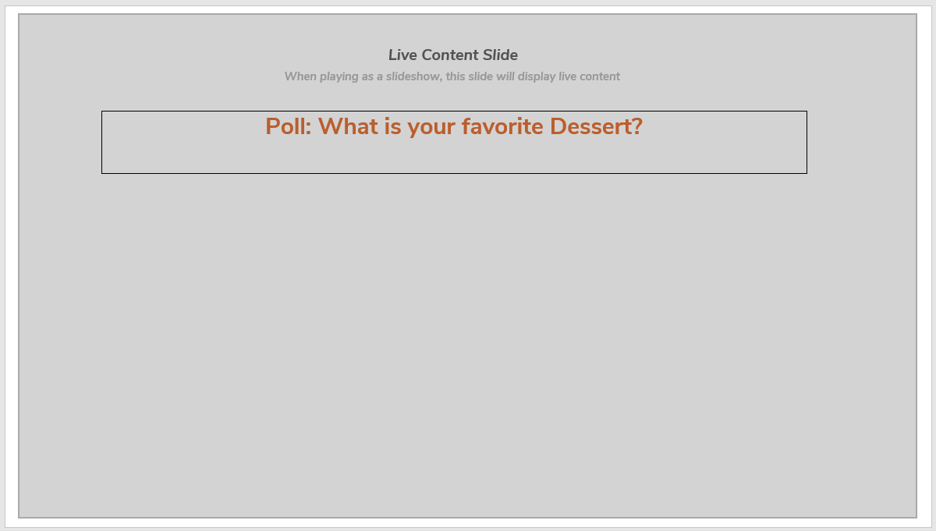
Sample do not use
Notes:
This is a sample of what the Conferences IO Polling slide will look like in your presentation. When it is launched in Presentation Mode it will activate and display the Question and Choices along with the Countdown Clock then the results will display.

Slide 7
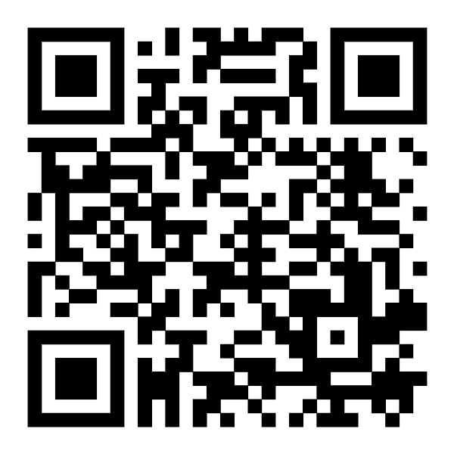
Audience Engagement Instructions
Please scan the QR code to respond to the Audience Polling questions in this Session
Sample do not use

